Slide 1

Ephesians 3:1-12

Slide 2
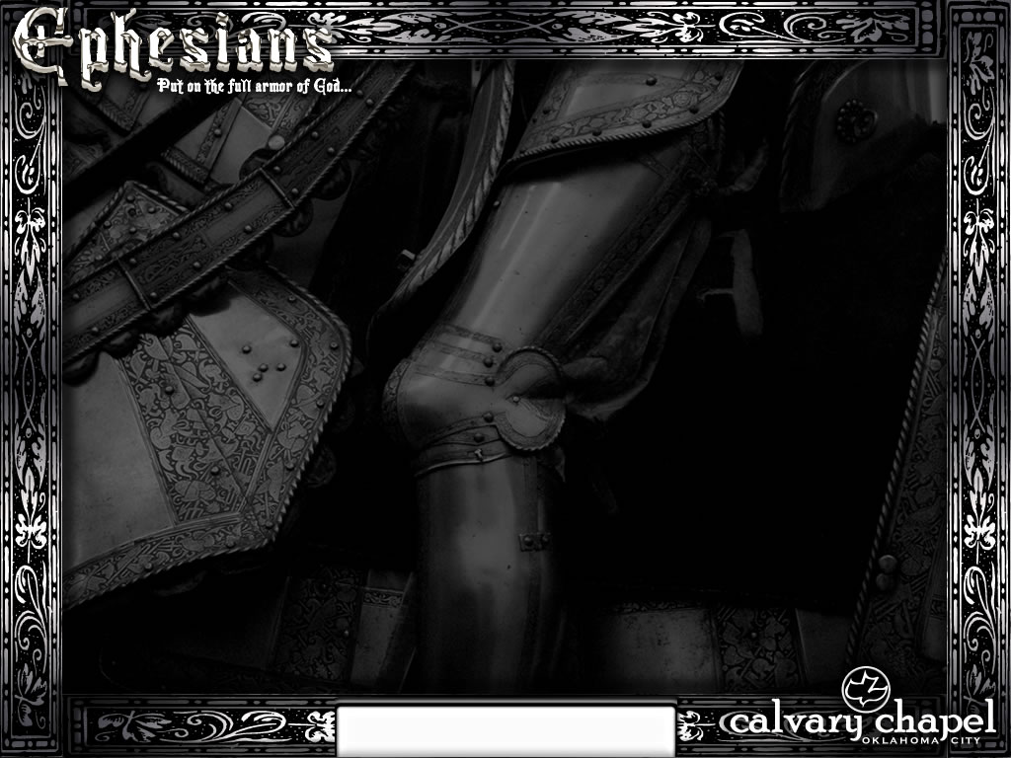
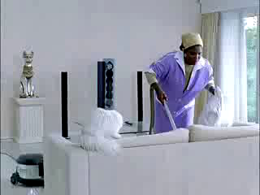
Cleaning Lady Distracted by the Radio
Ephesians 3:1-12

Slide 3
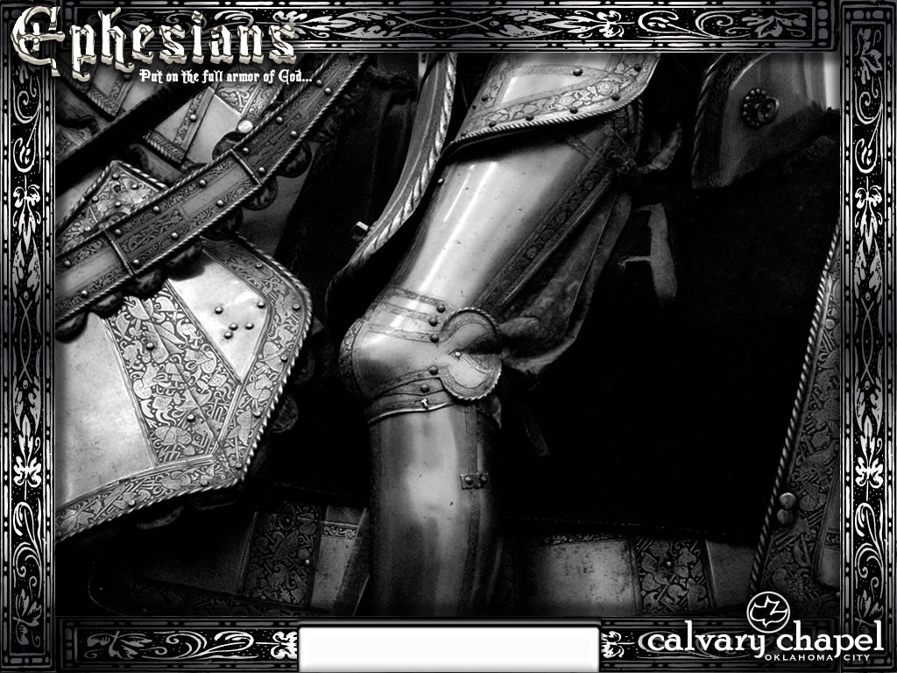
Ephesians 3:1-12

Slide 4
Eph. 2:14-18 ~ ¹⁴ For He Himself is our peace, who has made both one, and has broken down the middle wall of separation, ¹⁵ having abolished in His flesh the enmity, that is, the law of commandments contained in ordinances, so as to create in Himself one new man from the two, thus making peace, ¹⁶ and that He might reconcile them both to God in one body through the cross, thereby putting to death the enmity. ¹⁷ And He came and preached peace to you who were afar off and to those who were near. ¹⁸ For through Him we both have access by one Spirit to the Father.
Ephesians 3:1-12

Slide 5
Ephesians 3:1-12

Slide 6
Dispensation ~ oikonomia
From oikonomos ~ oikos (house) + nomos (law) – steward
NASB, better – stewardship
1 Pet. 4:10 ~ As each one has received a gift, minister it to one another, as good stewards of the manifold grace of God
Ephesians 3:1-12

Slide 7
Ephesians 3:1-12

Slide 8
Mystery ~ musterion – hidden, only available to the initiate
Ephesians 3:1-12

Slide 9
Ephesians 3:1-12

Slide 10
2 Cor. 5:17 ~ Therefore, if anyone is in Christ, he is a new creation; old things have passed away; behold, all things have become new.
Gal. 6:15 ~ For in Christ Jesus neither circumcision nor uncircumcision avails anything, but a new creation.
Ephesians 3:1-12

Slide 11
Ephesians 3:1-12

Slide 12
Fellow heirs ~ sugkleronomos
Same body ~ sussomos
Partakers ~ summetocos – sun (with) + metocos (partakers)
1 Cor. 3:21-22 ~ ²¹ Therefore let no one boast in men. For all things are yours: ²² whether Paul or Apollos or Cephas, or the world or life or death, or things present or things to come—all are yours.
James 4:1 ~ Where do wars and fights come from among you? Do they not come from your desires for pleasure that war in your members?
2 Pet. 1:3 ~ as His divine power has given to us all things that pertain to life and godliness, through the knowledge of Him who called us by glory and virtue,
Ephesians 3:1-12

Slide 13
Ephesians 3:1-12

Slide 14
Less than the least ~ elachistoteros - literally leaster
Ephesians 3:1-12

Slide 15
Warren Wiersbe ~ "Understanding the deep truths of God's Word does not give a man a big head; it gives him a broken and contrite heart."
C. H. Spurgeon ~ "The more grace we have, the less we shall think of ourselves, for grace, like light, reveals our impurity."
Ephesians 3:1-12

Slide 16
Jesus
Paul
Ephesians 3:1-12

Slide 17
Ephesians 3:1-12

