Slide 1

Ephesians 2:1-10

Slide 2
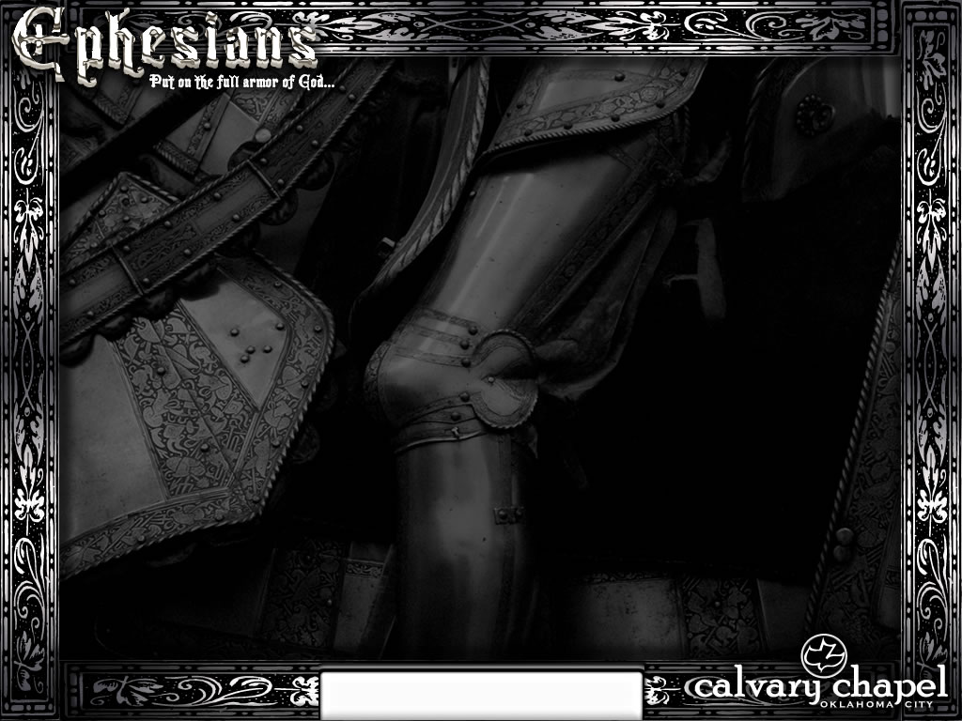
Good News: You baptized seven people today in the river.
Bad News: You lost two of them in the swift current.
Good News: The Women's Guild voted to send you a get-well card.
Bad News: The vote passed by 31-30.
Good News: The Elder Board accepted your job description the way you wrote it.
Bad News: They were so inspired by it, they also formed a search committee to find somebody capable of filling the position.
Ephesians 2:1-10

Slide 3
Good News: You finally found a choir director who approaches things exactly the same way you do.
Bad News: The choir mutinied.
Good News: Mrs. Jones is wild about your sermons.
Bad News: Mrs. Jones is also wild about the "Gong Show," "Fear Factor" and "Texas Chain Saw Massacre."
Ephesians 2:1-10

Slide 4
Good News: Your women's softball team finally won a game.
Bad News: They beat your men's softball team.
Good News: The trustees finally voted to add more church parking.
Bad News: They are going to blacktop the front lawn of your parsonage.
Good News: Church attendance rose dramatically the last three weeks.
Bad News: You were on vacation.
Ephesians 2:1-10

Slide 5
Good News: Your biggest critic just left your church.
Bad News: He has been appointed the Head Bishop of your denomination.
Good News: The youth group loves visit you at your house.
Bad News: It's in the middle of the night and they are armed with toilet paper and shaving cream to "decorate" your house.
Ephesians 2:1-10

Slide 6
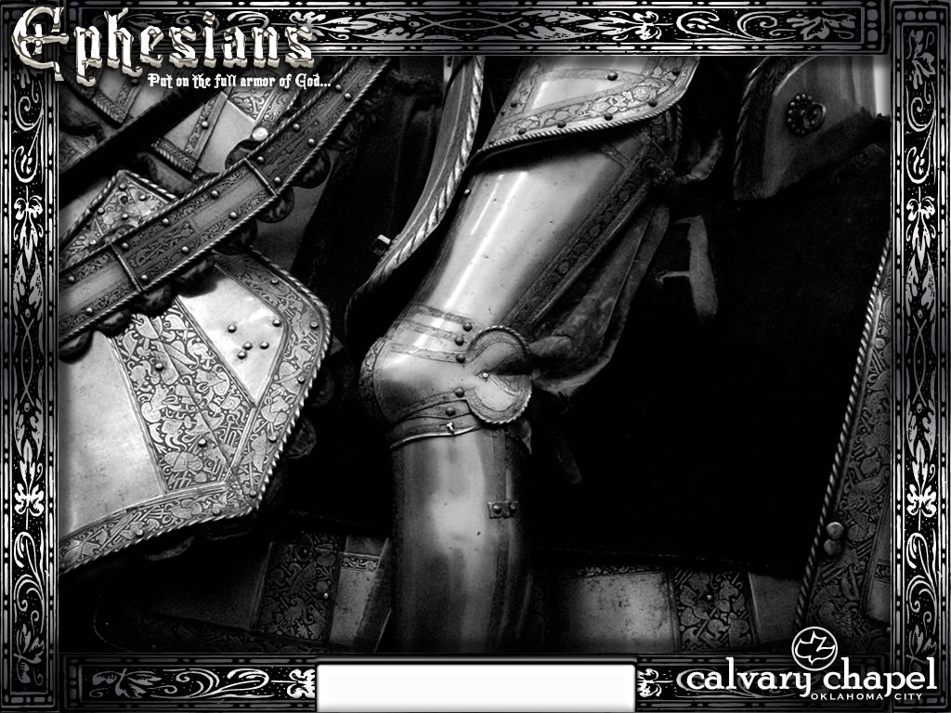
Ephesians 2:1-10

Slide 7
He made alive ~ italicized – NIV, NASB better
Ephesians 2:1-10

Slide 8
Ephesians 2:1-10

Slide 9
Bad news ~ vv. 1-3
Good news ~ vv. 4-10
Ephesians 2:1-10

Slide 10
Ephesians 2:1-10

Slide 11
Trespasses ~ paraptōma – a falling beside
Sins ~ hamartia – a missing of the mark
Walked ~ peripateō – to walk around
Course ~ aiōn – a period of time
World ~ kosmos – the system that sets itself up as independent from God
Ephesians 2:1-10

Slide 12
Ephesians 2:1-10

Slide 13
Bad
Vs.
Vs.
Vs.
Neutral
Good
Bad
Ephesians 2:1-10

Slide 14
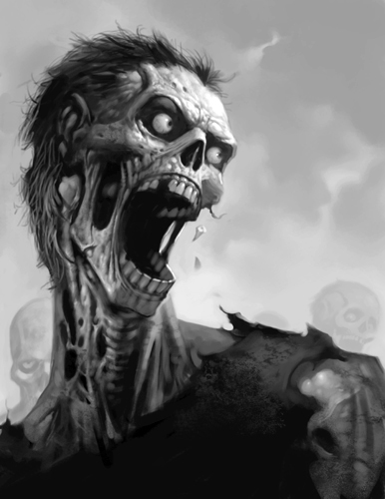
Now works ~ energeō – (energy)
Ephesians 2:1-10

Slide 15
Ephesians 2:1-10

Slide 16
v. 2 ~ Sons – huios – refers to position (offspring)
v. 3 ~ Children – tekna – refers to intimate relationship
Ephesians 2:1-10

Slide 17
Ephesians 2:1-10

Slide 18
Ps. 49:15 ~ But God will redeem my soul from the power of the grave. For He shall receive me. Selah.
Ps. 73:26 ~ My flesh and my heart fail; But God is the strength of my heart and my portion forever.
Acts 7:9 ~ And the patriarchs… sold Joseph into Egypt. But God was with him …
Rom. 5:8 ~ But God demonstrates His own love toward us, in that while we were still sinners, Christ died for us.
1 Cor. 10:13 ~ but God is faithful, who will not allow you to be tempted beyond what you are able,
Ephesians 2:1-10

Slide 19
Ephesians 2:1-10

Slide 20
Show ~ literally display
Ephesians 2:1-10

Slide 21
Ephesians 2:1-10

Slide 22
Salvation
is not of yourselves
What
?
Grace
?
feminine
God
Faith
?
Saved!
That
neuter
Me
Ephesians 2:1-10

Slide 23
Ephesians 2:1-10

Slide 24
Workmanship ~ poiēma – poem
Ephesians 2:1-10

Slide 25
Ephesians 2:1-10

