Slide 1

Ephesians 1:11-23

Slide 2
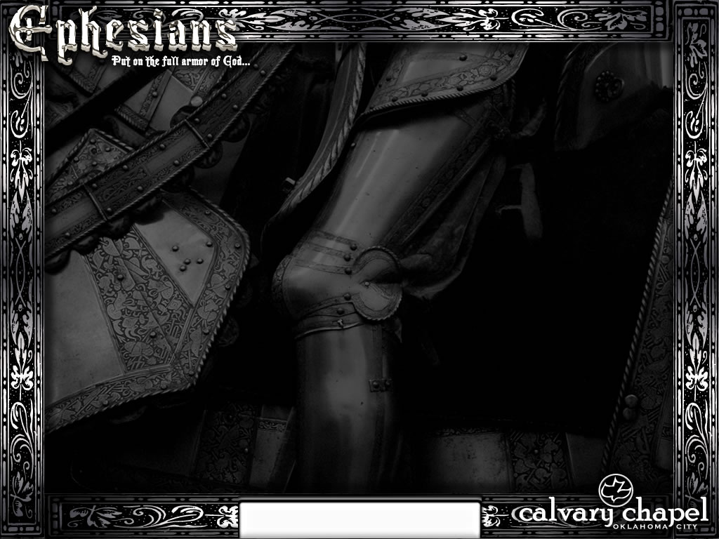
Obtained an inheritance ~ better, were made an inheritance
TLB -- … because of what Christ has done, we have become gifts to God that he delights in …
Spurgeon: "I don't have to reconcile good friends."
Ephesians 1:11-23

Slide 3
Do I have the freedom to be a Calvinist …
or am I predestined to be an Arminian?
Ephesians 1:11-23

Slide 4
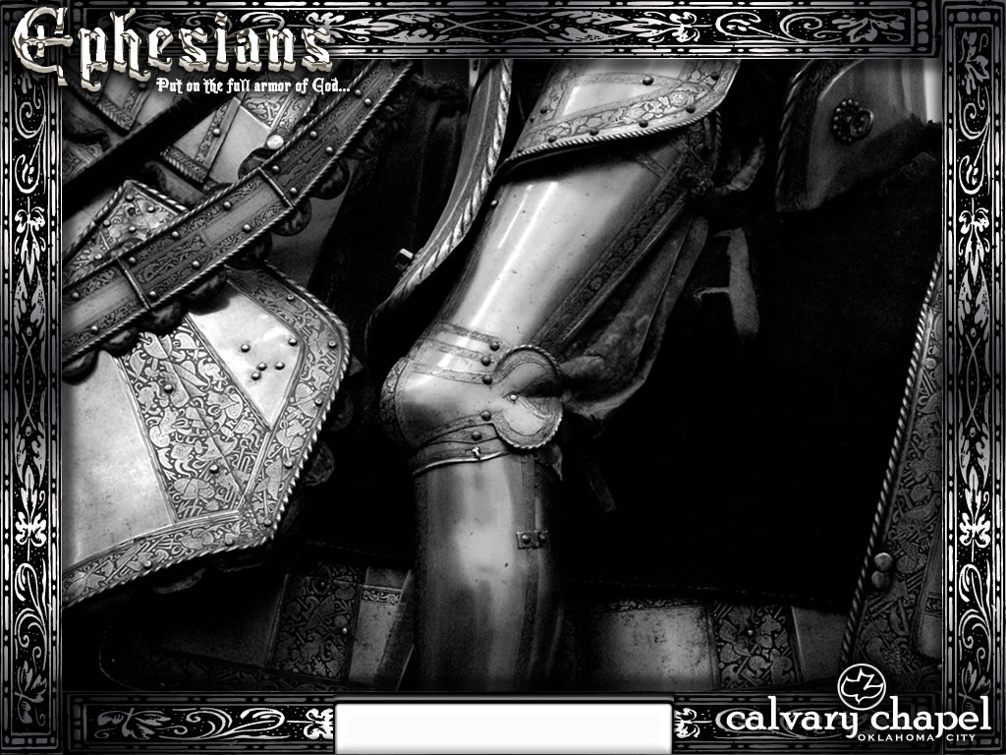
Ephesians 1:11-23

Slide 5
The Plan:
The Father provides (vv. 3-6)
The Son procures (vv. 7-12)
The Spirit preserves (vv. 13-14)
Ephesians 1:11-23

Slide 6
Ephesians 1:11-23

Slide 7
Knowledge ~ epignōsis – experiential knowledge
2 Tim. 3:7 ~ always learning and never able to come to the knowledge of the truth
Ephesians 1:11-23

Slide 8
Ephesians 1:11-23

Slide 9
Howard Hendricks ~ "I don't understand all I know."
NIV, NASB ~ eyes of your heart (NU text)
Ephesians 1:11-23

Slide 10
Ephesians 1:11-23

Slide 11
Know ~ eidō – to perceive
Ephesians 1:11-23

Slide 12
Ephesians 1:11-23

Slide 13
Westminster Catechism ~ “The chief end of man is to glorify God and to enjoy Him forever.”
Rev. 4:11 ~ "You are worthy, O Lord, To receive glory and honor and power; For You created all things, And by Your will they exist and were created."
Rev. 21:3-4 ~ ³ And I heard a loud voice from heaven saying, "Behold, the tabernacle of God is with men, and He will dwell with them, and they shall be His people. God Himself will be with them and be their God. ⁴ And God will wipe away every tear from their eyes; there shall be no more death, nor sorrow, nor crying. There shall be no more pain, for the former things have passed away."
1 Cor. 10:31b ~ … whatever you do, do all to the glory of God.
Ephesians 1:11-23

Slide 14
Ephesians 1:11-23

Slide 15
Rom. 5:8 ~ But God demonstrates His own love toward us, in that while we were still sinners, Christ died for us.
Ephesians 1:11-23

Slide 16
Ephesians 1:11-23

Slide 17
Our knowledge of Him leads to 3 things:
1) Hope of His calling (past)
2) Riches of His glory (future)
3) Greatness of His power (present)
Ephesians 1:11-23

Slide 18
Ephesians 1:11-23

Slide 19

JESUS
JESUS
You
Ephesians 1:11-23

Slide 20
Ephesians 1:11-23

