Slide 1
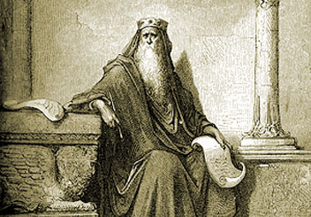





To everything thing there is a season
A time for every purpose under heaven
ECCLESIASTES
05-07
A free CD of this message will be available following the service
IT WILL ALSO be available LATER THIS WEEK
VIA cALVARYOKC.CO

Slide 2
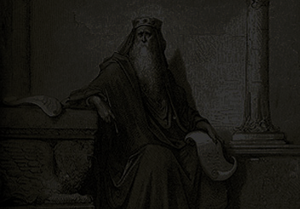
Prov. 28:9 ~ One who turns away his ear from hearing the law,
Even his prayer is an abomination.
Ecclesiastes 05-07

Slide 3
Ecclesiastes 05-07

Slide 4
David Guzik ~ “The priests of Baal prayed hard and long on Mount Carmel; Elijah prayed short and sweet, and full of faith to the living God. God heard and beautifully answered Elijah’s prayer.”
Ecclesiastes 05-07

Slide 5
Ecclesiastes 05-07

Slide 6
Messenger - malak - usually translated angel
Ecclesiastes 05-07

Slide 7
Ecclesiastes 05-07

Slide 8
John Bunyan ~ “In prayer, it is better to have a heart without words, than words without a heart.”
Ecclesiastes 05-07

Slide 9
Ecclesiastes 05-07

Slide 10
For it comes ~ KJV, for he cometh
Ecclesiastes 05-07

Slide 11
Ecclesiastes 05-07

Slide 12
Soul ~ nephesh – KJV, NIV, NASB, appetite
Ecclesiastes 05-07

Slide 13
Ecclesiastes 05-07

Slide 14
C. S. Lewis ~ “To argue with God is to argue with the power that makes it possible to argue at all.”
Ecclesiastes 05-07

Slide 15
Ecclesiastes 05-07

Slide 16
Prov. 30:8b-9 ~ ^{8b} Give me neither poverty nor riches—
Feed me with the food allotted to me;
⁹ Lest I be full and deny You,
And say, “Who is the Lord?”
Or lest I be poor and steal,
And profane the name of my God.
Ecclesiastes 05-07

Slide 17
Ecclesiastes 05-07

Slide 18
Name ~ shēm; ointment ~ shēmen
Ecclesiastes 05-07

Slide 19
Ecclesiastes 05-07

Slide 20
NLT ~ Better to spend your time at funerals than at parties.
After all, everyone dies —
Psalm 39:4 (a Psalm of David) ~ LORD, make me to know my end,
And what is the measure of my days,
That I may know how frail I am.
Ecclesiastes 05-07

Slide 21
Ecclesiastes 05-07

Slide 22
Vanity ~ hebel – vapor; better, fleeting
Ecclesiastes 05-07

Slide 23
Ecclesiastes 05-07

Slide 24
Destroy ~ better, devastate, or astonish
Ecclesiastes 05-07

Slide 25
Ecclesiastes 05-07

Slide 26
C. H. Spurgeon (Lectures To My Students) ~ “You cannot stop people's tongues and therefore the best thing to do is to stop your own ears and never mind what is spoken. There is a world of idle chitchat abroad, and he who takes note of it will have enough of it.”
Ecclesiastes 05-07

Slide 27
Ecclesiastes 05-07

