Slide 1
To everything thing there is a season
A time for every purpose under heaven
ECCLESIASTES
01-02
A free CD of this message will be available following the service
IT WILL ALSO be available LATER THIS WEEK
VIA cALVARYOKC.CO

Slide 2
Authorship:
Verse 1 ~ son of David
Verse 12 ~ king of Israel
List of all the sons of David who were kings of Israel:
1. Solomon
Ecclesiastes 01-02

Slide 3
Reign of Solomon (c. 970-930 BC)
970
960
950
940
930
Song of Songs
Proverbs
Ecclesiastes
Ecclesiastes 01-02

Slide 4
Modern relevancy?
Injustice ~ chapter 4
Crooked politics ~ chapter 5
Materialism ~ chapter 5
Nostalgia of the “good ol’ days” ~ chapter 7
Guilty go free to commit more crime ~ chapter 8
Incompetent leaders ~ chapter 10
Ecclesiastes 01-02

Slide 5
I. What is the Purpose of Life?
A. Life is monotonous
B. What good is wealth?
C. What good is wisdom?
D. We all end up in the same place
Ecclesiastes 01-02

Slide 6
Ecclesiastes 01-02

Slide 7
Preacher ~ koheleth – one who calls an assembly, presents an issue and brings it to a conclusion (ekklēsia)
LXX ~ ekklēsiastēs
Ecclesiastes 01-02

Slide 8
Ecclesiastes 01-02

Slide 9
Vanity ~ hebel – literally, vapor or breath
38x in book (5x in this verse)
Refers to that which is without substance
Ecclesiastes 01-02

Slide 10
Ecclesiastes 01-02

Slide 11
Profit ~ yithrōn – that which is left over
10x
Opposite of hebel
Under the sun ~ i.e. horizontally (29x)
Eccl. 12:13 ~ Let us hear the conclusion of the whole matter: Fear God and keep His commandments, For this is man's all.
Life
Ecclesiastes 01-02

Slide 12
Ecclesiastes 01-02

Slide 13
The four ancient “elements”:
Earth
Wind
Fire
Water
Ecclesiastes 01-02

Slide 14
Ecclesiastes 01-02

Slide 15
1 Kings 4:22-23 ~ ²² Now Solomon’s provision for one day was thirty kors of fine flour, sixty kors of meal, ²³ ten fatted oxen, twenty oxen from the pastures, and one hundred sheep, besides deer, gazelles, roebucks, and fatted fowl.
Kor = 59 gallons
Ecclesiastes 01-02

Slide 16
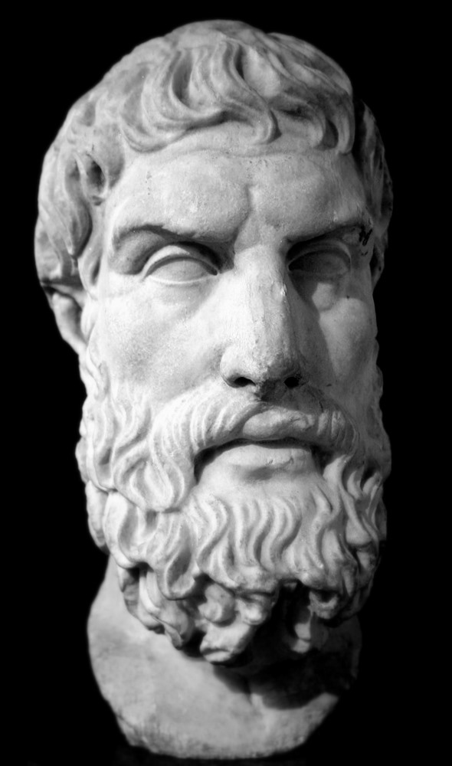
Epicurus ~ 341-270 BC
Solomon lived almost 600 years earlier
Ecclesiastes 01-02

Slide 17
Ecclesiastes 01-02

Slide 18
Musical instruments – better, harem (as in NIV)
Drugs (v. 3)
Sex (v. 8)
Rock ‘n’ roll (v. 8)
Ecclesiastes 01-02

Slide 19
Ecclesiastes 01-02

Slide 20
Prov. 8:35 ~ For whoever finds me (wisdom) finds life,
And obtains favor from the Lord;
Ecclesiastes 01-02

Slide 21
Ecclesiastes 01-02

Slide 22
Than is in italics
“There is nothing in man that he should eat and drink and find enjoyment in his toil.”
Ecclesiastes 01-02

Slide 23
Ecclesiastes 01-02

Slide 24
More than I ~ from the Masoretic text
NASB, For who can eat and who can have enjoyment without Him?
Ecclesiastes 01-02

Slide 25
Ecclesiastes 01-02

Slide 26
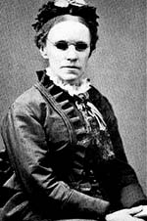
Fanny Crosby
“It seemed intended by the blessed providence of God that I should be blind all my life, and I thank him for the dispensation. If perfect earthly sight were offered me tomorrow I would not accept it. I might not have sung hymns to the praise of God if I had been distracted by the beautiful and interesting things about me.”
Ecclesiastes 01-02

Slide 27
Fanny Crosby
“If I had a choice, I would still choose to remain blind...for when I die, the first face I will ever see will be the face of my blessed Savior.”
Ecclesiastes 01-02

Slide 28
Fanny Crosby
(at age 8)
“Oh, what a happy child I am
Although I cannot see.
I am resolved that in this world
Contented I will be.
How many blessings I enjoy
That other people don't.
To weep and sigh
Because I'm blind,
I cannot and I won't.”
Ecclesiastes 01-02

Slide 29
Ecclesiastes 01-02

