Slide 1







A podcast of this message will be available later this week at www.calvaryokc.com
DEUTERONOMY
The “2nd” Law
29:01-30:20
A free CD recording will be available following the service

Slide 2

DEUTERONOMY
29:01-30:20
The “2nd” Law
1-4) 1st sermon
5-26) 2nd sermon
27-28) 3rd sermon
29-30) 4th sermon
31-33) Moses’ farewell
34) Moses’ death and burial

Slide 3
DEUTERONOMY
29:01-30:20
The “2nd” Law

Slide 4
DEUTERONOMY
29:01-30:20
The “2nd” Law
Covenant ~ 7x in chapter 29

Slide 5
DEUTERONOMY
29:01-30:20
The “2nd” Law

Slide 6
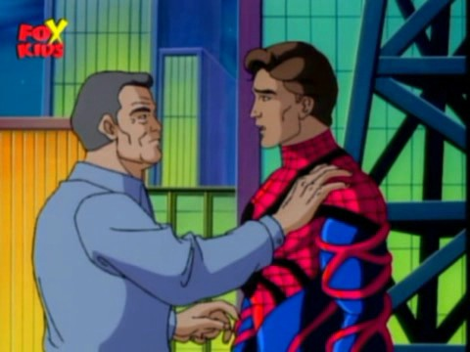
DEUTERONOMY
29:01-30:20
The “2nd” Law
come great wonders, Peter
With great trials…

Slide 7
DEUTERONOMY
29:01-30:20
The “2nd” Law

Slide 8
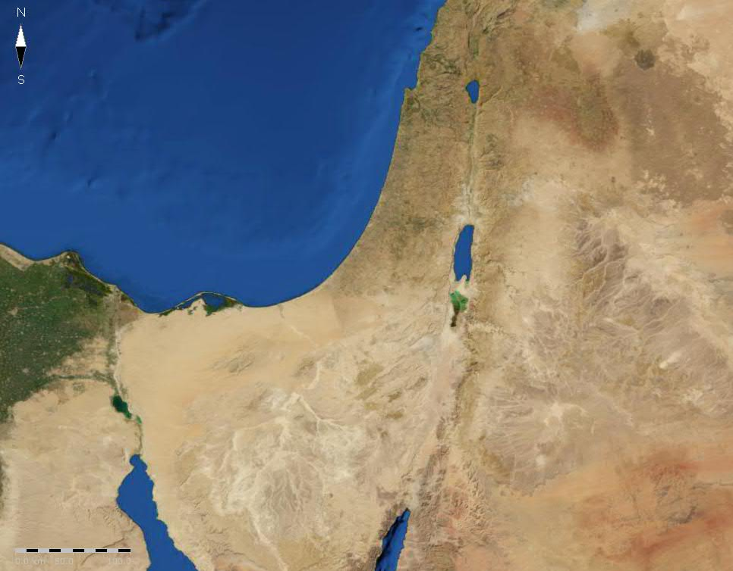
DEUTERONOMY
29:01-30:20
The “2nd” Law
Manasseh
Bashan
Gad
Heshbon
Reuben

Slide 9
DEUTERONOMY
29:01-30:20
The “2nd” Law

Slide 10
DEUTERONOMY
29:01-30:20
The “2nd” Law
Burn ~ KJV, smoke (literal)
Message ~ God won’t let him off the hook. God’s anger and jealousy will erupt like a volcano against that person.

Slide 11
DEUTERONOMY
29:01-30:20
The “2nd” Law

Slide 12



DEUTERONOMY
29:01-30:20
The “2nd” Law
John 16:12 ~ I still have many things to say to you, but you cannot bear them now.
www.jet.com

Slide 13
DEUTERONOMY
29:01-30:20
The “2nd” Law

Slide 14
DEUTERONOMY
29:01-30:20
The “2nd” Law
Matt. 24:31 ~ And He will send His angels with a great sound of a trumpet, and they will gather together His elect from the four winds, from one end of heaven to the other.

Slide 15
DEUTERONOMY
29:01-30:20
The “2nd” Law

Slide 16
DEUTERONOMY
29:01-30:20
The “2nd” Law
Mysterious ~ better, as NASB, NIV – difficult

Slide 17
DEUTERONOMY
29:01-30:20
The “2nd” Law

Slide 18
DEUTERONOMY
29:01-30:20
The “2nd” Law
Rom. 10:6-8 ~ ⁶ But the righteousness of faith speaks in this way, “Do not say in your heart, ‘Who will ascend into heaven?’” (that is, to bring Christ down from above) ⁷ or, “‘Who will descend into the abyss?’ ” (that is, to bring Christ up from the dead). ⁸ But what does it say? “The word is near you, in your mouth and in your heart” (that is, the word of faith which we preach) …

Slide 19
DEUTERONOMY
29:01-30:20
The “2nd” Law

