Slide 1
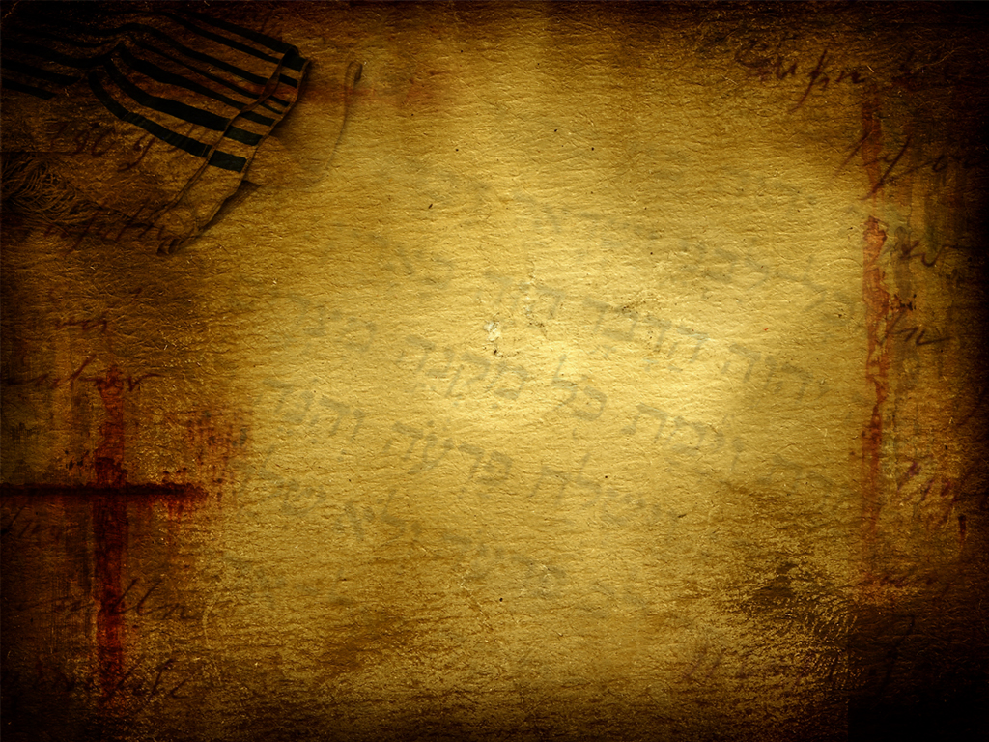






A podcast of this message will be available later this week at www.calvaryokc.com
DEUTERONOMY
The “2nd” Law
27:01-28:68
A free CD recording will be available following the service

Slide 2
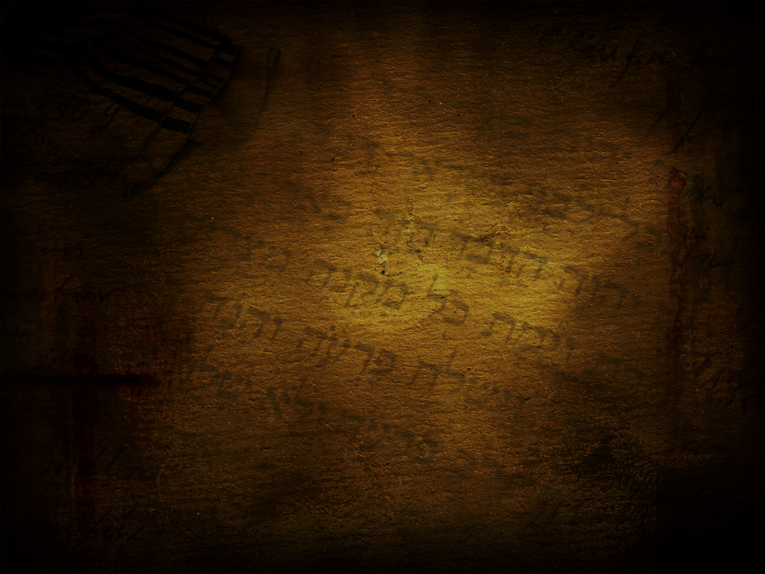
DEUTERONOMY
27:01-28:68
The “2nd” Law
1-4) 1st sermon
5-26) 2nd sermon
27-28) 3rd sermon
29-30) 4th sermon
31-33) Moses’ farewell
34) Moses’ death and burial

Slide 3
DEUTERONOMY
27:01-28:68
The “2nd” Law

Slide 4
DEUTERONOMY
27:01-28:68
The “2nd” Law
Jacob
Leah
Bilhah
Rachel
Zilpah
1.
Reuben
Dan
11.
Joseph
7.
5.
Gad
2.
Simeon
6.
Naphtali
12.
Benjamin
8.
Asher
3.
Levi
13.
Ephraim
4. Judah
14.
4.
Manasseh
9.
Issachar
10.
Zebulun

Slide 5
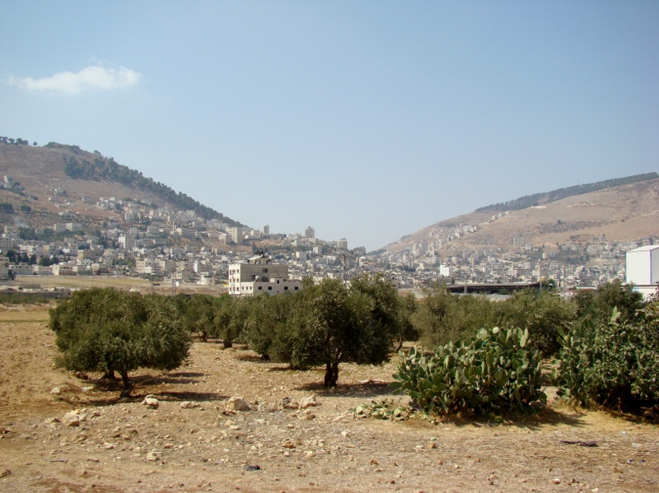

DEUTERONOMY
27:01-28:68
The “2nd” Law
Gerizim
Ebal

Slide 6
DEUTERONOMY
27:01-28:68
The “2nd” Law

Slide 7
DEUTERONOMY
27:01-28:68
The “2nd” Law
Gal. 3:10 ~ Cursed is everyone who does not continue in all things which are written in the book of the law, to do them.

Slide 8
DEUTERONOMY
27:01-28:68
The “2nd” Law

Slide 9
DEUTERONOMY
27:01-28:68
The “2nd” Law
Cling ~ KJV, cleave – dabaq – glue
Gen. 2:24 ~ Therefore a man shall leave his father and mother and be joined to his wife, and they shall become one flesh.

Slide 10
DEUTERONOMY
27:01-28:68
The “2nd” Law

Slide 11
DEUTERONOMY
27:01-28:68
The “2nd” Law
Ex. 15:26 ~ … If you diligently heed the voice of the Lord your God and do what is right in His sight, give ear to His commandments and keep all His statutes, I will put none of the diseases on you which I have brought on the Egyptians. For I am the Lord who heals you.

Slide 12
DEUTERONOMY
27:01-28:68
The “2nd” Law

Slide 13
DEUTERONOMY
27:01-28:68
The “2nd” Law
THE LORD YOUR GOD ~ Yahweh Elohim

Slide 14
DEUTERONOMY
27:01-28:68
The “2nd” Law

