Slide 1
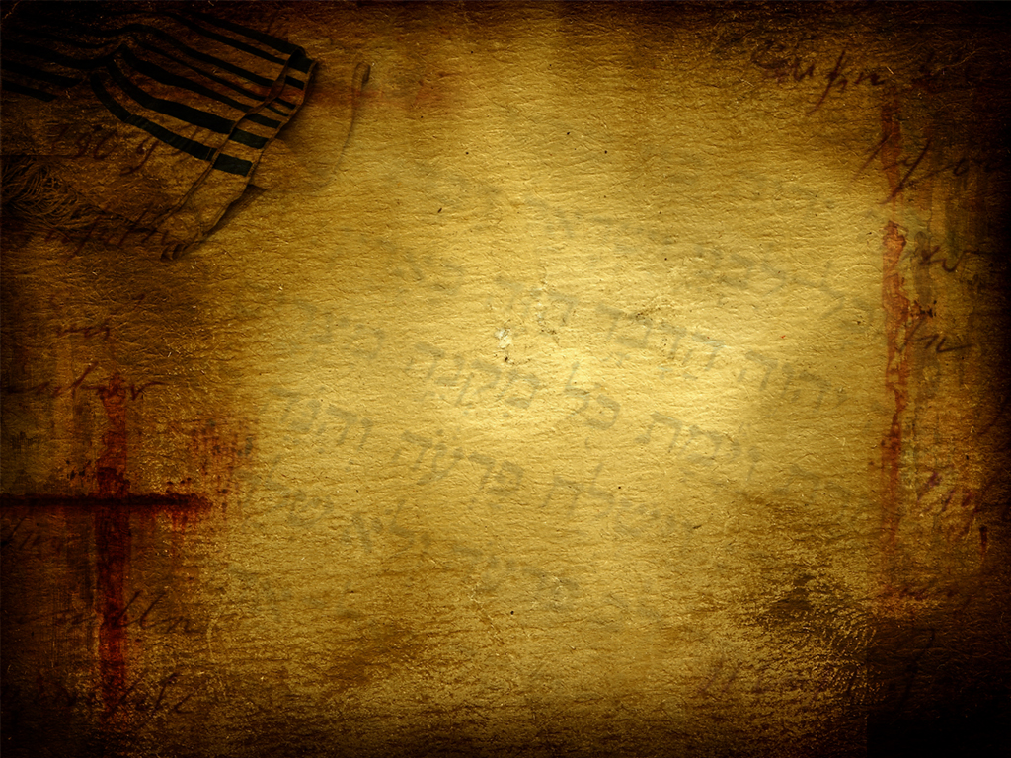






A podcast of this message will be available later this week at www.calvaryokc.com
DEUTERONOMY
The “2nd” Law
21:01-23:25
A free CD recording will be available following the service

Slide 2
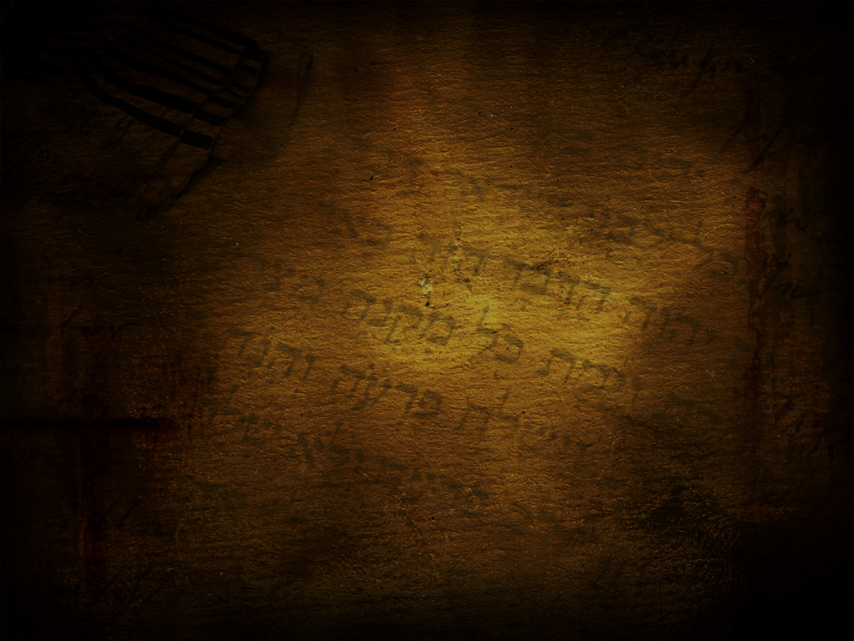
DEUTERONOMY
21:01-23:25
The “2nd” Law
Break ~ KJV, strike off the neck

Slide 3
DEUTERONOMY
21:01-23:25
The “2nd” Law

Slide 4
DEUTERONOMY
21:01-23:25
The “2nd” Law
Trim ~ KJV, pare – literally, “do”

Slide 5
DEUTERONOMY
21:01-23:25
The “2nd” Law

Slide 6
DEUTERONOMY
21:01-23:25
The “2nd” Law
Literally, “has had two wives” (v. 15)

Slide 7
DEUTERONOMY
21:01-23:25
The “2nd” Law

Slide 8
DEUTERONOMY
21:01-23:25
The “2nd” Law
Mother ~ KJV, dam

Slide 9
DEUTERONOMY
21:01-23:25
The “2nd” Law

Slide 10
DEUTERONOMY
21:01-23:25
The “2nd” Law
Parapet ~ KJV, battlement

Slide 11
DEUTERONOMY
21:01-23:25
The “2nd” Law

Slide 12
DEUTERONOMY
21:01-23:25
The “2nd” Law
Num. 15:37 ~ Speak to the sons of Israel, and tell them that they shall make for themselves tassels on the corners of their garments throughout their generations, and that they shall put on the tassel of each corner a cord of blue.

Slide 13
DEUTERONOMY
21:01-23:25
The “2nd” Law

Slide 14
DEUTERONOMY
21:01-23:25
The “2nd” Law
Illegitimate birth ~ NIV, born of a forbidden marriage
mamzer ~ obscure word only used 2x
Zech. 9:6 ~ A mixed race shall settle in Ashdod

Slide 15
DEUTERONOMY
21:01-23:25
The “2nd” Law
Ruth 4:18-22 ~ ¹⁸ Now this is the genealogy of Perez: Perez begot Hezron; ¹⁹ Hezron begot Ram, and Ram begot Amminadab; ²⁰ Amminadab begot Nahshon, and Nahshon begot Salmon; ²¹ Salmon begot Boaz, and Boaz begot Obed; ²² Obed begot Jesse, and Jesse begot David.
◆
❖
⬥







Perez ~ Illegitimate son of Judah and Tamar
David was the 10th generation from Perez

Slide 16
DEUTERONOMY
21:01-23:25
The “2nd” Law

Slide 17
DEUTERONOMY
21:01-23:25
The “2nd” Law
KJV, And thou shalt have a paddle upon thy weapon

Slide 18
DEUTERONOMY
21:01-23:25
The “2nd” Law

Slide 19
DEUTERONOMY
21:01-23:25
The “2nd” Law
Ritual harlot ~ qedeshah; perverted one ~ qedesh
qadash ~ sanctify, holy

Slide 20
DEUTERONOMY
21:01-23:25
The “2nd” Law

Slide 21
DEUTERONOMY
21:01-23:25
The “2nd” Law
Harlot ~ zanah – generic word for prostitute
Dog ~ keleb – NIV, male prostitute

Slide 22
DEUTERONOMY
21:01-23:25
The “2nd” Law

