Slide 1

the Book of
Daniel
10 . 1 - 11 . 20
A free CD of the study will be available upon request following the service.
A podcast will be available later in the week at calvaryokc.com.
A videowill be available at facebook.com/CalvaryOKC and our YouTube channel (Calvary Chapel OKC)

Slide 2

Daniel
10 . 1 - 11 . 20
Prophecy is pre-written history

Slide 3
Daniel
10 . 1 - 11 . 20

Slide 4
Daniel
10 . 1 - 11 . 20
long ~ gadol – great
NASB ~ great conflict
NIV, ESV ~ great war
NLT ~ great hardship

Slide 5
Daniel
10 . 1 - 11 . 20

Slide 6

Daniel
10 . 1 - 11 . 20

Slide 7
Daniel
10 . 1 - 11 . 20

Slide 8

Daniel
10 . 1 - 11 . 20
Non-corporeal ≠ omnipresent

Slide 9
Daniel
10 . 1 - 11 . 20

Slide 10




Daniel
10 . 1 - 11 . 20
530 BC
520 BC
500 BC
480 BC
Cambyses II (530-522 BC)
Gaumata (522 BC)
Darius I the Great (521-486 BC)
Xerxes
(486-465 BC)

Slide 11
Daniel
10 . 1 - 11 . 20

Slide 12
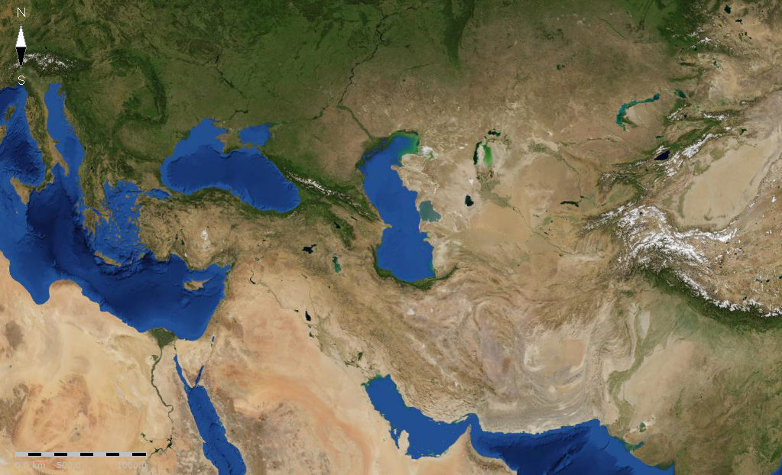
Daniel
10 . 1 - 11 . 20
Not two kings, but two dynasties (almost 200 years)
Cassander
Lysimachus
Seleucus
Ptolemy

Slide 13
Daniel
10 . 1 - 11 . 20
All history is HIS-story
Prophecy is pre-written history

Slide 14
Daniel
10 . 1 - 11 . 20

Slide 15
Daniel
10 . 1 - 11 . 20
Syria (North)
Seleucus Nicator (312 – 281 BC)
Egypt (South)
Ptolemy Soter (323 – 285 BC)

Slide 16
Daniel
10 . 1 - 11 . 20

Slide 17
Daniel
10 . 1 - 11 . 20
Syria (North)
X
X
Antiochus Theos (262 – 246 BC)
Laodice
X
X
Egypt (South)
X
X
Ptolemy Philadelphus
(285 – 246 BC)
Berenice

Slide 18
Daniel
10 . 1 - 11 . 20

Slide 19
Daniel
10 . 1 - 11 . 20
Syria (North)
Seleucus Callinicus (246 – 227 BC)
Seleucus Soter (227 – 223 BC)
Antiochus the Great (223 – 187 BC)
Egypt (South)
Ptolemy Euergetes (246 – 221 BC)
Ptolemy Philopator (221 – 204 BC)

Slide 20
Daniel
10 . 1 - 11 . 20

Slide 21
Daniel
10 . 1 - 11 . 20
equipment ~ KJV, riches – literally stuff

Slide 22
Daniel
10 . 1 - 11 . 20

Slide 23
Daniel
10 . 1 - 11 . 20
violent men ~ raiders, highwaymen

Slide 24
Daniel
10 . 1 - 11 . 20

Slide 25
Daniel
10 . 1 - 11 . 20
Syria (North)
Antiochus the Great (223 – 187 BC)
Cleopatra I
Egypt (South)
Ptolemy Epiphanes (204 – 181 BC)
(193 – 176 BC)`

Slide 26
Daniel
10 . 1 - 11 . 20

Slide 27
Daniel
10 . 1 - 11 . 20
Syria (North)
X
X
Seleucus Philopator (187 – 176 BC)
Antiochus Epiphanes (175 – 161 BC)
Heliodorus
Egypt (South)

Slide 28
Daniel
10 . 1 - 11 . 20

