Slide 1
the Book of
Daniel
8 . 1 - 27
A free CD of the study will be available upon request following the service.
A podcast will be available later in the week at calvaryokc.com.
A videowill be available at facebook.com/CalvaryOKC and our YouTube channel (Calvary Chapel OKC)

Slide 2
Daniel
8 . 1 - 27
Luke 21:24 ~ And they will fall by the edge of the sword, and be led away captive into all nations. And Jerusalem will be trampled by Gentiles until the times of the Gentiles are fulfilled.
Dan. 2:4 – 7:28 written in Aramaic
Rom. 11:25 ~ For I do not desire, brethren, that you should be ignorant of this mystery, lest you should be wise in your own opinion, that blindness in part has happened to Israel until the fullness of the Gentiles has come in.

Slide 3
Daniel
8 . 1 - 27
1950
1970
1990
2010
Times of the Gentiles ended (May 14, 1948)
Fullness of the Gentiles?

Slide 4
Daniel
8 . 1 - 27

Slide 5
Daniel
8 . 1 - 27
Media
Persia

Slide 6
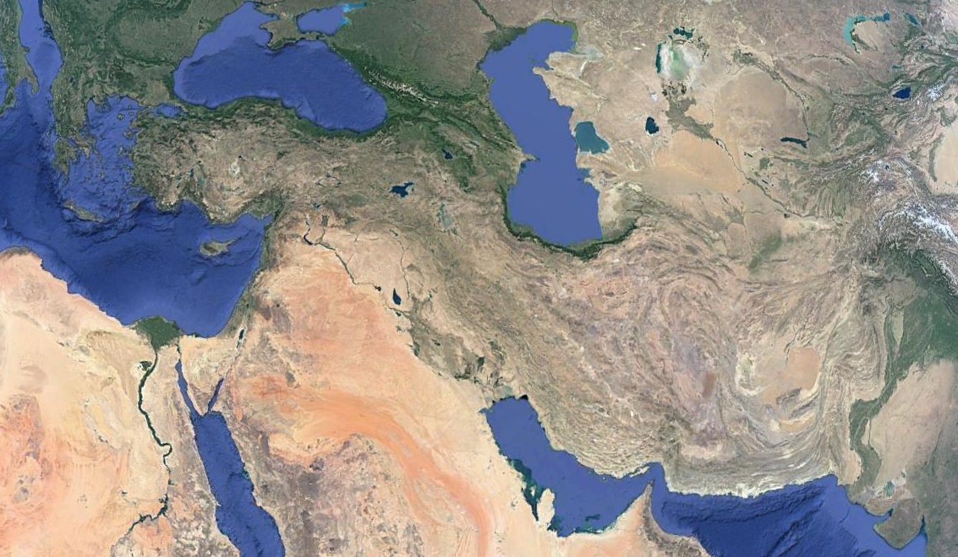
Daniel
8 . 1 - 27
Greeks
Scythyians
Egyptians

Slide 7
Daniel
8 . 1 - 27

Slide 8
Daniel
8 . 1 - 27
rage ~ KJV, choler

Slide 9
Daniel
8 . 1 - 27

Slide 10
Daniel
8 . 1 - 27

Slide 11
Daniel
8 . 1 - 27
Granicus (334 BC)
Issus
(333 BC)
Halicarnassus (334 BC)
Tyre
(332 BC)

Slide 12
Daniel
8 . 1 - 27
½ mi.
Old Tyre (mainland)
Island Tyre
causeway

Slide 13
Daniel
8 . 1 - 27
217 years
500 BC
400 BC
300 BC
200 BC
Fall of Babylon
(539 BC)
Fall of Persia
(530 BC)
Daniel’s vision
(547 BC)

Slide 14
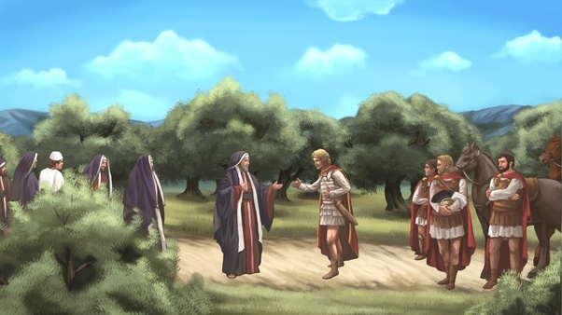
Daniel
8 . 1 - 27

Slide 15
Daniel
8 . 1 - 27

Slide 16
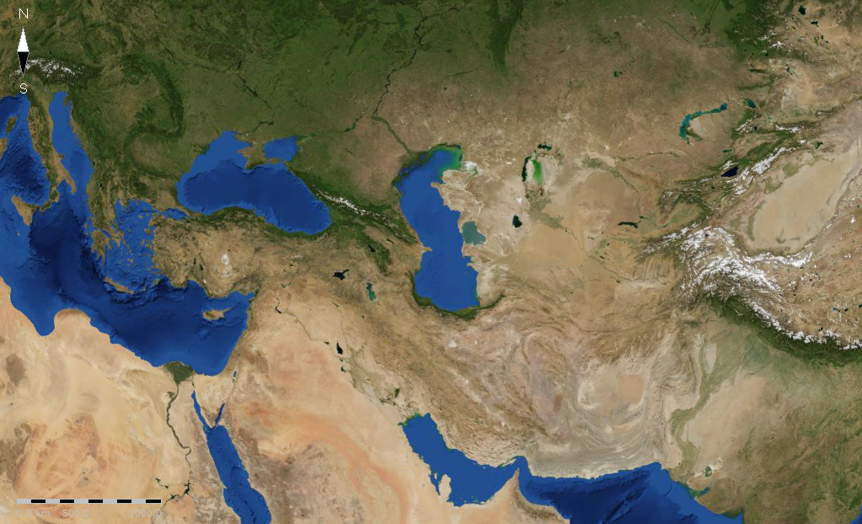
Daniel
8 . 1 - 27
Cassander
Lysimachus
Seleucus
Ptolemy

Slide 17
Daniel
8 . 1 - 27
Epimanēs
Antiochus IV ~
Epiphanēs
God Manifested
Theos
Epiphanēs

Slide 18
Daniel
8 . 1 - 27
217 years
383 years
500 BC
400 BC
300 BC
200 BC
Fall of Babylon
(539 BC)
Fall of Persia
(530 BC)
Antiochus IV
(164 BC)
Daniel’s vision
(547 BC)

Slide 19
Daniel
8 . 1 - 27

Slide 20
Daniel
8 . 1 - 27
holy ones ~ qadosh – KJV, saints

Slide 21
Daniel
8 . 1 - 27

Slide 22
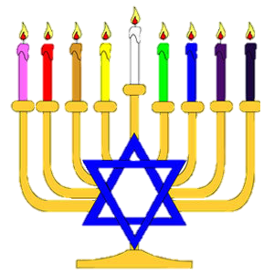
Daniel
8 . 1 - 27
Antiochus’ 1st incursion in Israel, Sept. 6, 170 BC + 2300 days = Day the sacrifices were restored, Dec. 25, 164 BC
Literally, 2300 evening and morning
The day the sacrifices were taken away, Dec. 16, 167 BC + 2,300 sacrifices = Day the sacrifices were restored, Dec. 25, 164 BC
Dec. 25, 164 BC ~ 1st Hanukuh

Slide 23
Daniel
8 . 1 - 27

Slide 24
Daniel
8 . 1 - 27
Jer. 30:7 ~ Alas! For that day is great,
So that none is like it;
And it is the time of Jacob's trouble,
But he shall be saved out of it.

Slide 25
Daniel
8 . 1 - 27

Slide 26
Daniel
8 . 1 - 27
NASB, while they are at ease
NIV, when they feel secure
KJV, by peace shall destroy

Slide 27
Daniel
8 . 1 - 27

