Slide 1
the Book of
Daniel
7 . 1 - 28
A free CD of the study will be available upon request following the service.
A podcast will be available later in the week at calvaryokc.com.
A videowill be available at facebook.com/CalvaryOKC and our YouTube channel (Calvary Chapel OKC)

Slide 2
Daniel
7 . 1 - 28
Chapters 7-12 ~ prophetic (written in 1st person)
Chapters 1-6 ~ historical (written in 3rd person)

Slide 3
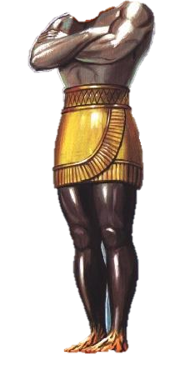
Daniel
7 . 1 - 28
Chapter 2
Head of Gold ~ Babylon (605-539 BC)
Breast of Silver ~ Persia (539-331BC)
Thighs of Brass ~ Greece (331-168 BC)
Legs of Iron ~ Rome (168 BC-AD 476
Feet of Iron and Clay ~ Revived Roman Empire

Slide 4
Daniel
7 . 1 - 28

Slide 5
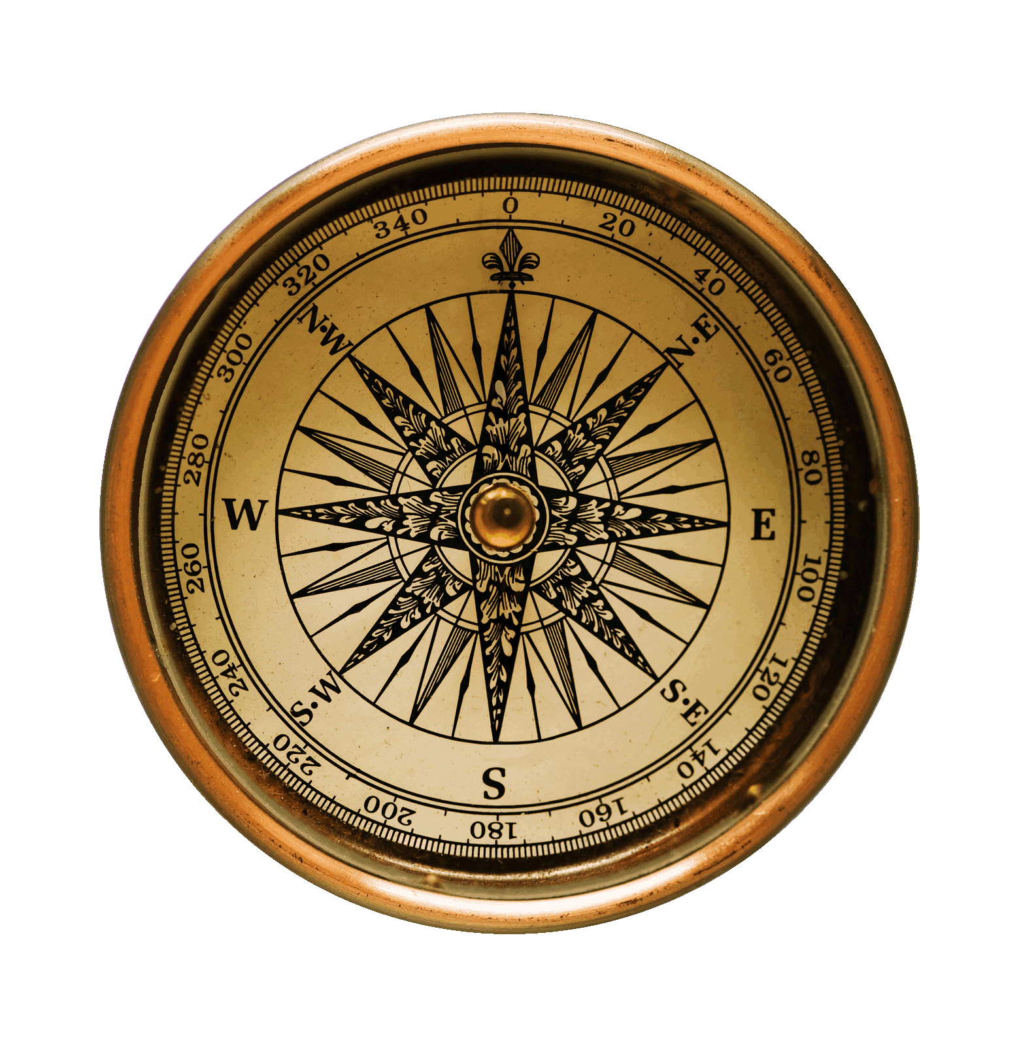
Daniel
7 . 1 - 28
In prophecy ~ sea = gentile nations
winds = something ominous
vv. 7-12 ~ fourth beast
vv. 2-6 ~ three beasts that rise out of the sea
vv. 13-14 ~ Son of Man
This Photo by Unknown Author is licensed under CC BY-NC-ND

Slide 6
Daniel
7 . 1 - 28
four winds ~ ruach, or 4 spirits (angels)
Rev. 7:1 ~ After these things I saw four angels standing at the four corners of the earth, holding the four winds of the earth, that the wind should not blow on the earth, on the sea, or on any tree.

Slide 7
Daniel
7 . 1 - 28

Slide 8
Daniel
7 . 1 - 28
Nebuchadnezzar ~ the head of gold

Slide 9
Daniel
7 . 1 - 28

Slide 10
Daniel
7 . 1 - 28
Medo-Persian ~ torso of silver

Slide 11
Daniel
7 . 1 - 28
three ribs ~ Babylon, Lydia and Egypt
Or, Babylon, Assyria and Egypt

Slide 12
Daniel
7 . 1 - 28

Slide 13
Daniel
7 . 1 - 28
Greece ~ thighs of brass

Slide 14
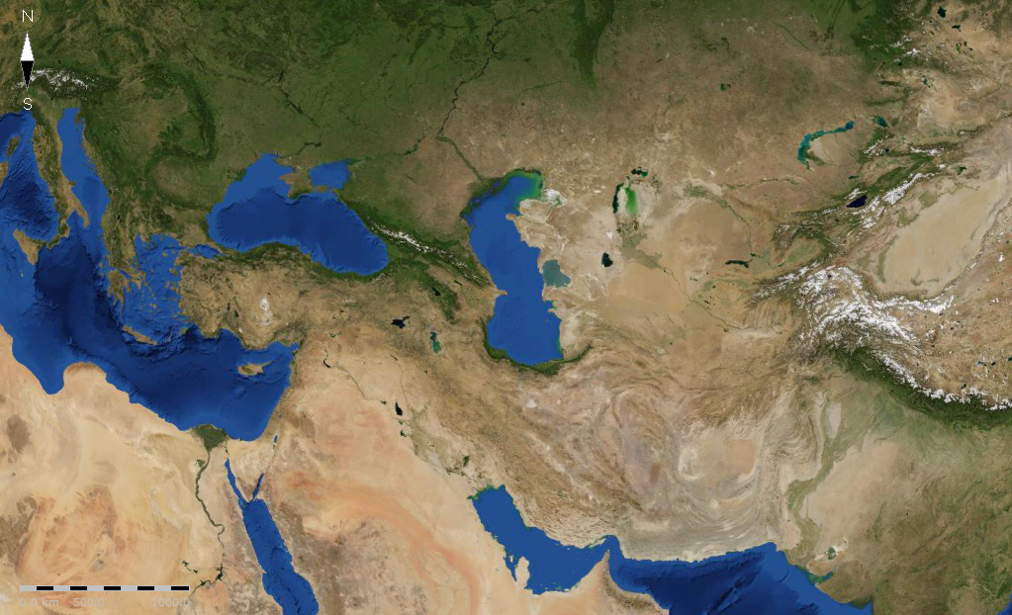
Daniel
7 . 1 - 28
“Let my kingdom go to the strong”
Cassander
Lysimachus
Seleucus
Ptolemy

Slide 15
Daniel
7 . 1 - 28

Slide 16
Daniel
7 . 1 - 28
Romans and Revived Roman Empire ~ legs of iron
Romans ~ legs of iron

Slide 17
Daniel
7 . 1 - 28
Possibly Britain (lion) and US (eagle), Russia (bear), Confederation of Asian nations (leopard) and Revived Roman Empire (non-descript beast)

Slide 18
Daniel
7 . 1 - 28

Slide 19
Daniel
7 . 1 - 28
Rev. 13:1-2 ~ ¹ Then I stood on the sand of the sea. And I saw a beast rising up out of the sea, having seven heads and ten horns, and on his horns ten crowns, and on his heads a blasphemous name. ² Now the beast which I saw was like a leopard, his feet were like the feet of a bear, and his mouth like the mouth of a lion. The dragon gave him his power, his throne, and great authority.

Slide 20
Daniel
7 . 1 - 28

Slide 21
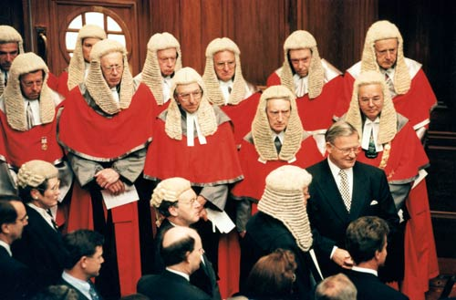
Daniel
7 . 1 - 28
Ancient of Days ~ literally, days without beginning

Slide 22
Daniel
7 . 1 - 28

Slide 23
Daniel
7 . 1 - 28
Ancient of Days ~ literally, days without beginning
Book of Deeds
Book of Life

Slide 24
Daniel
7 . 1 - 28

Slide 25
Daniel
7 . 1 - 28
residue ~ NIV, whatever was left

Slide 26
Daniel
7 . 1 - 28

Slide 27
Daniel
7 . 1 - 28
saints ~ literally, holy ones

Slide 28
Daniel
7 . 1 - 28

Slide 29
Daniel
7 . 1 - 28
European Economic Union ~ 1957 – Belgium, France, Italy, Luxembourg, the Netherlands and West Germany
1967 became the European Community
1973, added Denmark, Greenland (which left in ’85), Ireland and the UK
1981 ~ Greece (the 10th nation)
1986 ~ Portugal and Spain

Slide 30
Daniel
7 . 1 - 28
Became the European Union in 1993
1995 ~ Austria, Finland and Sweden
2004 ~ Cyrus, Czech Republic, Estonia, Hungary,
Latvia, Lithuania, Malta, Poland, Slovakia, and
Slovenia
2007 ~ Bulgaria and Romania
2013 ~ Croatia (28)
Proposed additions ~ Turkey, North Macedonia, Montenegro, Albania and Serbia

Slide 31
Daniel
7 . 1 - 28
Roman Empire AD 117
Eupean Union

Slide 32
Daniel
7 . 1 - 28

Slide 33
Daniel
7 . 1 - 28
thoughts ~ KJV, cogitations

Slide 34
Daniel
7 . 1 - 28

Slide 35
Daniel
7 . 1 - 28

