Slide 1
the Book of
Daniel
5 . 1 - 31
A free CD of the study will be available upon request following the service.
A podcast will be available later in the week at calvaryokc.com.
A videowill be available at facebook.com/CalvaryOKC and our YouTube channel (Calvary Chapel OKC)

Slide 2
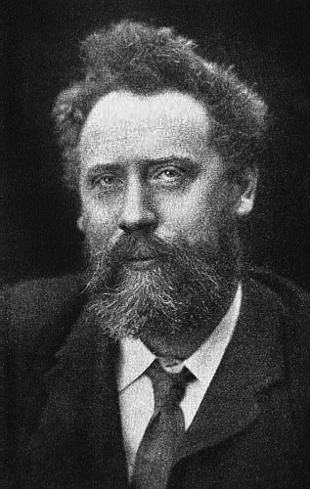
Daniel
5 . 1 - 31
Invictus ~ William E. Henley (1849-1903)
Out of the night that covers me,
Black as the Pit from pole to pole,
I thank whatever gods may be
For my unconquerable soul.
In the fell clutch of circumstance
I have not winced nor cried aloud.
Under the bludgeonings of chance
My head is bloody, but unbowed.

Slide 3
Daniel
5 . 1 - 31
Invictus ~ William E. Henley (1849-1903)
Beyond this place of wrath and tears
Looms but the Horror of the shade,
And yet the menace of the years
Finds, and shall find me, unafraid.
It matters not how strait the gate,
How charged with punishment the scroll,
I am the master of my fate:
I am the captain of my soul.

Slide 4
Daniel
5 . 1 - 31
Jer. 27:6-7 ~ ⁶ And now I have given all these lands into the hand of Nebuchadnezzar the king of Babylon, My servant; and the beasts of the field I have also given him to serve him. ⁷ So all nations shall serve him and his son and his son’s son, until the time of his land comes; and then many nations and great kings shall make him serve them. (c. 609 BC)

Slide 5
Daniel
5 . 1 - 31
70 years
Evil-Merodach
Nergal-Sharezer
Nebuchadnezzar
Nabonidus
600 BC
580 BC
560 BC
540 BC
c. 609 BC
Jeremiah’s prophecy
Oct. 12, 539 BC
Belshazzar’s Feast

Slide 6
Daniel
5 . 1 - 31

Slide 7
Daniel
5 . 1 - 31
56’
173’

Slide 8
Daniel
5 . 1 - 31

Slide 9
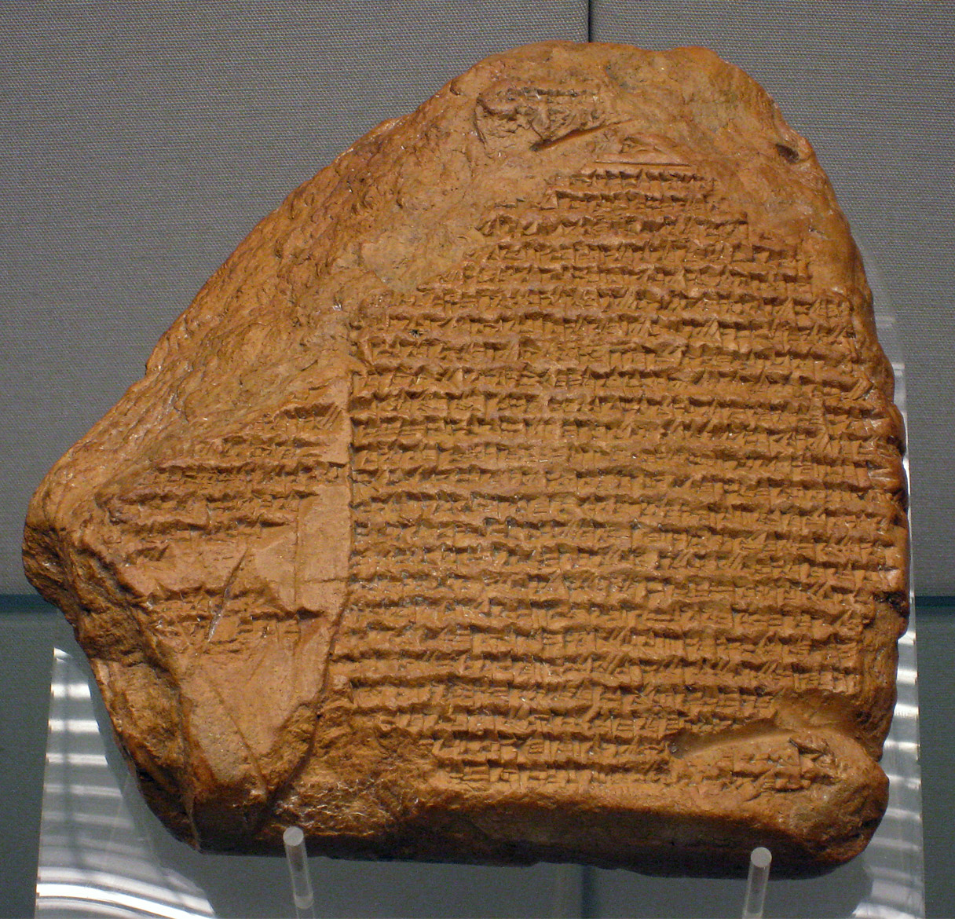
Daniel
5 . 1 - 31
Nabonidus Chronicle
British Museum

Slide 10
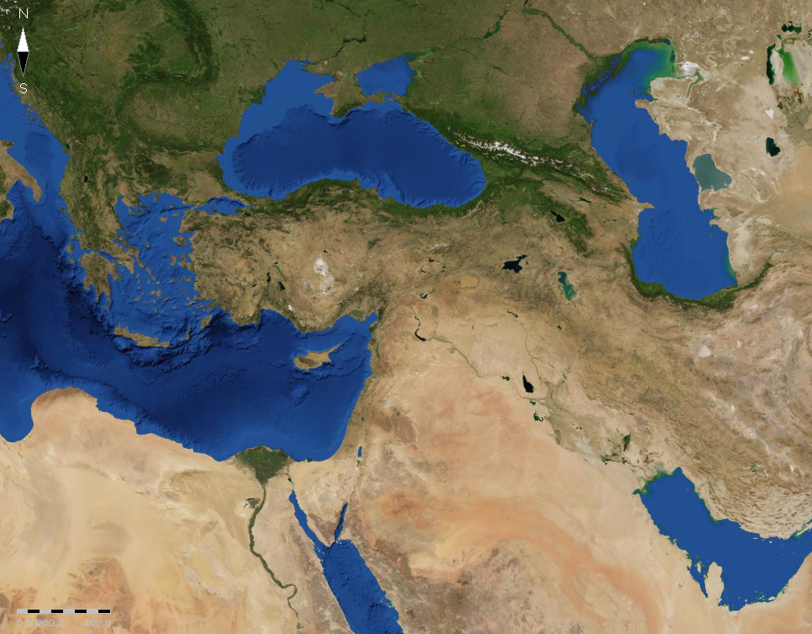
Daniel
5 . 1 - 31
Babylon
Tayma

Slide 11
Daniel
5 . 1 - 31

Slide 12
Daniel
5 . 1 - 31
Jam. 4:17 ~ Therefore, to him who knows to do good and does not do it, to him it is sin.
95% of Americans believe in some kind of God
65% believe in all-powerful, all-knowing Creator of the universe who rules the world today

Slide 13
Daniel
5 . 1 - 31

Slide 14
Daniel
5 . 1 - 31
Mene
Mene ~ numbered (minas ~ Luke 19:11-27)
Mene
Tekel
Tekel ~ i.e. shekel, a weight
Peres
Peres ~ divided
Upharsin is Peres with the conjunction and plural
Peres is from the same root as Persian
numbered,
numbered,
weighed
and divided

Slide 15
Daniel
5 . 1 - 31

Slide 16
Daniel
5 . 1 - 31
Is. 44:28-45:4 ~ ²⁸ Who says of Cyrus, “He is My shepherd, And he shall perform all My pleasure, Saying to Jerusalem, ‘You shall be built,’ And to the temple, ‘Your foundation shall be laid.’”
^{45:1} Thus says the LORD to His anointed, To Cyrus, whose right hand I have held—To subdue nations before him And loose the armor of kings, To open before him the double doors, So that the gates will not be shut:

Slide 17
Daniel
5 . 1 - 31
Is. 44:28-45:4 ~ ² “I will go before you And make the crooked places straight; I will break in pieces the gates of bronze And cut the bars of iron. ³ I will give you the treasures of darkness And hidden riches of secret places, That you may know that I, the LORD, Who call you by your name, Am the God of Israel. ⁴ For Jacob My servant’s sake, And Israel My elect, I have even called you by your name; I have named you, though you have not known Me.”

Slide 18
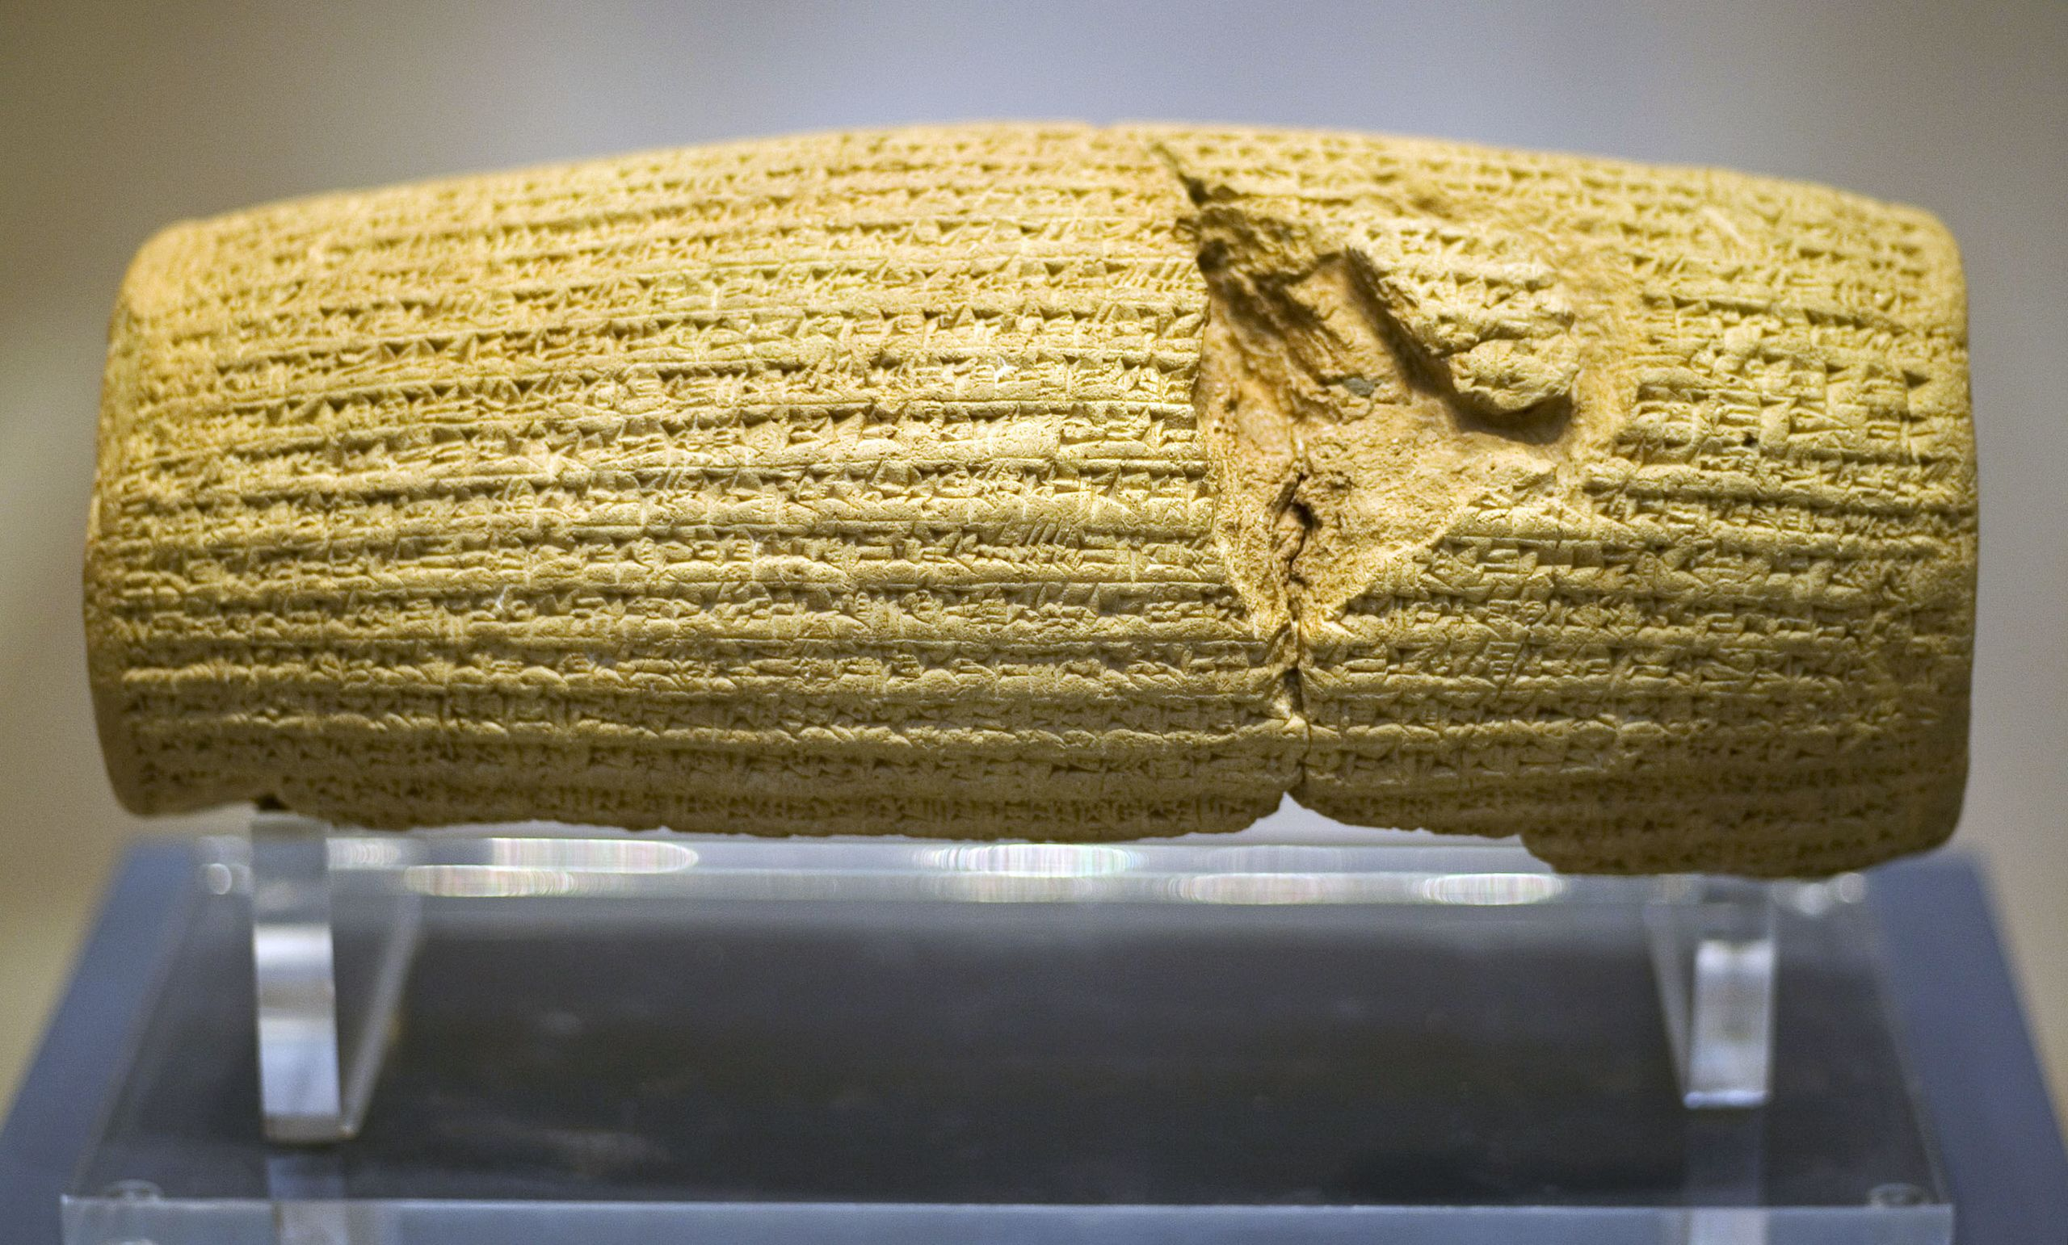
Daniel
5 . 1 - 31
Cyrus cylinder
3.9”
8.6”
British Museum

Slide 19
Daniel
5 . 1 - 31

Slide 20
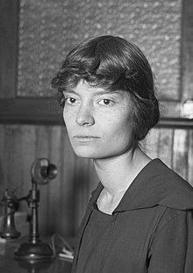
Daniel
5 . 1 - 31
Conquered ~ Dorothea Day (1897-1980)
Out of the light that dazzles me,
Bright as the sun from pole to pole,
I thank the God I know to be,
For Christ - the Conqueror of my soul.
Since His the sway of circumstance,
I would not wince nor cry aloud.
Under the rule which men call chance,
My head, with joy, is humbly bowed.

Slide 21
Daniel
5 . 1 - 31
Conquered ~ Dorothea Day (1897-1980)
Beyond this place of sin and tears,
That Life with Him and His the Aid,
That, spite the menace of the years,
Keeps, and will keep me unafraid.
I have no fear though straight the gate:
He cleared from punishment the scroll.
Christ is the Master of my fate!
Christ is the Captain of my soul!

Slide 22
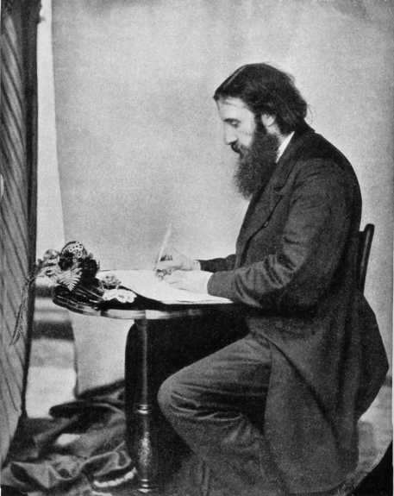
Daniel
5 . 1 - 31
George MacDonald (1824-1905) ~ “How often we look upon God as our last and feeblest resource! We go to Him because we have nowhere else to go. And then we learn that the storms of life have driven us, not upon the rocks, but into the desired haven.”
This Photo by Unknown Author is licensed under CC BY-SA

Slide 23
Daniel
5 . 1 - 31

