Slide 1
the Book of
Daniel
2 . 1 - 4 9
A free CD of the study will be available upon request following the service.
A podcast will be available later in the week at calvaryokc.com.
A videowill be available at facebook.com/CalvaryOKC and our YouTube channel (Calvary Chapel OKC)

Slide 2
Daniel
2 . 1 - 49
A great gathering of wise guys
magicians ~ from a word meaning an engraver
astrologers ~ also translated necromancer or enchanter
sorcerers ~ pharmakos in the LXX

Slide 3
D
aniel
2 . 1 - 49

Slide 4
Daniel
2 . 1 - 49
From the 2:4b to 7:28 is in Aramaic

Slide 5
D
aniel
2 . 1 - 49

Slide 6
Daniel
2 . 1 - 49
My decision is firm: ~ KJV, The thing is gone from me:
thing ~ Aramaic – word, command

Slide 7
D
aniel
2 . 1 - 49

Slide 8
Daniel
2 . 1 - 49
Herodotus’ description of Babylon
Walls ~ 56 miles in circumference (18 mi. X 10 mi.)
Walls ~ 320’ high
Walls ~ 87’ thick

Slide 9
Daniel
2 . 1 - 49
Valliance
Bank Tower
Babylon
320’

Slide 10
Daniel
2 . 1 - 49
18 mi.
10 mi.
Babylon

Slide 11
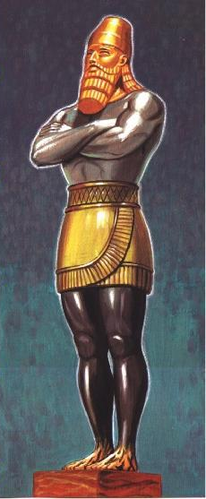
Daniel
2 . 1 - 49
Head of Gold ~ Babylon (605-539 BC)
Breast of Silver ~ Persia (539-331BC)
Thighs of Brass ~ Greece (331-168 BC)
Legs of Iron ~ Rome (168 BC-AD 476
Feet of Iron and Clay ~ Revived Roman Empire

Slide 12
D
aniel
2 . 1 - 49

Slide 13
Daniel
2 . 1 - 49
European Economic Union ~ 1957 – Belgium, France, Italy, Luxembourg, the Netherlands and West Germany
1967 became the European Community
1973, added Denmark, Greenland (which left in ’85), Ireland and the UK
1981 ~ Greece (the 10th nation)
1986 ~ Portugal and Spain

Slide 14
Daniel
2 . 1 - 49
Became the European Union in 1993
1995 ~ Austria, Finland and Sweden
2004 ~ Cyrus, Czech Republic, Estonia, Hungary,
Latvia, Lithuania, Malta, Poland, Slovakia, and
Slovenia
2007 ~ Bulgaria and Romania
2013 ~ Croatia (28)
Proposed additions ~ Turkey, North Macedonia, Montenegro, Albania and Serbia

Slide 15
Daniel
2 . 1 - 49
Roman Empire AD 117
Eupean Union

Slide 16
D
aniel
2 . 1 - 49

Slide 17
Daniel
2 . 1 - 49
7-year Tribulation
Church Age
1000-year Millennial Kingdom
Rapture of the Church

Slide 18
Daniel
2 . 1 - 49
Matt. 24:32-34 ~ ³² “Now learn this parable from the fig tree: When its branch has already become tender and puts forth leaves, you know that summer is near. ³³ So you also, when you see all these things, know that it is near—at the doors! ³⁴ Assuredly, I say to you, this generation will by no means pass away till all these things take place.

Slide 19
Daniel
2 . 1 - 49
May 14, 1948
Sept. 29-30, 1981
1988
1950
1960
1970
1980
40 years

Slide 20
D
aniel
2 . 1 - 49

