Slide 1
3:12-21
A CD of this message will be available (free of charge) immediately following today’s service.
A podcast will also be available later in the week at calvaryokc.com.

Slide 2
3:12-21
Colossians 3:12–21 ~ ¹² Therefore, as the elect of God, holy and beloved, put on tender mercies, kindness, humility, meekness, longsuffering; ¹³ bearing with one another, and forgiving one another, if anyone has a complaint against another; even as Christ forgave you, so you also must do. ¹⁴ But above all these things put on love, which is the bond of perfection. ¹⁵ And let the peace of God rule in your hearts, to which also you were called in one body; and be thankful. ¹⁶ Let the word of Christ dwell in you richly in all wisdom, teaching and admonishing one another in psalms and hymns and spiritual songs,

Slide 3
3:12-21
Colossians 3:12–21 ~ singing with grace in your hearts to the Lord. ¹⁷ And whatever you do in word or deed, do all in the name of the Lord Jesus, giving thanks to God the Father through Him.
¹⁸ Wives, submit to your own husbands, as is fitting in the Lord.
¹⁹ Husbands, love your wives and do not be bitter toward them.
²⁰ Children, obey your parents in all things, for this is well pleasing to the Lord.
²¹ Fathers, do not provoke your children, lest they become discouraged.

Slide 4
3:12-21
Wisdom from Grandpa …
Whether a man winds up with the nest egg or a goose egg depends a lot on the kind of chick he marries.
Trouble in marriage often starts when a man gets so busy earnin’ his salt that he forgets his sugar.
Too many couples marry for better or for worse, but not for good.

Slide 5
3:12-21
Wisdom from Grandpa …
When a man marries a woman, they become one,
but the trouble starts when they try to decide which one.
If a man has enough “horse sense” to treat his wife like a thoroughbred, she will never be an old nag.
Judgin' from the specimens they pick for husbands, it’s no wonder that brides often blush.

Slide 6
3:12-21
Wisdom from Grandpa …
On anniversaries the wise husband always forgets the past
... but never the present.
A foolish husband remarks to his wife: “Honey, you stick to the washin,’ ironin,’ cookin,’ and scrubbin.’
Ain’t no wife of mine
ever gonna work.”
The bonds of matrimony are a good investment only when the interest is kept up.

Slide 7
3:12-21
Wisdom from Grandpa …
Many girls like to marry a military man – he can cook, sew, make a bed, and is in good health
... and he’s already used to taking orders.

Slide 8
3:12-21

Slide 9
3:12-21
the elect of God
How can I possibly reconcile
?
Why should I feel the need to reconcile two good friends?
God has absolute knowledge
God knows who will choose Him
Man is morally responsible
God’s sovereignty
God is sovereign
Take me to your leader
and man’s freewill?
?

Slide 10
3:12-21

Slide 11
3:12-21
tender mercies ~ splagknon
KJV, bowels of compassion
I LEFT MY BOWELS IN SAN FRANCISCO
You move me

Slide 12
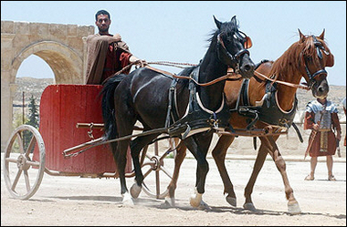
3:12-21
tender mercies ~ splagknon
KJV, bowels of compassion

Slide 13
3:12-21

Slide 14
3:12-21
C. S. Lewis ~ “We all agree that forgiveness is a beautiful idea until we have to practice it.”

Slide 15
3:12-21

Slide 16
3:12-21
IF
IF the praise of man elates me and his blame depresses me; if I cannot rest under misunderstanding without defending myself; if I love to be loved more than to love, to be served more than to serve, then I know nothing of Calvary love.
IF I can hurt another by speaking faithfully without much preparation of spirit, and without hurting myself far more than I hurt that other, then I know nothing of Calvary love.
~
Amy Carmichael
~

Slide 17
3:12-21
IF
IF I dominate myself, if my thoughts revolve around myself, if I am so occupied with myself I rarely have “a heart at leisure from itself,” then I know nothing of Calvary love.
IF souls can suffer alongside, and I hardly know it, because the spirit of discernment is not in me, then I know nothing of Calvary love.
~
Amy Carmichael
~

Slide 18
3:12-21
IF
IF I slip into the place that can be filled by Christ alone, making myself the first necessity to a soul instead of leading it to fasten upon Him, then I know nothing of Calvary love.
IF I refuse to allow one who is dear to me to suffer for the sake of Christ, if I do not see such suffering as the greatest honor that can be offered to any follower of the Crucified, then I know nothing of Calvary love.
~
Amy Carmichael
~

Slide 19
3:12-21

Slide 20
3:12-21
rule ~ to be an umpire
Phil. 4:6-7 – ⁶ worry about nothing, pray about everything, give thanks for anything; ⁷ and the peace of God, which surpasses all understanding, will guard your hearts and minds through Christ Jesus.

Slide 21
3:12-21

Slide 22
3:12-21
psalms ~ psalmos
Vine’s Expository Dictionary ~ initially, “a striking or twitching with the fingers (on musical strings)”
Then later, “a sacred song, sung to musical accompaniment.”
hymns ~ humnos – song containing religious content
spiritual songs ~ pneumatikos (spiritual) ōdē

Slide 23
3:12-21

Slide 24
3:12-21
submit ~ hupotassō – “a voluntary attitude of giving in, cooperating, assuming responsibility, and carrying a burden”
KJV, NIV ~ Wives, submit yourselves

Slide 25
3:12-21

Slide 26
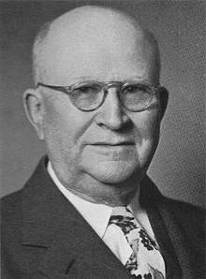
3:12-21
Harry Ironsides (1876-1931) ~
“Women are superior to men
… at being women.”

Slide 27
3:12-21

Slide 28
3:12-21
Merrihew Unabridged Collegiate Dictionary (PD)
Submission : n. to love
Love : n. to submit

Slide 29
3:12-21

Slide 30
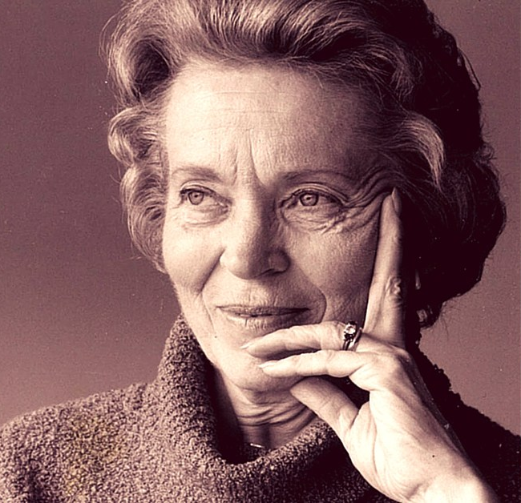
3:12-21
Elisabeth Elliot (1926-2015) ~
“Today you are choosing to
be married because you are
in love. Tomorrow choose to
be in love because you are
married.”

Slide 31
3:12-21

Slide 32
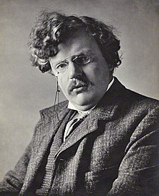
3:12-21
G.K. Chesterton (1874-1936) ~ “I have known many happy marriages, but
never a compatible one. The
whole aim of marriage is to
fight through and survive the
instant when incompatibility
becomes unquestionable.”

Slide 33
3:12-21

Slide 34
3:12-21

Slide 35
3:12-21
Genesis 2:18 (KJV) ~ And the Lord God said, It is not good that the man should be alone; I will make him a help meet for him.
-
help ~ ezer – help or helper
meet ~ a preposition that has the idea of opposite
literally, I will make a completer for him

Slide 36
3:12-21

Slide 37
3:12-21
Rules for wives:
1. Submit voluntarily and responsibly
Rules for husbands:
1. Love sacrificially and unconditionally
Rules for children:
1. Obey completely and properly

Slide 38
3:12-21

Slide 39
3:12-21
5 rules of parenting:
1. Discipline, don’t punish
2. Explain consequences prior to transgression
3. Be consistent
4. Discipline appropriate to transgression
5. Always demonstrate love following

Slide 40
3:12-21

