Slide 1

3:1-11
A CD of this message will be available (free of charge) immediately following today’s service.
A podcast will also be available later in the week at calvaryokc.com.

Slide 2



3:1-11
The Epistle
of Paul
To the saints and faithful brethren in Christ in Colosse
Chapters 1-2 –
Doctrinal
(What He
hath done)
Chapters 3-4 –
Practical
(What we
shalt do)

Slide 3
3:1-11
Col. 3:1-11 (Wuest) ~ ¹ In view of the fact, therefore, that you were raised with Christ, the things above be constantly seeking, where Christ is, on the right hand of God, seated. ² The things above be constantly setting your mind upon, not the things on the earth; ³ for you died, and your life has been hidden with Christ in God. ⁴ Whenever Christ is made visible, our life, then also you with Him shall be manifested in glory.
⁵ By a once-for-all act, and at once, put to death your members which are upon the earth:

Slide 4
3:1-11
Col. 3:1-11 (Wuest) ~ fornication, impurity, depraved passion, wicked craving, and avarice which is of such a nature as to be idolatry; ⁶ because of which things there comes the wrath of God; ⁷ in the sphere of which things also you ordered your behavior at one time when you were living in them. ⁸ But now put away once for all, and at once, also all these things: a habitual, revengeful anger, violent fits of anger, malignity, slander, obscene speech out of your mouth. ⁹ Stop lying to one another, having stripped off and away from yourselves and for your

Slide 5
3:1-11
Col. 3:1-11 (Wuest) ~ own advantage the old, antiquated, outworn, decrepit, useless man with his evil practices, ¹⁰ and having clothed yourselves with the new man who is constantly being renewed, with a resulting advanced and perfect experiential knowledge which is according to the image of the One who created him; ¹¹ in which state there cannot be Greek or Jew, circumcision or uncircumcision, Barbarian, Scythian, slave, or free man, but Christ is all things and in all things.

Slide 6

3:1-11

Slide 7
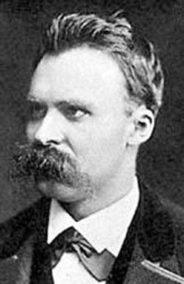
3:1-11
“God is dead.” – Nietzsche
X
X
“Nietzsche is dead.”
-- God

Slide 8
3:1-11

Slide 9
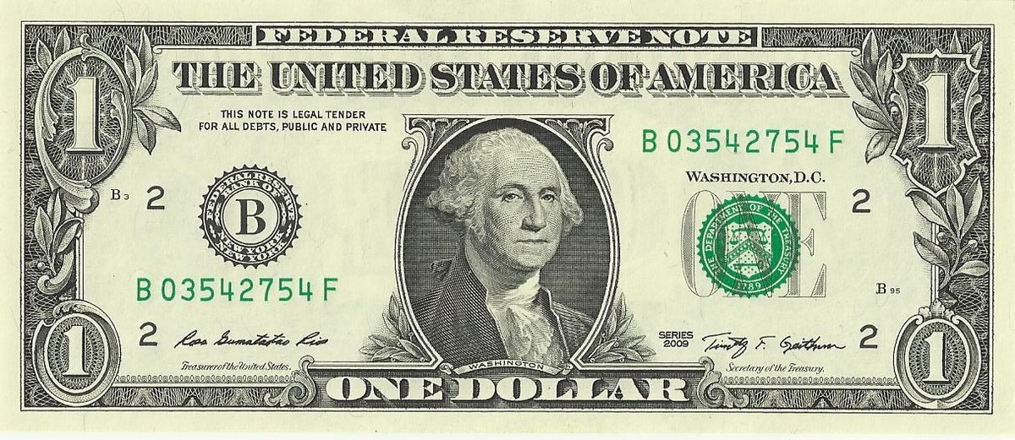
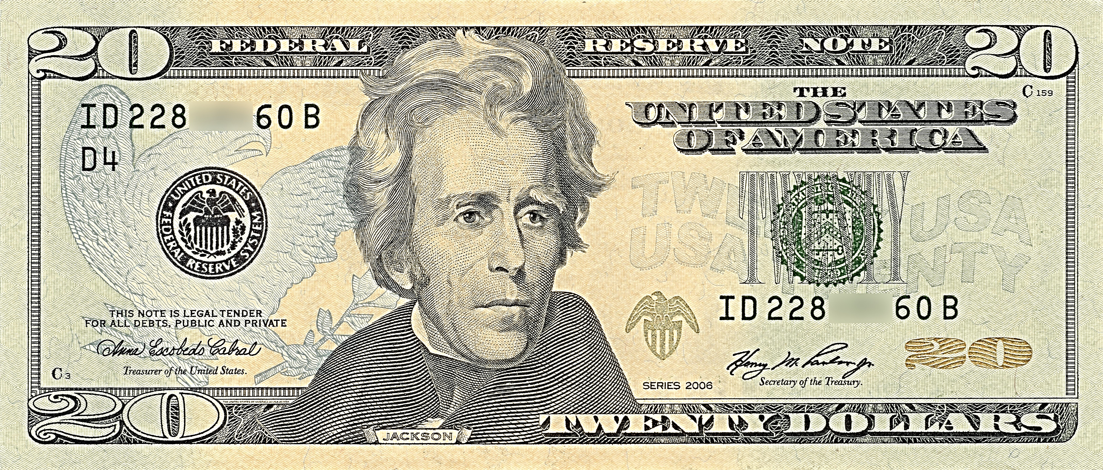
3:1-11
“I’ve been to the finest restaurants, Broadway shows, Las Vegas, Atlantic City … I even went on a Caribbean cruise. Where have you been?”
“Oh … I’ve been to the Methodist church, the Episcopal church, the Baptist church, many, many Calvary Chapel churches.”
“What’s a church?”

Slide 10
3:1-11

Slide 11
3:1-11
If ~ “condition of the first class” – i.e. Since (as in NIV)
literally, keep seeking

Slide 12
3:1-11

Slide 13


3:1-11
mind ~ phroneō – from a word meaning diaphragm

Slide 14
3:1-11
mind ~ phroneō – from a word meaning diaphragm
KJV ~ affections
literally, keep minding
Matt. 6:19-21 ~ ¹⁹ Do not lay up for yourselves treasures on earth, where moth and rust destroy and where thieves break in and steal; ²⁰ but lay up for yourselves treasures in heaven, where neither moth nor rust destroys and where thieves do not break in and steal. ²¹ where your treasure is, there your heart will be also.

Slide 15
3:1-11

Slide 16
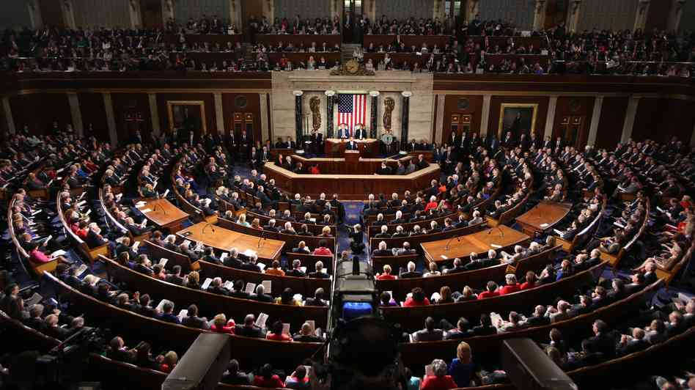
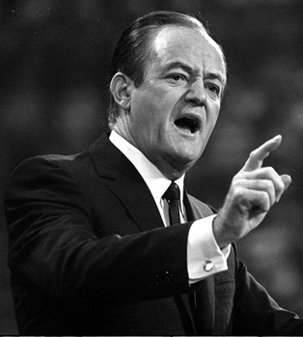
3:1-11
Hubert Humphrey (1911-1978) - “How you stand depends on where you sit.”
Democrats
Republicans
?
?

Slide 17
3:1-11

Slide 18
3:1-11
KJV ~ Mortify therefore your members …
fornication ~ porneia – any sexual thought or act outside of marriage
uncleanness ~ akatharsia
a ~ negative particle meaning without
katharos ~ to cleanse
passion ~ pathos
evil desire ~ kakos epithumia
KJV ~ concupiscence

Slide 19
3:1-11
Increase 2015-1016
Disease
# of cases
Chlamydia
1.59 million
4.7%
Gonorrhea
468,514
18.5%
Primary/Secondary Syphilis
27,814
17.6%
Congenital Syphilis
628
27.6%
www.cdc.gov

Slide 20
3:1-11

Slide 21
3:1-11
Prov. 6:27 ~ Can a man take fire in his bosom and not be burned?

Slide 22
3:1-11

Slide 23
3:1-11
anger ~ orgē ~ writhing, twisting
v. 6 ~ Because of these things the wrath of God is coming upon the sons of disobedience,
Mark Twain ~ “When angry, slowly count to four;
when very angry – swear.”

Slide 24
3:1-11
wrath ~ thumos – thermal

Slide 25



3:1-11
thumos
wrath
orgē
anger

Slide 26
3:1-11

Slide 27
3:1-11
blasphemy ~ blasphēmia – from 2 words: to hurt and fame

Slide 28
3:1-11

Slide 29

3:1-11

Slide 30
3:1-11

Slide 31
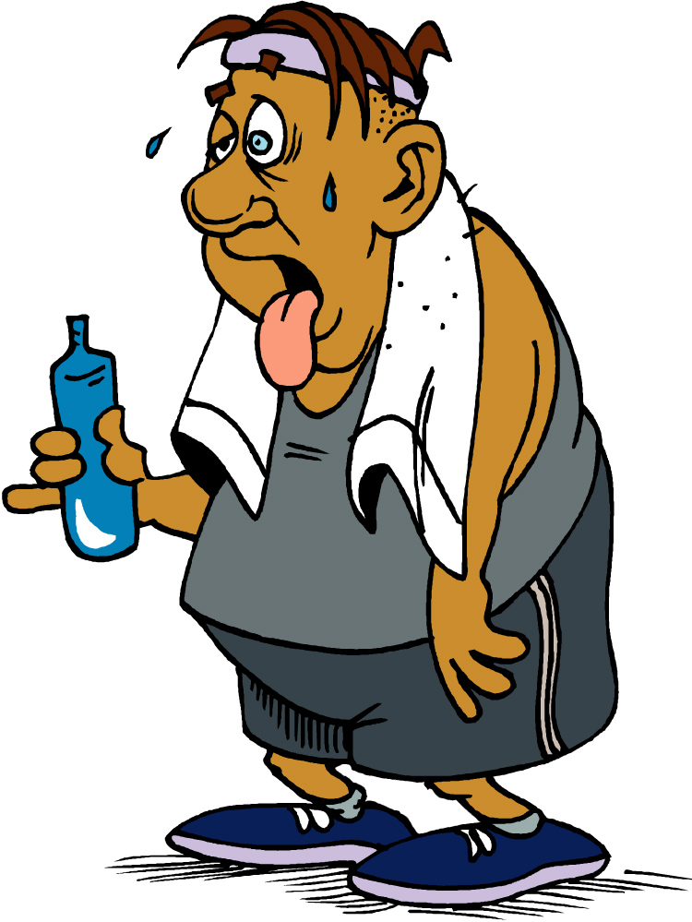
3:1-11

Slide 32
3:1-11

Slide 33




3:1-11
Worldliness
In myself
Godliness
In Christ
World view
Bible view
complete-o-meter

Slide 34
3:1-11

