Slide 1
2:11-23
A CD of this message will be available (free of charge) immediately following today’s service.
A podcast will also be available later in the week at calvaryokc.com.

Slide 2
2:11-23
Col. 2:11-23 ~ ¹¹ In Him you were also circumcised with the circumcision made without hands, by putting off the body of the sins of the flesh, by the circumcision of Christ, ¹² buried with Him in baptism, in which you also were raised with Him through faith in the working of God, who raised Him from the dead. ¹³ And you, being dead in your trespasses and the uncircumcision of your flesh, He has made alive together with Him, having forgiven you all trespasses, ¹⁴ having wiped out the handwriting of requirements that was against us, which was contrary to us. And He has taken it out of the way, having nailed it to the cross. ¹⁵ Having disarmed

Slide 3
2:11-23
Col. 2:11-23 ~ principalities and powers, He made a public spectacle of them, triumphing over them in it.
¹⁶ So let no one judge you in food or in drink, or regarding a festival or a new moon or sabbaths, ¹⁷ which are a shadow of things to come, but the substance is of Christ. ¹⁸ Let no one cheat you of your reward, taking delight in false humility and worship of angels, intruding into those things which he has not seen, vainly puffed up by his fleshly mind, ¹⁹ and not holding fast to the Head, from whom all the body, nourished and knit together by joints and ligaments, grows with the increase that is from God.

Slide 4
2:11-23
Col. 2:11-23 ~ ²⁰ Therefore, if you died with Christ from the basic principles of the world, why, as though living in the world, do you subject yourselves to regulations — ²¹ “Do not touch, do not taste, do not handle,” ²² which all concern things which perish with the using — according to the commandments and doctrines of men? ²³ These things indeed have an appearance of wisdom in self-imposed religion, false humility, and neglect of the body, but are of no value against the indulgence of the flesh.

Slide 5
2:11-23

Slide 6
2:11-23
vv. 1-10) applies to the libertines
vv. 11-17) applies to the ascetics
vv. 18-19) applies to the libertines
vv. 20-23) applies to the ascetics

Slide 7
2:11-23

Slide 8
2:11-23
Deut. 10:16 ~ Therefore circumcise the foreskin of your heart, and be stiff-necked no longer.
Jere. 4:4 ~ Circumcise yourselves to the Lord,
And take away the foreskins of your hearts,
You men of Judah and inhabitants of Jerusalem,
Lest My fury come forth like fire,
And burn so that no one can quench it,
Because of the evil of your doings.”

Slide 9
2:11-23
Rom. 4:9b-12 (Phillips) ~ ^{9b} Note this carefully. We began by saying that Abraham's faith was counted unto him for righteousness. ¹⁰ When this happened, was he a circumcised man? He was not, he was still uncircumcised. ¹¹ It was afterwards that the sign of circumcision was given to him, as a seal upon that righteousness which God was accounting to him as yet an uncircumcised man! God's purpose here is twofold.

Slide 10
2:11-23
Rom. 4:9b-12 (Phillips) ~ First, that Abraham might be the spiritual father of all who since that time, despite their uncircumcision, show the faith that is counted as righteousness. ¹² Then, secondly, that he might be the circumcised father of all those who are not only circumcised, but are living by the same sort of faith which he himself had before he was circumcised.

Slide 11
2:11-23

Slide 12
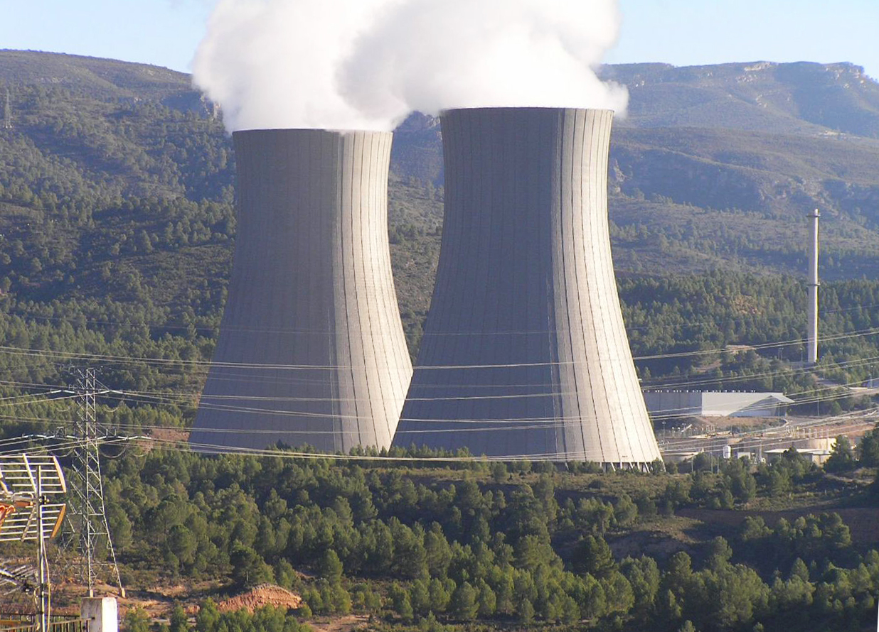
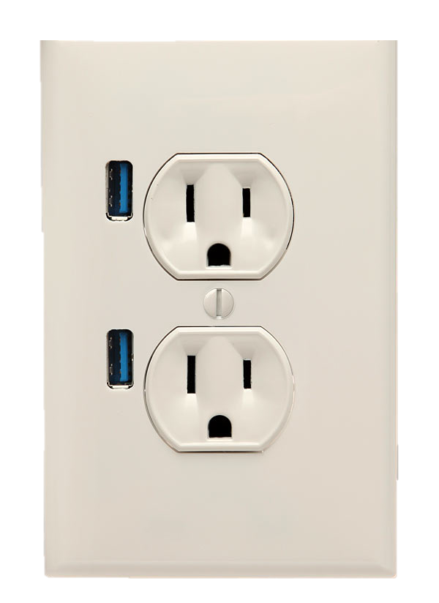
2:11-23
GOD
GRACE
circumcision
faith
man

Slide 13
2:11-23

Slide 14
2:11-23
GOD
GRACE
baptism
faith
man

Slide 15
2:11-23

Slide 16
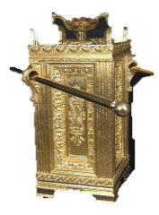
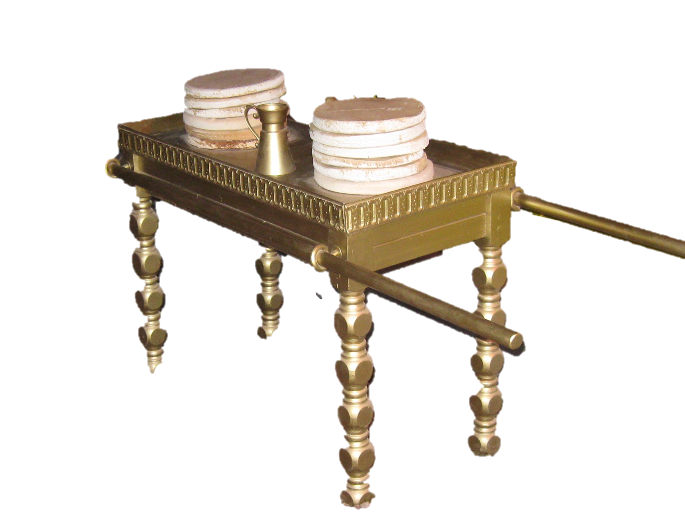
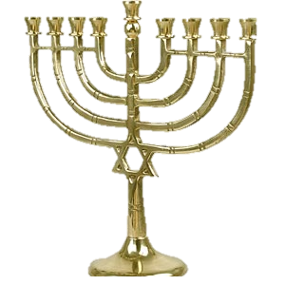
2:11-23
Ark of the Covenant
Golden Altar
Table of Showbread
Menorah

Slide 17
2:11-23

Slide 18
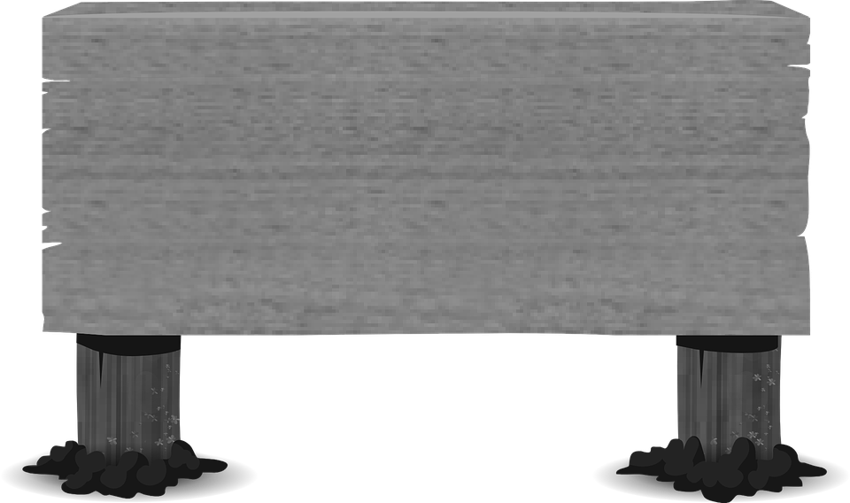
2:11-23
requirements ~ dogma
(twist off, sever, cut, clip, snip, snap off, pluck, pinch off, pull, bend, crush, pare, cleave, divide, break, touch or take, borrow, steal, remove or otherwise harm, mutilate or endanger)
DO NOT PICK
THE FLOWERS

Slide 19
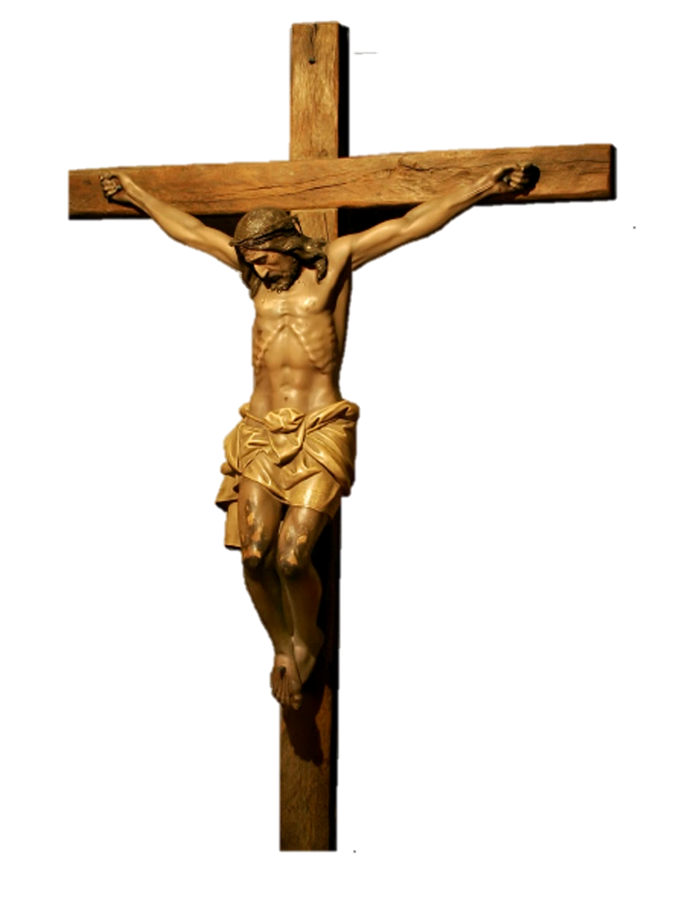
2:11-23
LEX
I.N.R.I.
JESUS (the)
IESVS
LEX
(the LAW)
NAZARENE
NAZARENVS
KING (of the)
REX
JEWS
IVDÆORVM

Slide 20
2:11-23

Slide 21
2:11-23

Slide 22
2:11-23

Slide 23
2:11-23
taking delight in
false
humility
Phillips ~ … by persuading you to make yourselves “humble” and fall down and worship angels.

Slide 24
2:11-23

Slide 25
2:11-23
A.W. Tozer (1897-1963) ~ “The present position of Christ in the gospel churches may be likened to that of a king in a limited constitutional monarchy. The king (sometimes depersonalized by the term ‘the Crown’) is in such a country no more than a traditional rallying point, a pleasant symbol of unity and loyalty much like a flag or a national anthem. He is lauded, feted, and supported, but his real authority is small. Nominally he is head over all, but in every crisis someone else makes the decisions.

Slide 26
2:11-23
A.W. Tozer (1897-1963) ~ On formal occasions he appears in his royal attire to deliver the tame, colorless speech put into his mouth by the real rulers of the country. The whole thing may be no more than good-natured make-believe, but it is rooted in antiquity, it is a lot of fun, and no one wants to give it up.”

Slide 27
2:11-23

Slide 28
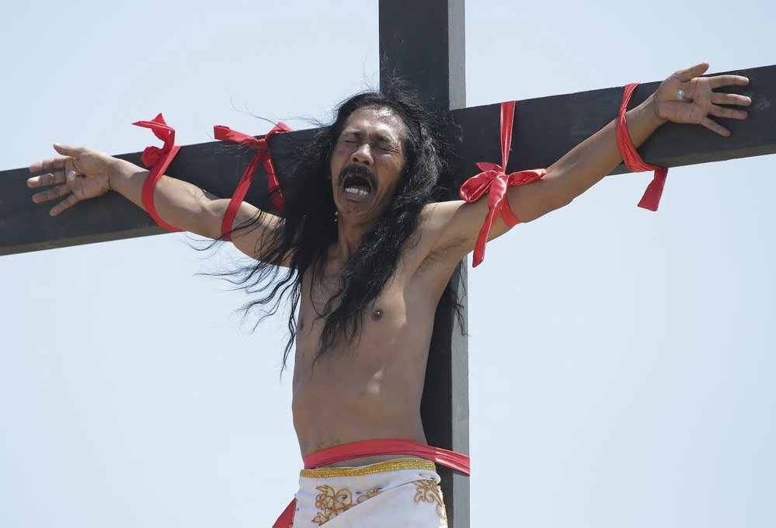
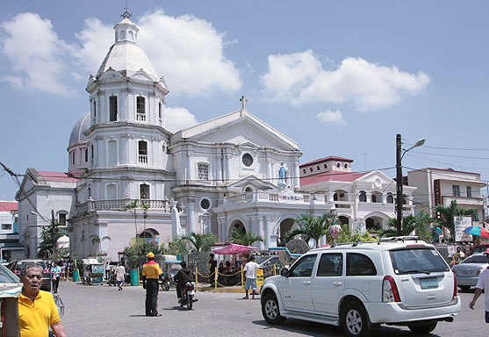
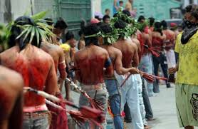
2:11-23
self-imposed religion ~ literally, (as KJV) will-worship
San Fernando, Philippines
Good Friday

Slide 29
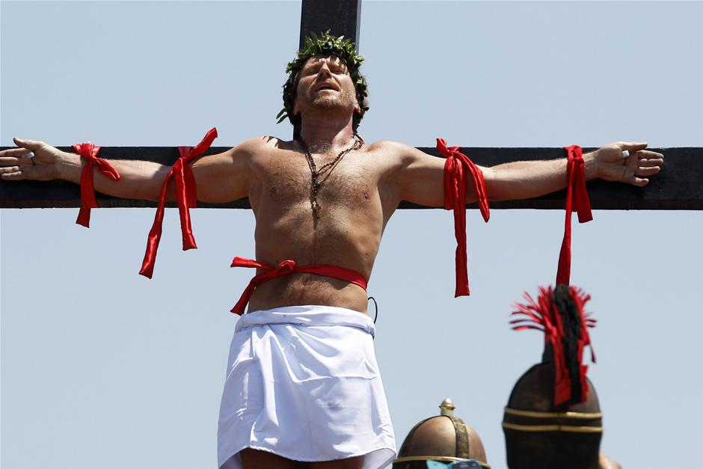
2:11-23
“It was a great experience between me and God.
It was great … it was fun.”
Lasse Spang Olsen, Danish film director

Slide 30
2:11-23
C.S. Lewis (1898-1963) ~ “A world of nice people, content in their own niceness, looking no further, turned away from God, would be just as desperately in need of salvation as a miserable world-and might be even more difficult to save.”

Slide 31
2:11-23

