Slide 1

2:1-10
A CD of this message will be available (free of charge) immediately following today’s service.
A podcast will also be available later in the week at calvaryokc.com.

Slide 2

2:1-10
Basic truths of childhood:
1) No matter how hard you try, you can’t baptize cats.
2) When your Mom is mad at your Dad, don’t let her brush your hair.
3) If your sister hits you, don’t hit her back. They always catch the second person.
4) Never ask your 3-year old brother to hold a tomato.

Slide 3
2:1-10
Basic truths of childhood:
5) You can’t trust dogs to watch your food.
6) Never sneeze when someone is cutting your hair.
7) Never hold a Dust-Buster and a cat at the same time.
8) You can’t hide a piece of broccoli in a glass of milk.
9) Never wear polka-dot underwear under white shorts.

Slide 4
2:1-10
Basic truths of childhood:
10) The best place to be when you’re sad is Papa’s lap.

Slide 5

2:1-10

Slide 6
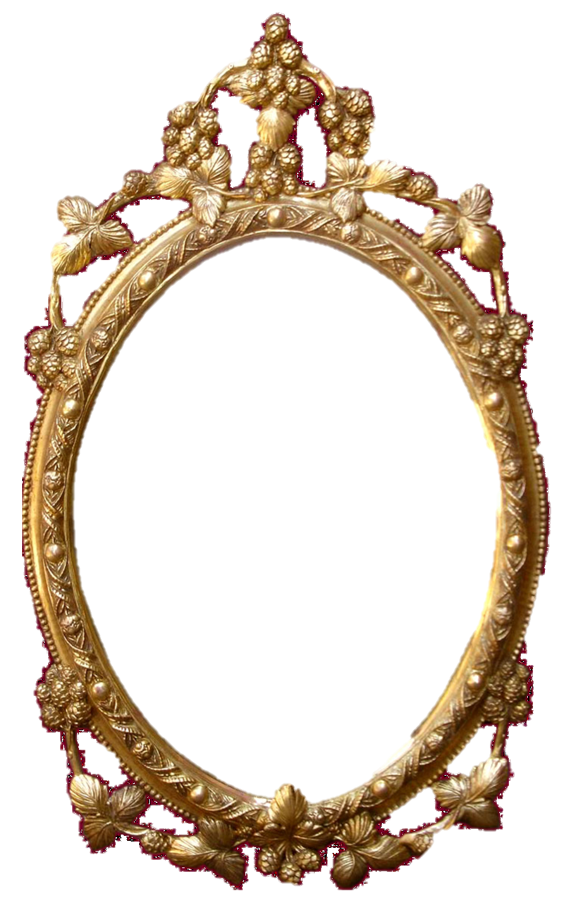

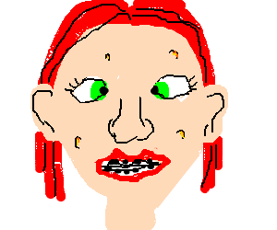

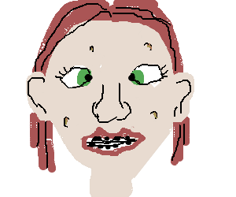
2:1-10
I think …
I think …
I think …
I am the most beautiful woman in England.
I am the most beautiful woman in England.
Mirror of truth

Slide 7
2:1-10

Slide 8
2:1-10
Libertine : a person who is unrestrained by convention or morality; specifically : one leading a dissolute life

Slide 9
2:1-10
Nicolaitans (Rev. 2:6; 2:15)
Irenaeus (d. AD 202) (Against Heresies) ~ “The Nicolaitans are the followers of that Nicolas who was one of the seven first ordained to the diaconate by the apostles. They lead lives of unrestrained indulgence. The character of these men is very plainly pointed out in the Apocalypse of John, [when they are represented] as teaching that it is a matter of indifference to practice adultery, and to eat things sacrificed to idols.”

Slide 10
2:1-10
Nicolaitans (Rev. 2:6; 2:15)
Docetists (from dokē ~ to seem)
Docetism : a belief opposed as heresy in early Christianity that Christ only seemed to have a human body and to suffer and die on the cross
Ascetic : practicing strict self-denial as a measure of personal and especially spiritual discipline

Slide 11




2:1-10
Flesh-indulging
Flesh-denying
Libertines
Ascetics
Gnosticism-o-meter

Slide 12
2:1-10

Slide 13
2:1-10
vv. 1-10) applies to the libertines
vv. 11-17) applies to the ascetics
vv. 18-19) applies to the libertines
vv. 20-23) applies to the ascetics

Slide 14
2:1-10

Slide 15
2:1-10
conflict ~ agōn – agony

Slide 16
2:1-10

Slide 17







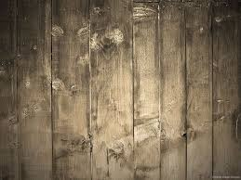

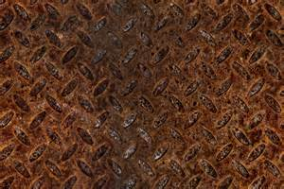





2:1-10
wisdom
knowledge
treasures
of
and
all
the
Ye Olde Treafure Mappe

Slide 18
2:1-10
The New Testament is hidden in the Old
The Old Testament is revealed in the New

Slide 19
2:1-10

Slide 20
2:1-10
para
logizomai
deceive ~ paralogizomai
para ~ beside
logizomai ~ logic

Slide 21
2:1-10

Slide 22
2:1-10
Rabbi Simlai (3rd cent.) ~ 613 (365 negative, 248 positive)
David ~ 11 (Psalm 15:1-15)
Micah ~ 3 (do justly, love mercy, walk humbly)
Habakkuk ~ 1 (2:4 ~ the just shall live by faith)

Slide 23
2:1-10

Slide 24
2:1-10
cheat ~ KJV spoil; literally, plunder
NASB, NIV ~ captive

Slide 25
2:1-10

Slide 26

2:1-10
Godhead ~ theotēs
NASB ~ For in Him all the fullness of Deity dwells in bodily form,
Bishop Henry Moule ~ “A Savior Who is not God is like bridge unfinished at the other end.”
23.83 miles

Slide 27
2:1-10

Slide 28
2:1-10
E. M. Bounds ~ “Men are looking for better machinery. God is looking for better men.”

Slide 29
2:1-10

