Slide 1
1:15-29
A CD of this message will be available (free of charge) immediately following today’s service.
A podcast will also be available later in the week at calvaryokc.com.

Slide 2
1:15-29
He is the God/Man
He is not ½ God / ½ Man
i.e. 50% God / 50% Man = 100% Jesus
He is not God on the inside / Man on the outside
100% God / 100% Man = 200% Jesus

Slide 3
1:15-29

Slide 4
1:15-29
Colossians 1:15–29 ~ ¹⁵ He is the image of the invisible God, the firstborn over all creation. ¹⁶ For by Him all things were created that are in heaven and that are on earth, visible and invisible, whether thrones or dominions or principalities or powers. All things were created through Him and for Him. ¹⁷ And He is before all things, and in Him all things consist. ¹⁸ And He is the head of the body, the church, who is the beginning, the firstborn from the dead, that in all things He may have the preeminence.
¹⁹ For it pleased the Father that in Him all the fullness should dwell, ²⁰ and by Him to reconcile all things to

Slide 5
1:15-29
Colossians 1:15–29 ~ Himself, by Him, whether things on earth or things in heaven, having made peace through the blood of His cross.
²¹ And you, who once were alienated and enemies in your mind by wicked works, yet now He has reconciled ²² in the body of His flesh through death, to present you holy, and blameless, and above reproach in His sight — ²³ if indeed you continue in the faith, grounded and steadfast, and are not moved away from the hope of the gospel which you heard, which was preached to every creature under heaven, of which I, Paul, became a minister.

Slide 6
1:15-29
Colossians 1:15–29 ~ ²⁴ I now rejoice in my sufferings for you, and fill up in my flesh what is lacking in the afflictions of Christ, for the sake of His body, which is the church, ²⁵ of which I became a minister according to the stewardship from God which was given to me for you, to fulfill the word of God, ²⁶ the mystery which has been hidden from ages and from generations, but now has been revealed to His saints. ²⁷ To them God willed to make known what are the riches of the glory of this mystery among the Gentiles: which is Christ in you, the hope of glory. ²⁸ Him we preach, warning every man and teaching every man in all wisdom, that we may

Slide 7
1:15-29
Colossians 1:15–29 ~ present every man perfect in Christ Jesus. ²⁹ To this end I also labor, striving according to His working which works in me mightily.

Slide 8
1:15-29

Slide 9
1:15-29
HELLO AND WELCOME TO THE MENTAL HEALTH HOTLINE

Slide 10
1:15-29
IF YOU ARE OBSESSIVE-COMPULSIVE, PRESS 1 REPEATEDLY

Slide 11
1:15-29
IF YOU ARE CO-DEPENDENT, ASK SOMEONE TO PRESS 2 FOR YOU

Slide 12
1:15-29
IF YOU have MULTIPLE PERSONALITIES, PRESS 3, 4, 5 AND 6

Slide 13
1:15-29
IF YOU ARE PARANOID, WE KNOW WHAT YOU ARE AND WHAT YOU WANT, STAY ON THE LINE AND WE’LL TRACE YOUR CALL

Slide 14
1:15-29
IF YOU ARE DELUSIONAL, PRESS 7 AND YOUR CALL WILL BE TRANSFERRED TO THE MOTHER SHIP

Slide 15
1:15-29
IF YOU ARE SCHIZOPHRENIC, LISTEN CAREFULLY AND A SMALL VOICE WILL TELL YOU WHICH NUMBER TO PRESS

Slide 16
1:15-29
IF YOU ARE DEPRESSIVE, IT DOESN’T MATTER WHICH NUMBER YOU PRESS, NO ONE WILL ANSWER YOU

Slide 17
1:15-29
IF YOU ARE DYSLEXIC, PRESS 69696969

Slide 18
1:15-29
IF YOU HAVE A NERVOUS DISORDER, PLEASE FIDGET WITH THE HASH key UNTIL THE BEEP

Slide 19
1:15-29
AFTER THE BEEP, PLEASE WAIT FOR THE BEEP

Slide 20
1:15-29
If you have a short-term memory loss, please try your call again later

Slide 21
1:15-29
If you have low self-esteem, hang up … all our operators are too busy to talk to you

Slide 22
1:15-29

Slide 23
1:15-29
v. 29 ~ To this to His working which works in me mightily.
end
I also labor, striving according

Slide 24
1:15-29

Slide 25
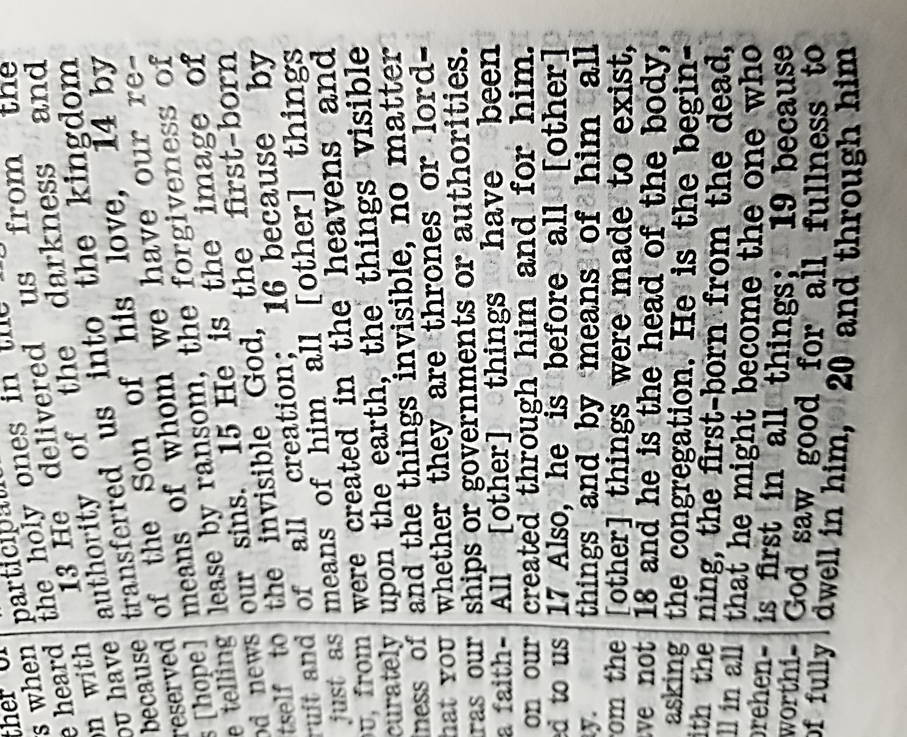
1:15-29

Slide 26
1:15-29

Slide 27
1:15-29
[other]
NWT ~ “My Lord and
my God!”

Slide 28
1:15-29

Slide 29
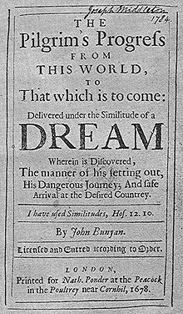
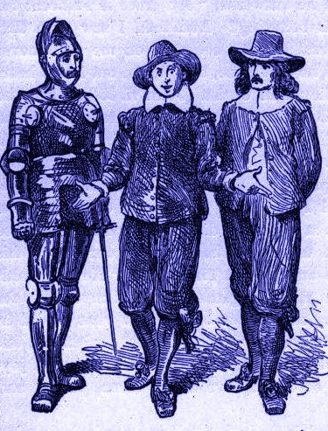
1:15-29
Prov. 26:12 ~ There is more hope of a fool than of him.
Celestial City: heaven
Wicket-gate: Jesus
Hopeful
Ignorance
Christian

Slide 30
1:15-29

Slide 31
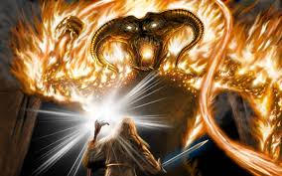
1:15-29

Slide 32
1:15-29

Slide 33
1:15-29
2 Pet. 3:12 ~ … the heavens will be dissolved, being on fire, and the elements will melt with fervent heat …

Slide 34
1:15-29

Slide 35
1:15-29
preeminence ~ prōteuō – verb form of first

Slide 36
1:15-29

Slide 37
1:15-29
alienated ~ literally, away from another
reconciled ~ to change away from

Slide 38
1:15-29

Slide 39
1:15-29
imbecilizomai ~ imbesilizomai
W. Ian Thomas (1914-2007) ~ “To be in Christ ­ that is redemption; but for Christ to be in you ­ that is sanctification! To be in Christ ­ that makes you fit for heaven; but for Christ to be in you ­ that makes you fit for earth! To be in Christ ­ that changes your destination; but for Christ to be in you ­ that changes your destiny! The one makes heaven your home ­ the other makes this world His workshop.”

Slide 40
1:15-29
dayenu ~ “It would have been enough.”
“If only He had brought us out of Egypt, but had not punished the Egyptians … ”
“dayenu”
“If only He had punished the Egyptians, but not destroyed their gods … ”
“dayenu”
“If only He had given us the Sabbath, but had not given us the land of Israel … ”
“dayenu”
“But He has given us the land of Israel.”

Slide 41
1:15-29
dayenu ~ “It would have been enough.”
“If only He had died for our sins, but had not given us His Spirit … ”
“dayenu”
“If only He had given us His Spirit, but had not adopted us in His family … ”
“dayenu”
“If only He had adopted us into His family, but had not placed us in Jesus … “
“dayenu”
“But He has placed us in Jesus.”

Slide 42
1:15-29

Slide 43
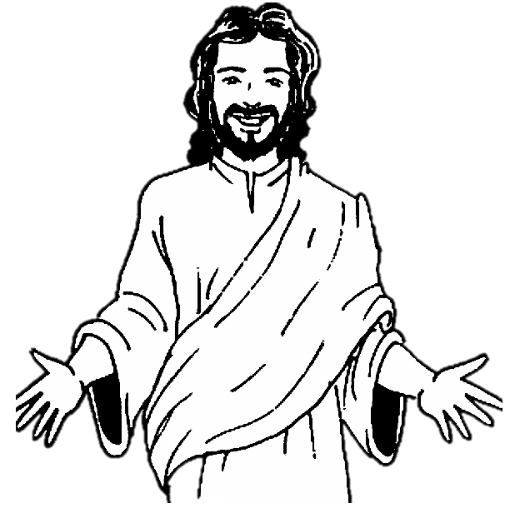
1:15-29
Jesus
Me

Slide 44
1:15-29

