Slide 1

1:1-15
A CD of this message will be available (free of charge) immediately following today’s service.
A podcast will also be available later in the week at calvaryokc.com.

Slide 2


1:1-15
Prison letters:
Philemon
Colossians
Ephesians
Philippians

Slide 3
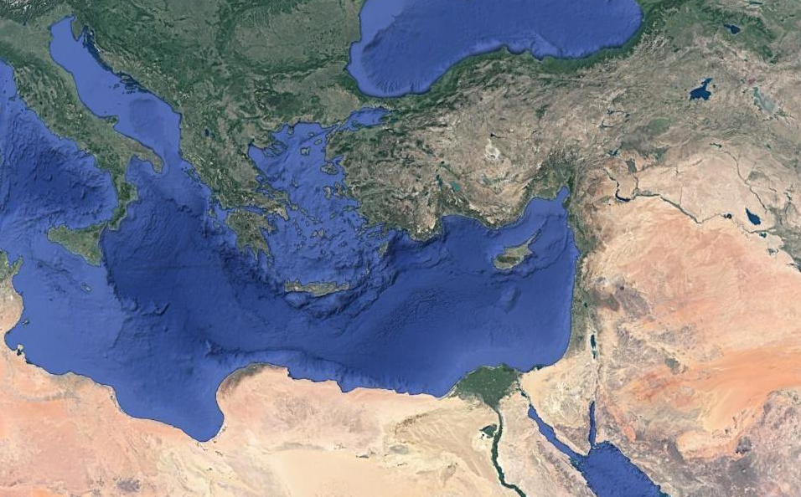
1:1-15
Hierapolis
Laodicea
Colosse

Slide 4
1:1-15
¹ Paul, an apostle of Jesus Christ by the will of God, and Timothy our brother,
² To the saints and faithful brethren in Christ who are in Colosse:
Grace to you and peace from God our Father and the Lord Jesus Christ.
³ We give thanks to the God and Father of our Lord Jesus Christ, praying always for you, ⁴ since we heard of your faith in Christ Jesus and of your love for all the saints; ⁵ because of the hope which is laid up for you in heaven, of which you heard before in the word of the truth of the gospel, ⁶ which has come to you, as it has
Colossians 1:1-15 ~

Slide 5
1:1-15
also in all the world, and is bringing forth fruit, as it is also among you since the day you heard and knew the grace of God in truth; ⁷ as you also learned from Epaphras, our dear fellow servant, who is a faithful minister of Christ on your behalf, ⁸ who also declared to us your love in the Spirit.
⁹ For this reason we also, since the day we heard it, do not cease to pray for you, and to ask that you may be filled with the knowledge of His will in all wisdom and spiritual understanding; ¹⁰ that you may walk worthy of the Lord, fully pleasing Him, being fruitful in every good work and increasing in the knowledge of God;
Colossians 1:1-15 ~

Slide 6
1:1-15
¹¹ strengthened with all might, according to His glorious power, for all patience and longsuffering with joy; ¹² giving thanks to the Father who has qualified us to be partakers of the inheritance of the saints in the light. ¹³ He has delivered us from the power of darkness and conveyed us into the kingdom of the Son of His love, ¹⁴ in whom we have redemption through His blood, the forgiveness of sins.
¹⁵ He is the image of the invisible God, the firstborn over all creation.
Colossians 1:1-15 ~

Slide 7

1:1-15

Slide 8
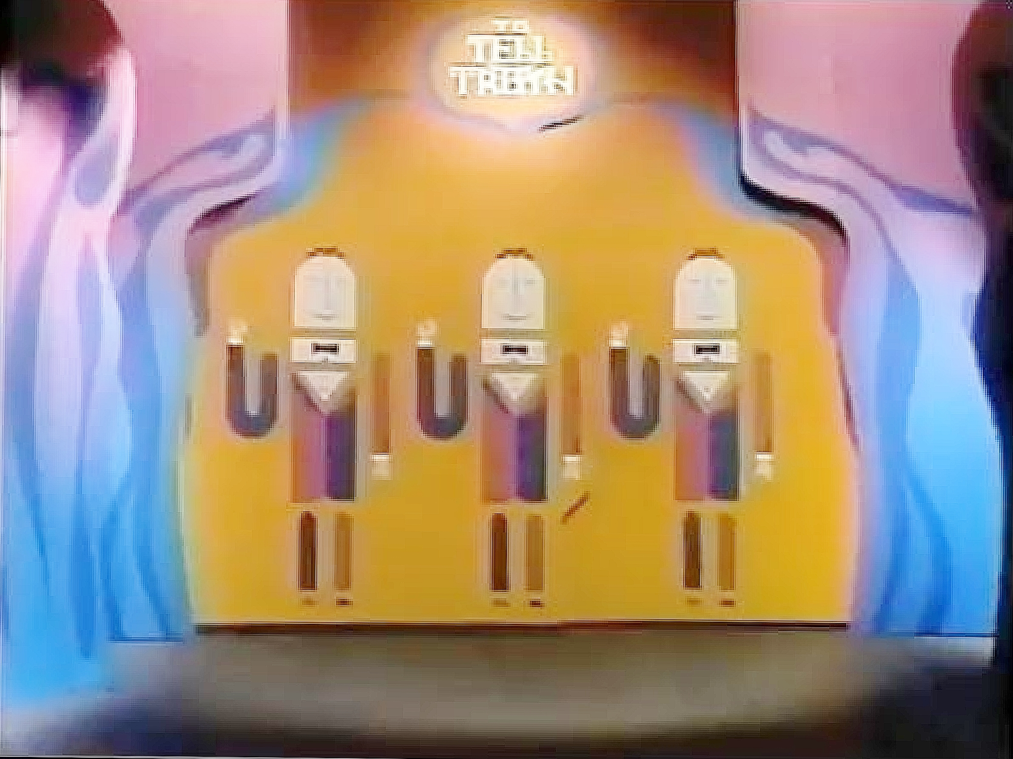
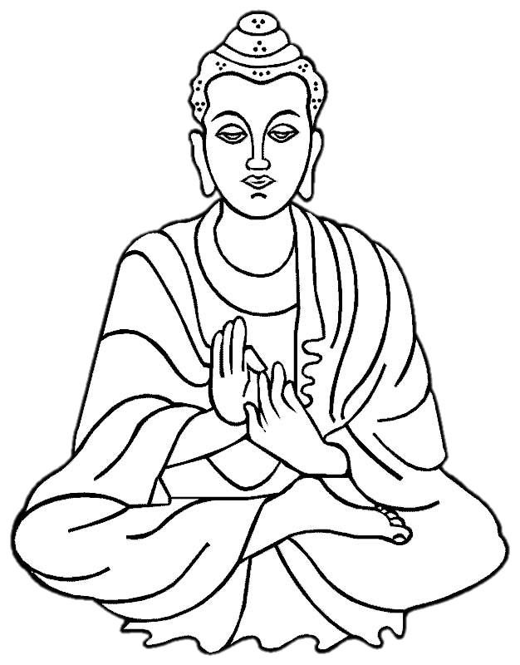
1:1-15
My name is Jesus Christ

Slide 9
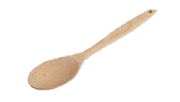

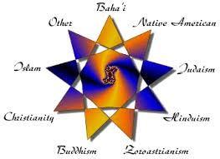
1:1-15
Bah’ai
Bah’ai ~ Amalgamation of Christianity, Buddhism and Islam
Christianity
Buddhism
Islam

Slide 10
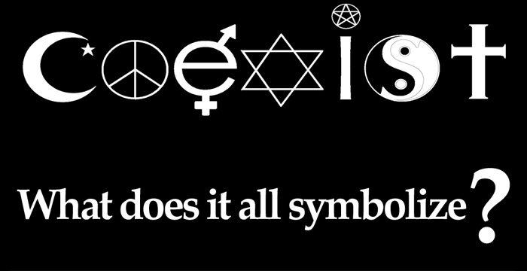
1:1-15
Bah’ai ~ Amalgamation of Christianity, Buddhism and Islam
Coexist ~ Hodge podge of virtually anything that starts with “I believe … ”
Coexist ~ Islam, peace, sexual equality, Wicca, Taoism, Christianity
Coexist

Slide 11

1:1-15
Bah’ai ~ Amalgamation of Christianity, Buddhism and Islam
Coexist ~ Islam, peace, sexual equality, Wicca, Taoism, Christianity
Taoism
Greek
Gnosticism ~ A blending of Taoism, Greek philosophy and Christianity
Gnosticism
philosophy
Christianity

Slide 12
1:1-15

Slide 13
1:1-15
All-powerful
Unnamed Father
All-good

Slide 14
1:1-15
All-powerful
Unnamed Father
All-good
Less
Less
Less
Less

Slide 15
1:1-15
All-powerful
Unnamed Father
All-good
Less Powerful
Less
Less
Less
Less
Less Good
Lesser
Lesser
Lesser
Lesser
Lesser
Lesser

Slide 16
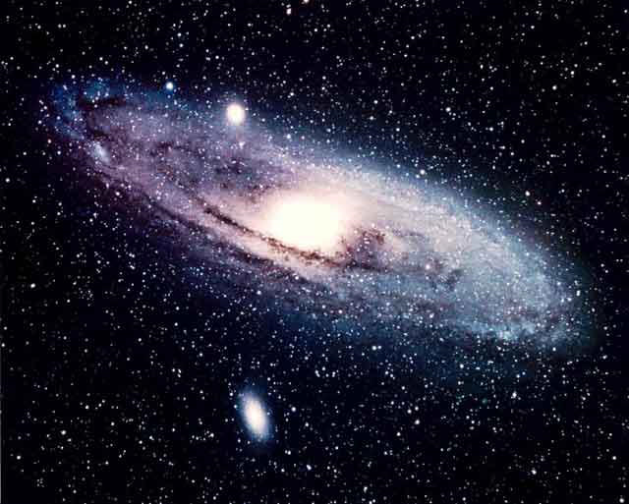
1:1-15
All-powerful
Unnamed Father
All-good
Less Powerful
Less
Less
Less
Less
Less Good
Lesser
Lesser
Lesser
Lesser
Lesser
Lesser
Least
Least
Least
Least
Least
Least
Least
Least
Least
Least
Least
You are here

Slide 17
1:1-15

Slide 18
1:1-15
2 Pet. 2:1 ~ But there were also false prophets among the people, even as there will be false teachers among you, who will secretly bring in destructive heresies, even denying the Lord who bought them, and bring on themselves swift destruction.
heresies ~ haireisis – from haireomai (a personal choice)
Hence, a self-willed opinion

Slide 19
1:1-15

Slide 20
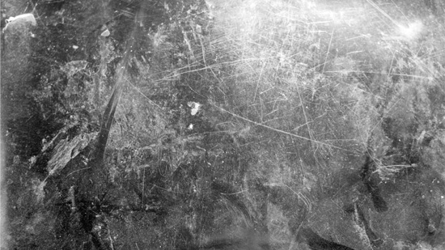
1:1-15
LOVE
FAITH
HOPE
PAST
PRESENT
FUTURE

Slide 21
1:1-15

Slide 22
1:1-15
Dorothy Sayers (1893-1957) ~ “In the world it is called Tolerance, but in hell it is called Despair ... the sin that believes in nothing, cares for nothing, seeks to know nothing, interferes with nothing, enjoys nothing, hates nothing, finds purpose in nothing, lives for nothing, and remains alive because there is nothing for which it will die.”

Slide 23
1:1-15

Slide 24
1:1-15
1) partakers
2) delivered
3) conveyed
4) redeemed
5) forgiven

Slide 25
1:1-15

Slide 26
1:1-15
image ~ eikōn
firstborn ~ prōtotokos
prōtos ~ first
titkō
~ born
Occurs 8x in the New Testament
Merrihew Standard Version ~ Christ makes the invisible God visible; He is before all creation.

Slide 27
1:1-15

Slide 28
1:1-15
Isaac had two sons ~ Esau and Jacob
Esau was born first
Jacob was the firstborn
Joseph had two sons ~ Manasseh and Ephraim
Manasseh was born first
Jacob was the firstborn

Slide 29
1:1-15

