Slide 1
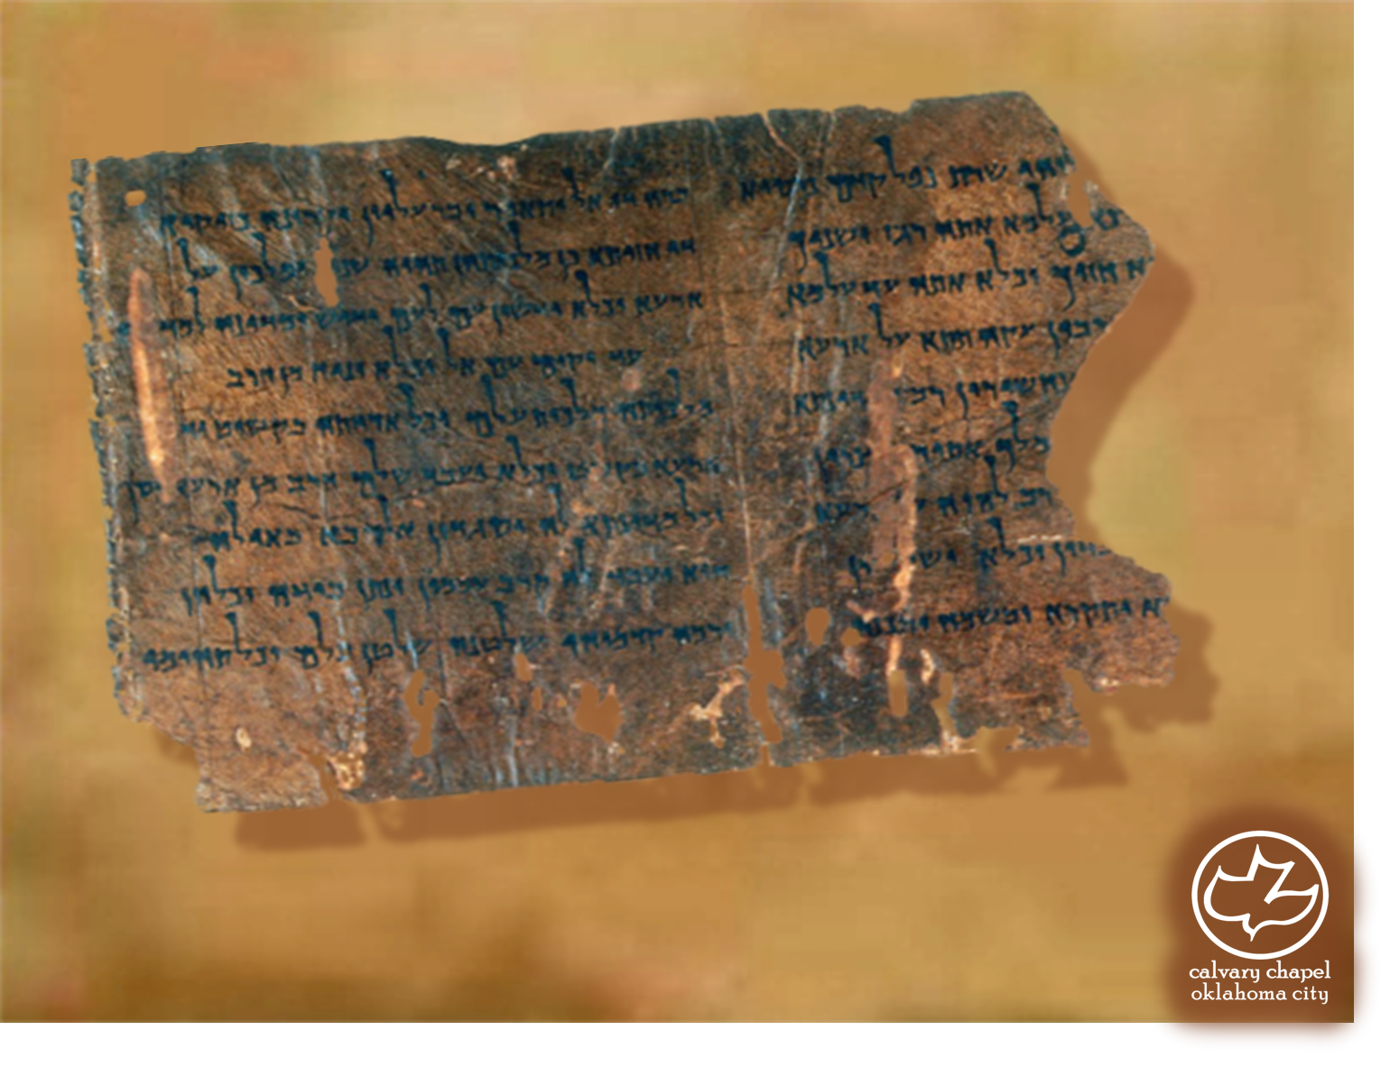

Minor Prophets … Major Message:
Amos 7:1-9:15
A CD of this message will be available (free of charge) immediately following today's message
This message will be available via podcast later this week at calvaryokc.com

Slide 2
Amos 7:1-9:15
Relented ~ nacham - KJV, repented, to be moved by compassion
D. A. Carson ~ “Consequently, it necessarily appears to us that God changes course and this is what the Bible calls his ‘repenting’: the will of God, though inflexible, is not unfeeling but takes loving regard of our weaknesses and foolishnesses in his perfect and sovereign ordering of his world.”

Slide 3
Amos 7:1-9:15
Jude 12, 13 ~ ¹² These are spots in your love feasts, while they feast with you without fear, serving only themselves. They are clouds without water, carried about by the winds; late autumn trees without fruit, twice dead, pulled up by the roots; ¹³ raging waves of the sea, foaming up their own shame; wandering stars for whom is reserved the blackness of darkness forever.

Slide 4
Amos 7:1-9:15
C. H. Spurgeon ~ “Every prophet has a manner and style peculiarly his own. Although God speaketh through them all, yet they lose not their individuality or originality of character. The breath which causes the music is the same, but no two of the instruments give forth precisely the same sound. It is true they all utter the words of God; but each voice has its own special cry, so that though God is pre-eminently seen, yet the man is not lost.”

Slide 5
Amos 7:1-9:15
Spout ~ drop (KJV) or drip - impassioned discourse with saliva running freely from mouth

Slide 6
Amos 7:1-9:15
Summer fruit ~ qayits
End ~ qets

Slide 7
Amos 7:1-9:15
Swallow up ~ literally pant after (implies covetous intent)

Slide 8
Amos 7:1-9:15

Slide 9
Amos 7:1-9:15
Matt. 27:45 ~ Now from the sixth hour until the ninth hour there was darkness over all the land.

Slide 10
Amos 7:1-9:15
Zech. 12:10 ~ And I will pour on the house of David and on the inhabitants of Jerusalem the Spirit of grace and supplication; then they will look on Me whom they pierced. Yes, they will mourn for Him as one mourns for his only son, and grieve for Him as one grieves for a firstborn.

Slide 11
Amos 7:1-9:15
F. B. Meyer ~ “We may question ourselves, whether we feed enough on God’s Word. If we would grow strong, we must feed, not on condiments and sweetmeats, not on tit-bits and scraps, not on versicles and pious sentences; but on the strong meat of the Word, on the doctrines, histories, types of Scripture. Oh for more hunger and thirst for these!”

Slide 12
Amos 7:1-9:15
NLT ~ “Are you Israelites more important to me than the Ethiopians?” asks the LORD.

Slide 13
Amos 7:1-9:15
C. H. Spurgeon ~ “I think I see you, poor believer, tossed about like that wheat, up and down, right and left, in the sieve, and in the air, never resting. Perhaps it is suggested to you, ‘God is very angry with me.’ No, the farmer is not angry with his wheat when he casts it up and down in the sieve, and neither is God angry with you; this you shall see one day when the light shall show that love ruled in all
your griefs.”

