Slide 1
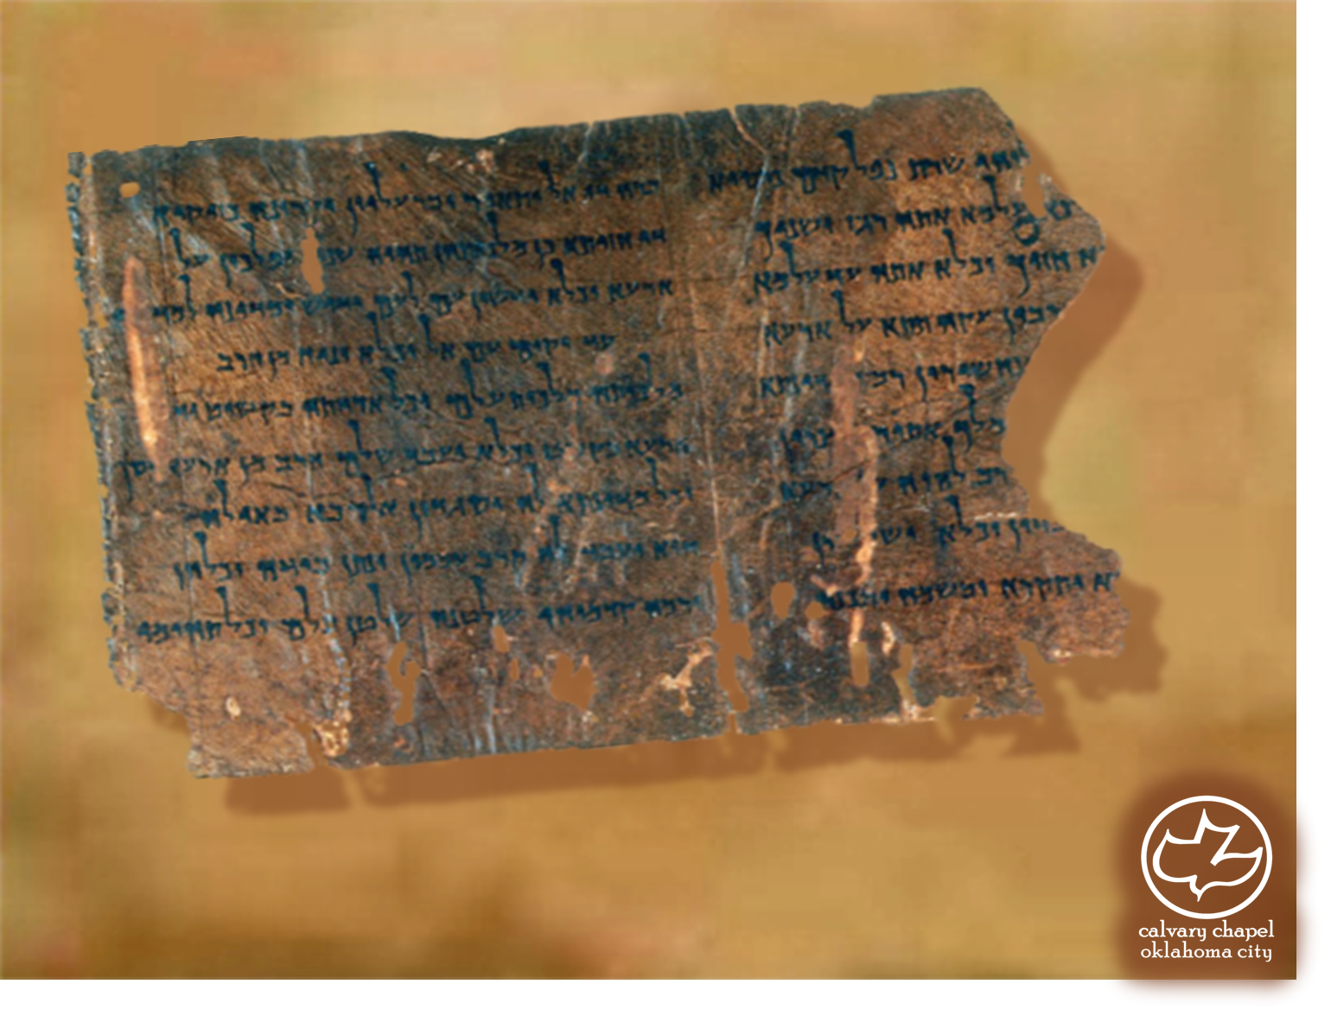

Minor Prophets … Major Message:
Amos 4:1-6:14
A CD of this message will be available (free of charge) immediately following today's message
This message will be available via podcast later this week at calvaryokc.com

Slide 2
Amos 4:1-6:14
Well-known sports figure: “Fame is a vapor, popularity is an accident, and money takes wings. The only thing that endures is character.”

Slide 3
Amos 4:1-6:14
Prov. 22:1 ~ A good name is to be chosen rather than great riches, loving favor rather than silver and gold.
Eccl. 7:1 ~ A good name is better than precious ointment, and the day of death than the day of one's birth;

Slide 4
Amos 4:1-6:14
Thomas Edward McComiskey ~ “These women may not have been directly involved in mistreating the poor. But their incessant demands for luxuries drove their husbands to greater injustices.”

Slide 5
Amos 4:1-6:14
Adam Clarke ~ “The prophet here represents the iniquitous, opulent, idle, lazy drones, whether men or women, under the idea of fatted bullocks, which were shortly to be led out to the slaughter.”

Slide 6
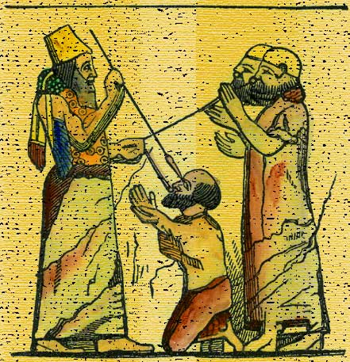
Amos 4:1-6:14

Slide 7
Amos 4:1-6:14
Three days ~ KJV, NIV – three years
Some translators think it should be three years of days
Deut. 14:28 ~ At the end of every third year you shall bring out the tithe of your produce of that year and store it up within your gates.

Slide 8
Amos 4:1-6:14
GOOD – GOD = O
G
O
O
D
Leaven ~ Feast of Pentecost - Lev. 23:17

Slide 9
Amos 4:1-6:14
Bribe ~ kopher, from kaphar, to cover

Slide 10
Amos 4:1-6:14
eyes, v. 22;
and ears, v. 23
Closed nostrils, v. 21;

Slide 11
Amos 4:1-6:14
NIV ~ Shrine (Sikkuth); Pedestal (Chiun)
D. A. Carson ~ “Without the control of the word of God it is not that people will believe nothing but that they will believe anything.”

Slide 12
Amos 4:1-6:14
NLT ~ And when a relative who is responsible to dispose of the dead goes into the house to carry out the bodies, he will ask the last survivor, “Is anyone else with you?” When the person begins to swear, “No, by … , ”he will interrupt and say, “Stop! Don’t even mention the name of the LORD.”

Slide 13
Amos 4:1-6:14
Lo Debar ~ nothing (KJV)
Karnaim ~ horns (KJV)

Slide 14
Amos 4:1-6:14
Well-known sports figure
O. J. Simpson
: “Fame is a vapor, popularity is an accident, and money takes wings. The only thing that endures is character.”

