Slide 1
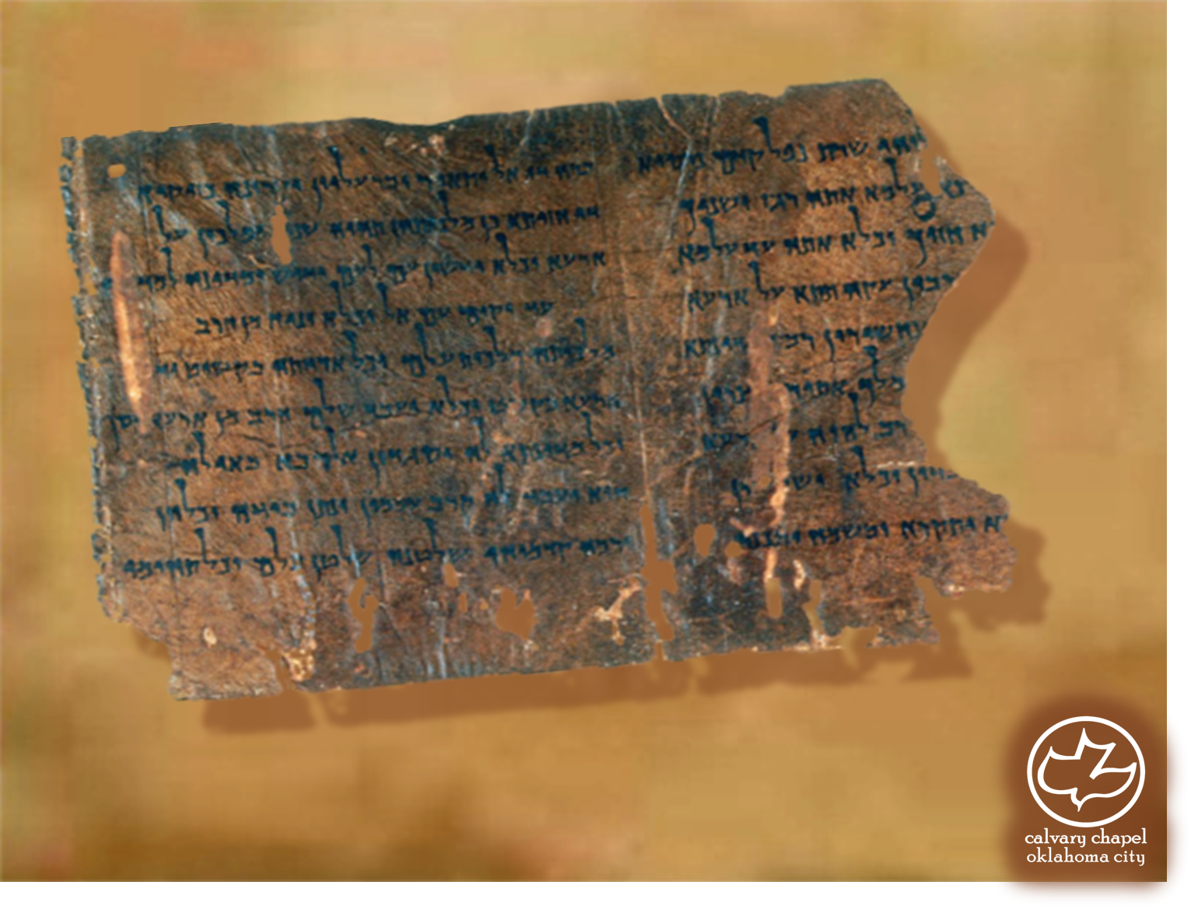

Minor Prophets … Major Message:
Amos 1:1-3:15
A CD of this message will be available (free of charge) immediately following today's message
This message will be available via podcast later this week at calvaryokc.com

Slide 2
Amos 1:1-3:15
Uzziah
790BC
770BC
750BC
730BC
710BC
690BC
Amos
Joel?
Amos ~ burdened

Slide 3
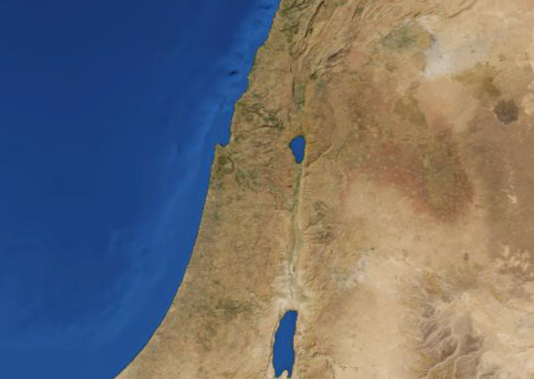
Amos 1:1-3:15
Samaria
Tekoa

Slide 4
Amos 1:1-3:15
Amos 7:14-15 ~ ¹⁴ Then Amos answered, and said to Amaziah: "I was no prophet, Nor was I a son of a prophet, But I was a sheepbreeder And a tender of sycamore fruit. ¹⁵ Then the LORD took me as I followed the flock, And the LORD said to me, ‘Go, prophesy to My people Israel.’

Slide 5
Amos 1:1-3:15
Zech. 14:5 ~ Then you shall flee through My mountain valley, For the mountain valley shall reach to Azal. Yes, you shall flee As you fled from the earthquake In the days of Uzziah king of Judah.

Slide 6
Amos 1:1-3:15
Valley of Aven = Valley of Wickedness, Idolatry or Vanity
Beth Eden = House of pleasure
2 Kg. 16:9 ~ So the king of Assyria heeded him; for the king of Assyria went up against Damascus and took it, carried its people captive to Kir, and killed Rezin.

Slide 7
Amos 1:1-3:15
Rom. 3:1-2 ~ ¹ What advantage then has the Jew, or what is the profit of circumcision? ² Much in every way! Chiefly because to them were committed the oracles of God.

Slide 8
Amos 1:1-3:15
ESV ~ those who trample the head of the poor into the dust of the earth

Slide 9
Amos 1:1-3:15
Deut. 24:12 ~ And if the man is poor, you shall not keep his pledge overnight.

Slide 10
Amos 1:1-3:15
Or as NIV ~ Now then, I will crush you as a cart crushes when loaded with grain.

Slide 11
Amos 1:1-3:15
Calamity ~ KJV, evil – ra’ – not preferable

