Slide 1
A C T S
of the apostles
8:1-17

Slide 2
A C T S
8:1-17
$400 for materials; $400 for crew; $100 for me
FL: $900 –
$300 for materials; $300 for crew; $100 for me
TX: $700 –
$1000 for you; $1000 for me; we hire the guy from Texas
NY: $2700 –

Slide 3
A C T S
8:1-17

Slide 4
A C T S
8:1-17
Acts 1:8 ~ But you shall receive power when the Holy Spirit has come upon you; and you shall be witnesses to Me in Jerusalem, and in all Judea and Samaria, and to the end of the earth.

Slide 5
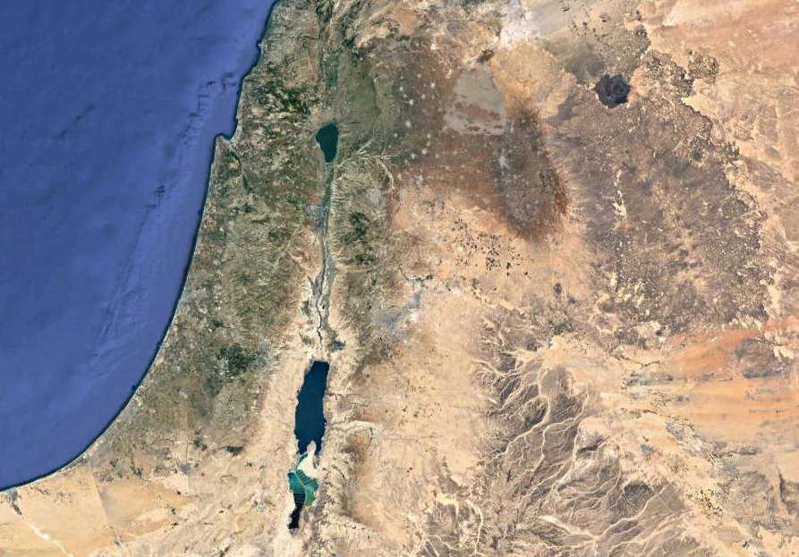
A C T S
8:1-17
Samaria
Jerusalem
Judah

Slide 6
A C T S
8:1-17

Slide 7
A C T S
8:1-17
lamentation ~ over him, not for him

Slide 8
A C T S
8:1-17

Slide 9
A C T S
8:1-17
dragging off ~ KJV, haling

Slide 10
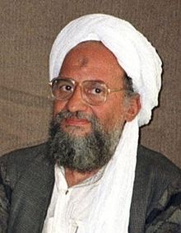
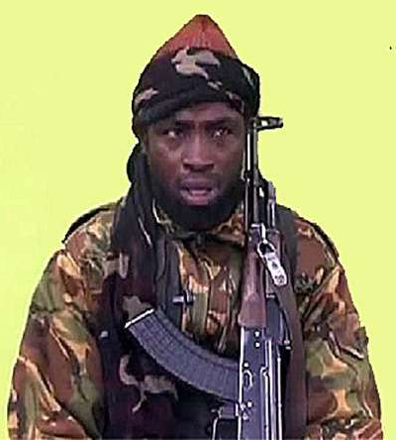
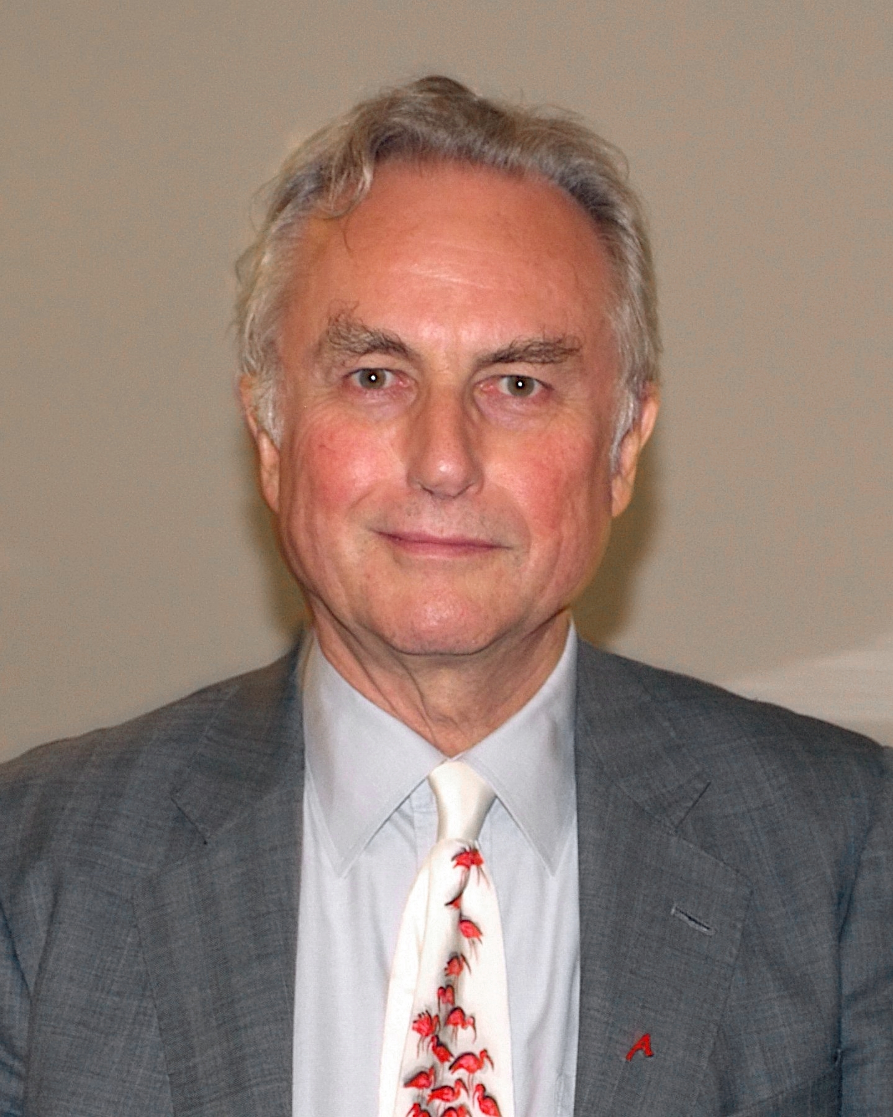
A C T S
8:1-17
Abubakar Shekau
Ayman al-Zawahiri
Ali Khamenei
Saul of Tarsus
(aka, the Apostle Paul)
Richard Dawkins

Slide 11
A C T S
8:1-17

Slide 12
A C T S
8:1-17
sorcery ~ mageuō – magic

Slide 13
A C T S
8:1-17

Slide 14
A C T S
8:1-17
with ~ para (alongside)
John 14:17 – … the Spirit of Truth, whom the world cannot receive, because it neither sees Him nor knows Him; but you know Him, for He dwells with you and will be in you.
en ~ in
John 20:22 – And when He had said this, He breathed on them, and said to them, “Receive the Holy Spirit.”

Slide 15
A C T S
8:1-17
upon ~ epi
Acts 1:8 ~ “But you shall receive power when the Holy Spirit has come upon you; and you shall be witnesses to Me in Jerusalem, and in all Judea and Samaria, and to the end of the earth.”

Slide 16
A C T S
8:1-17

Slide 17
A C T S
8:1-17
Gal. 2:20 ~ I have been crucified with Christ; it is no longer I who live, but Christ lives in me; and the life which I now live in the flesh I live by faith in the Son of God, who loved me and gave Himself for me.

Slide 18
A C T S
8:1-17

Slide 19
A C T S
8:1-17
Rom. 6:11 ~ Likewise you also, reckon yourselves to be dead indeed to sin, but alive to God in Christ Jesus our Lord.

Slide 20
A C T S
8:1-17

Slide 21
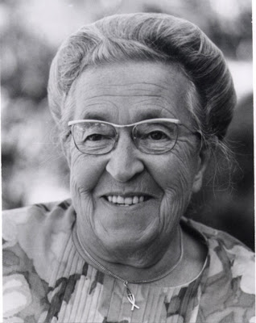
A C T S
8:1-17
Corrie ten Boom (1892-1983) ~ “I have a glove here in my hand. The glove cannot do anything by itself, but when my hand is in it, it can do many things. True, it is not the glove, but my hand in the glove that acts. We are gloves. It is the Holy Spirit in us who is the hand, who does the job. We have to make room for the hand so that every finger is filled.”

Slide 22
A C T S
8:1-17

Slide 23
A C T S
8:1-17
An understanding of the limitless Power that dwells within me to accomplish that desire
An all-consuming desire to have more of Him and less of me
A conscious submitting to that Power
Phil. 1:6 ~ being confident of this very thing, that He who has begun a good work in you will complete it until the day of Jesus Christ …

Slide 24
A C T S
8:1-17

