Slide 1
A C T S
of the apostles
7:1-60

Slide 2
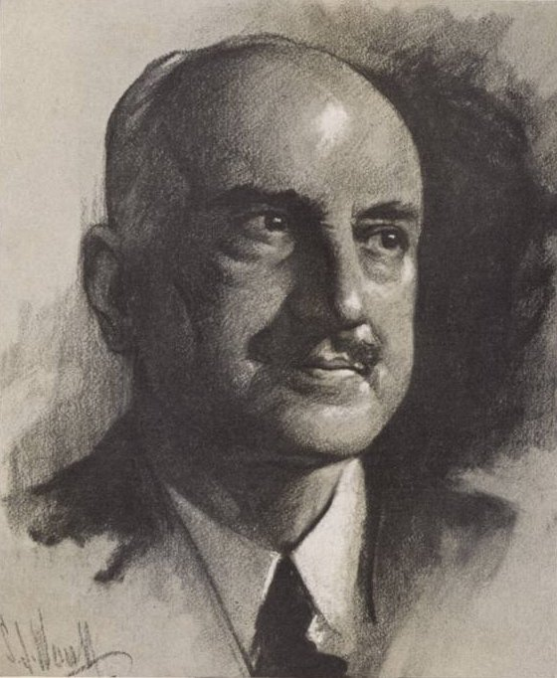
A C T S
7:1-60
George Santayana (1863-1952) ~ “Those who cannot remember the past, are condemned to repeat it.”

Slide 3
A C T S
7:1-60

Slide 4
A C T S
7:1-60
Acts 6:14 ~ They also set up false witnesses who said, “This man does not cease to speak blasphemous words against this holy place and the law;

Slide 5
A C T S
7:1-60

Slide 6
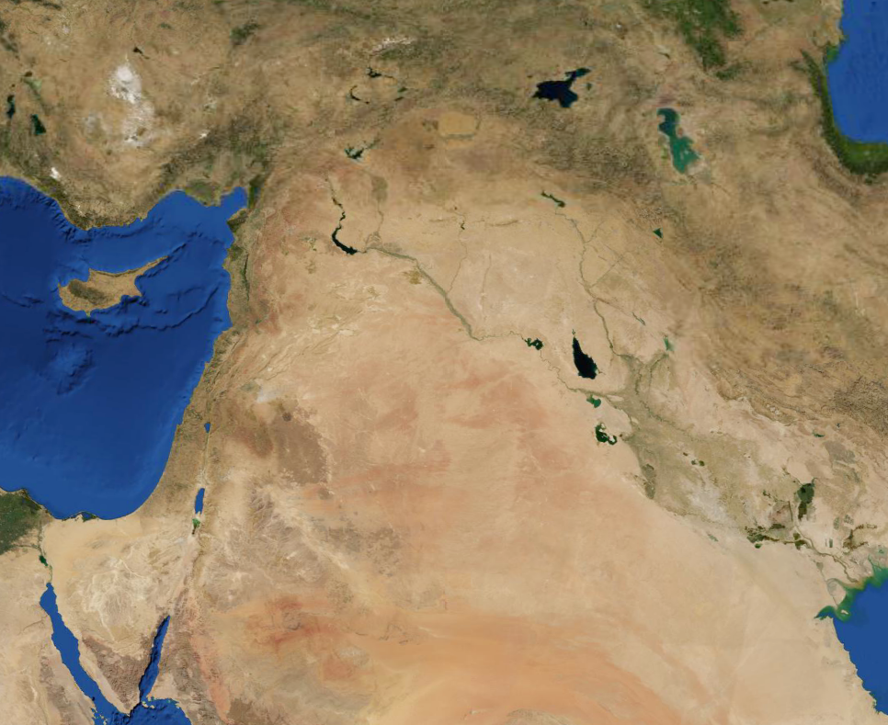
A C T S
7:1-60
Haran
Abraham’s journey to Canaan
Canaan
Ur

Slide 7
A C T S
7:1-60

Slide 8
A C T S
7:1-60
Joseph as a “Type” of Jesus
Stephen: “Just so you don’t miss this, Joseph was not accepted by his brethren the first time.”
1
Beloved by Father
Gen. 37:3
Matt. 3:17
2
Hated by Brethren
Gen. 37:3-4
John 15:25
3
Envied by Brethren
Gen. 37:11
Mark 15:10
4
Price of a Slave
Gen. 37:28
Matt. 26:15
5
Humbled as a Servant
Gen. 39:1ff
Phil. 2:1ff
6
Falsely Accused
Gen. 39:16-18
Matt. 26:59-60
7
Exalted to Honor
Gen. 41:14ff
Phil. 2:9-10
8
Unrecognized 1st Time
Gen. 42:8
Acts 3:17
9
Revealed 2nd Time
Gen. 45:1ff
Acts 7:13
10
Took Gentile Bride
Gen. 41:45
Acts 15:6-18
It took great hardship to open their eyes

Slide 9
A C T S
7:1-60

Slide 10
A C T S
7:1-60
Moses as a “Type” of Jesus
Stephen: “Just so you don’t miss this, Moses was not accepted by his brethren the first time.”
1
Almost Slain as a Child
Exod. 1:22
Matt. 2:13-20
2
Refused the World
Heb. 11:24-26
Matt. 4:8-10
3
Rejected the 1st Time
Exod. 2:11-14
Isa. 53:3
4
Became a Shepherd
Exod. 3:1
John 10
5
Took Gentile Bride
Exod. 2:21
Acts 15:6-18
6
Received 2nd Time
Exod. 4:29-31
Acts 7:5
7
Delivered by Blood of the Lamb
Exod. 12
1 Pet. 2:24
8
Prophet
Deut. 18:15-19
Luke 13:33
9
Priest
Psalm 99:6
Heb. 6:20
10
King
Deut. 33:4-5
1 Tim. 6:15
It took great hardship to open their eyes

Slide 11
A C T S
7:1-60

Slide 12
A C T S
7:1-60
congregation ~ ekklēsia – KJV, church

Slide 13
A C T S
7:1-60

Slide 14
A C T S
7:1-60
Joshua ~ KJV, Jesus – Iēsou

Slide 15
A C T S
7:1-60

Slide 16
A C T S
7:1-60
Luke 12:11-12 – ¹¹ Now when they bring you to the synagogues and magistrates and authorities, do not worry about how or what you should answer, or what you should say. ¹² For the Holy Spirit will teach you in that very hour what you ought to say.

Slide 17
A C T S
7:1-60

Slide 18
A C T S
7:1-60
KJV, gnashed on him …

Slide 19
A C T S
7:1-60

Slide 20
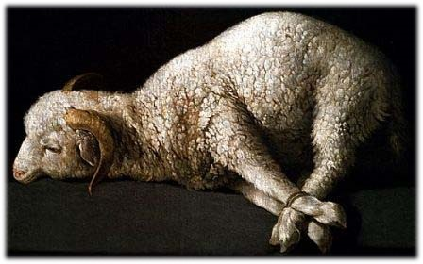
A C T S
7:1-60

Slide 21
A C T S
7:1-60

