Slide 1
A C T S
of the apostles
4:32-5:16

Slide 2
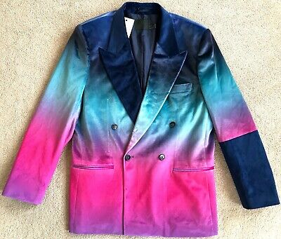
A C T S
4:32-5:16

Slide 3
A C T S
4:32-5:16

Slide 4
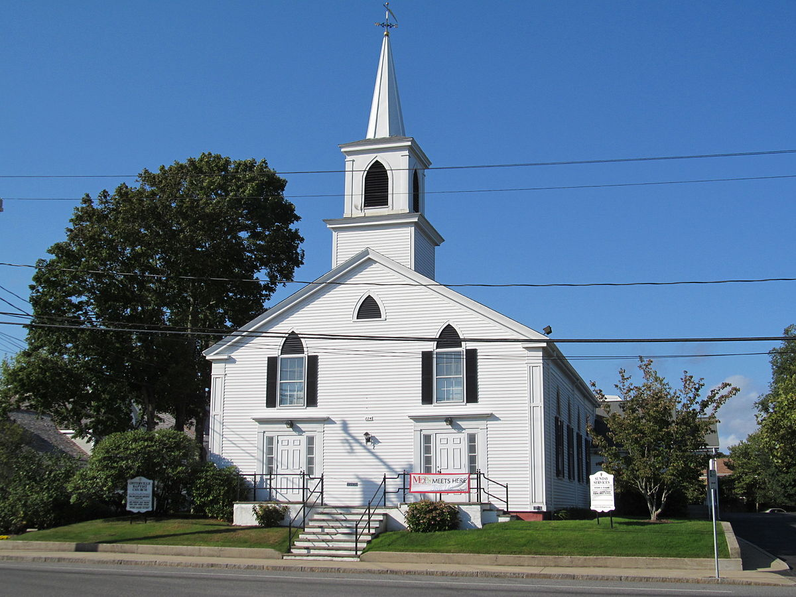
A C T S
4:32-5:16
Mi
stuff es su stuff
My
cosas is your cosas
Ye olde early church

Slide 5
A C T S
4:32-5:16

Slide 6
A C T S
4:32-5:16
From nonprofitsource.com
Only 5% tithe, and 80% of Americans only give 2% of their income.
Christians are giving at a rate of 2.5% of income;
During the Great Depression it was 3.3%.
The average giving by adults who attend US Protestant churches is about $17 a week.
37% of regular church attendees and Evangelicals don’t give money to church.

Slide 7
A C T S
4:32-5:16
Gal. 6:1 ~ Brethren, if a man is overtaken in any trespass, you who are spiritual restore such a one in a spirit of gentleness, considering yourself lest you also be tempted.

Slide 8
A C T S
4:32-5:16

Slide 9
A C T S
4:32-5:16
Barnabas ~ of Aramaic origin
bar ~ son or son of
nebiy ~ prophet

Slide 10
A C T S
4:32-5:16

Slide 11
A C T S
4:32-5:16
Did they sell it for $1000 and give $100?
Did they sell it for $1000 and give $900?
Rom. 12:3 ~ For I say, through the grace given to me, to everyone who is among you, not to think of himself more highly than he ought to think, but to think soberly, as God has dealt to each one a measure of faith.

Slide 12
A C T S
4:32-5:16

Slide 13
A C T S
4:32-5:16
Acts 4:8a ~ Then Peter, filled with the Holy Spirit, said to them …

Slide 14
A C T S
4:32-5:16

Slide 15
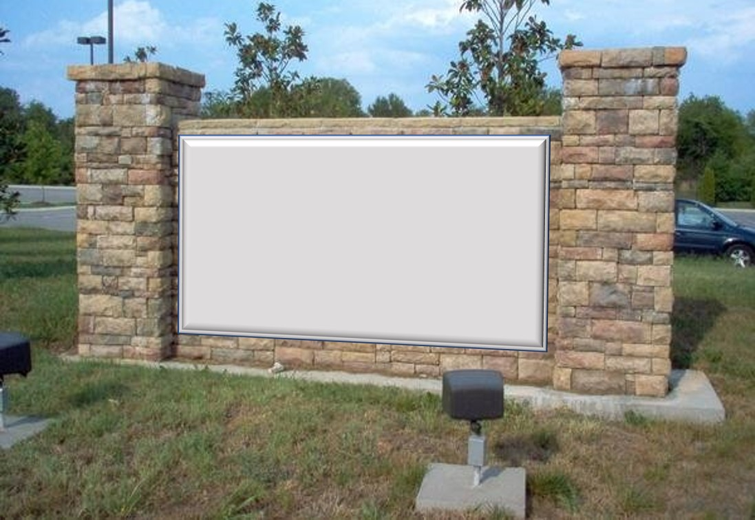
A C T S
4:32-5:16
The Fundamental,
Bible-believing, Spirit-filled, Pre-tribulation, NKJV only
First Church of Jerusalem
8:30
Sundays: ; 10:00; am
11:30

Slide 16
A C T S
4:32-5:16

Slide 17
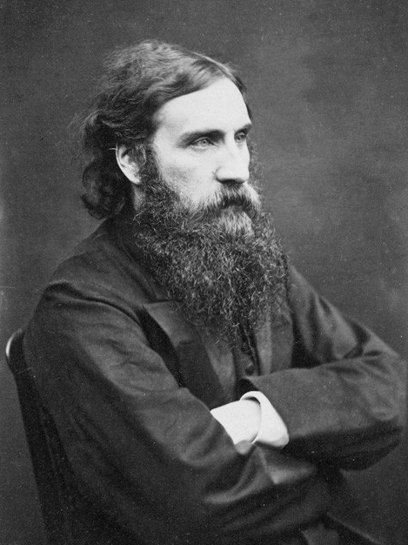
A C T S
4:32-5:16
George MacDonald (1824-1905) ~ “Half of the misery in the world comes from trying to look, instead of trying to be, what one is not.”

Slide 18
A C T S
4:32-5:16

Slide 19
A C T S
4:32-5:16
great grace (4:33)
great power (4:33)
great fear (5:11)

Slide 20
A C T S
4:32-5:16

Slide 21
A C T S
4:32-5:16
Solomon’s Porch

Slide 22
A C T S
4:32-5:16

Slide 23
A C T S
4:32-5:16
1 Pet. 1:3 ~ Blessed be the God and Father of our Lord Jesus Christ, who according to His abundant mercy has begotten us again to a living hope through the resurrection of Jesus Christ from the dead…
Rom. 5:2 ~ through whom also we have access by faith into this grace in which we stand, and rejoice in hope of the glory of God.

Slide 24
A C T S
4:32-5:16
Rom. 12:12 ~ Rejoicing in hope, patient in tribulation, continuing steadfastly in prayer;
1 John 3:3 ~ And every man who has this hope in Him purifies himself, just as he is pure.

Slide 25
A C T S
4:32-5:16

