Slide 1
A C T S
of the apostles
4:1-31

Slide 2
A C T S
4:1-31

Slide 3
A C T S
4:1-31

Slide 4
A C T S
4:1-31
Heb. 12:1b ~ let us lay aside every weight, and the sin which so easily ensnares us, and let us run with endurance the race that is set before us,

Slide 5
A C T S
4:1-31

Slide 6
A C T S
4:1-31
Deut. 13:1-3 ~ ¹ If there arises among you a prophet or a dreamer of dreams, and he gives you a sign or a wonder, ² and the sign or the wonder comes to pass, of which he spoke to you, saying, “Let us go after other gods” – which you have not known – “and let us serve them,” ³ you shall not listen to the words of that prophet or that dreamer of dreams, for the Lord your God is testing you to know whether you love the Lord your God with all your heart and with all your soul.

Slide 7
A C T S
4:1-31

Slide 8
A C T S
4:1-31
Eph. 5:18 ~ And do not be drunk with wine, in which is dissipation; but be filled with the Spirit,
present tense, passive voice, imperative mood
present tense in Greek means the action is continuous (+ing)
passive voice in Greek means the subject receives the action of the verb
imperative voice in Greek means the subject is commanded to perform the action

Slide 9
A C T S
4:1-31

Slide 10
A C T S
4:1-31
GOD
Watchtower
Baha’i
Depart from Me, I never knew you
Taoism
Neo-paganism
New Age
Shintoism
Confucianism
Wicca
Mormonism
Hinduism
Rama dama ding dong
The unknown god
Animism
Buddhism
Jesus

Slide 11
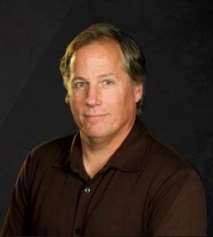
A C T S
4:1-31
David Guzik ~ “If there are many roads to God, then Jesus is not one of them … because He said there aren’t many roads to Him.”
John 14:6 ~ Jesus said to him, “I am the way, the truth, and the life. No one comes to the Father except through Me.”

Slide 12
A C T S
4:1-31

Slide 13
A C T S
4:1-31
uneducated ~ agrammatos – literally, unlettered
uneducated ~ idiōtēs – literally, a commoner
Charles Spurgeon (1834-1892) ~
the “Prince of Preachers”
G. Campbell Morgan (1865-1945) ~
“rejected on earth, accepted in heaven”
D. L. Moody (1837-1899) ~
former shoe salesman
Billy Sunday (1862-1935) ~
former professional baseball player
A. W. Tozer (1897-1963) ~
one of the greatest
authors of the 20th century

Slide 14
A C T S
4:1-31

Slide 15
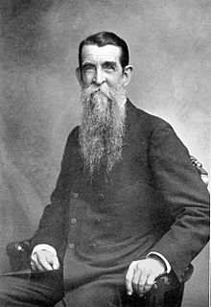
A C T S
4:1-31
Henry Clay Trumbull (1830-1903) ~ “Conscience is not given to a man to instruct him in the right, but to prompt him to choose the right instead of the wrong when he is instructed as to what is right. It tells a man that he ought to do right, but does not tell him what is right. And if a man has made up his mind that a certain wrong course is the right one, the more he follows his conscience the more hopeless he is as a wrongdoer. One is pretty far gone in an evil way when he serves the devil conscientiously.”

Slide 16
A C T S
4:1-31

Slide 17
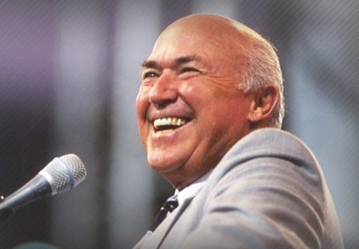
A C T S
4:1-31
Chuck Smith (1927-2013) ~ “If after I die, someone tries to erect a building with my name on it, I pray right now that God would send an earthquake.”

Slide 18
A C T S
4:1-31

Slide 19
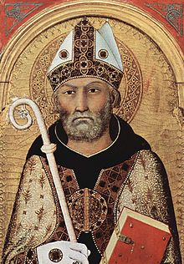
A C T S
4:1-31
St. Augustine (AD 354-430) ~ “Pray as though everything depended on God, and work as though everything depended on you.”

Slide 20
A C T S
4:1-31

