Slide 1
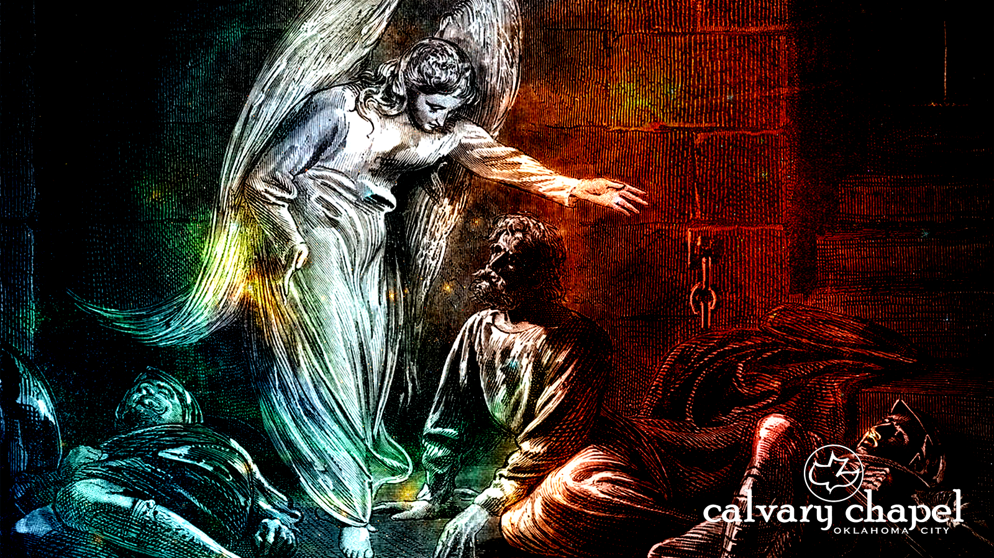
A C T S
of the apostles
3:1-26

Slide 2
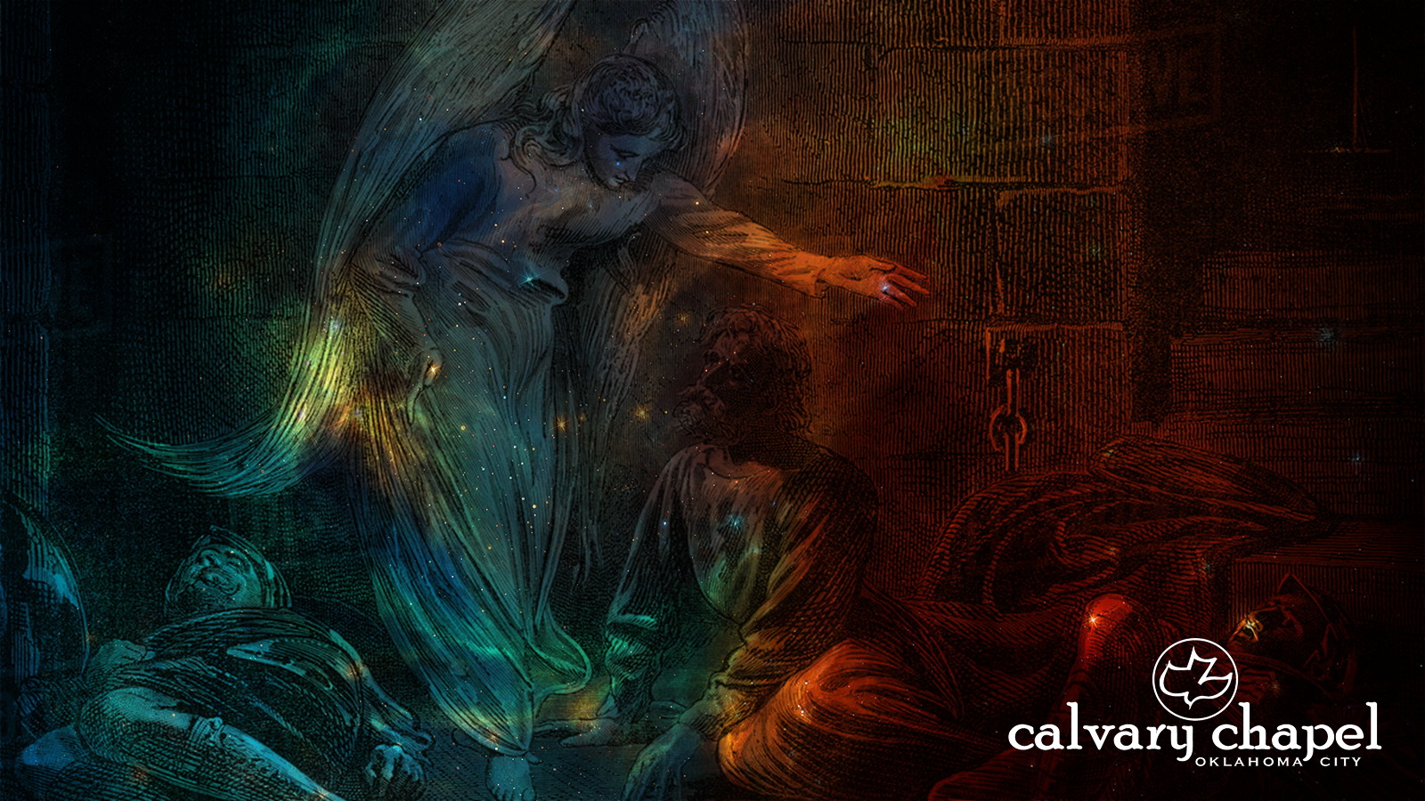

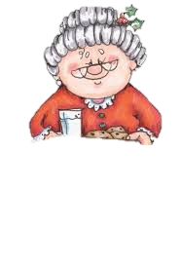
A C T S
3:1-26
Mildred! Do
you know we just ran through three red lights in a row! You could have killed us!
I must be
losing it; I could have sworn we just went through a red light.
Oh.
Am I driving?

Slide 3
A C T S
3:1-26

Slide 4
A C T S
3:1-26
ninth hour ~ 3 p.m.

Slide 5
A C T S
3:1-26

Slide 6
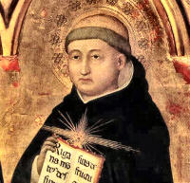
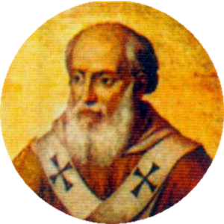
A C T S
3:1-26
True, holy father,
neither can she any longer say to the lame, ‘Rise up and walk.’
You see, the
Church is no longer in that age in which she said, ‘Silver and gold have I none.’
Thomas Aquinas
Pope Innocent IV

Slide 7
A C T S
3:1-26

Slide 8

A C T S
3:1-26
Or the same?
Will it be different now?

Slide 9
A C T S
3:1-26

Slide 10
A C T S
3:1-26
feet ~ basis
ankle ~ sphuron (sphere)

Slide 11
A C T S
3:1-26

Slide 12
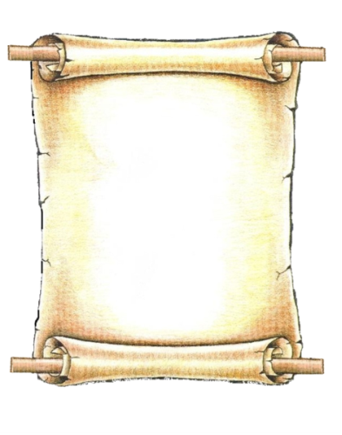

A C T S
3:1-26
Apostle Peter’s Healing Seminars, Inc.
8-week course
stpete@aphsi.com
Your miracle awaits you!
us on FaceBook

Slide 13
A C T S
3:1-26

Slide 14
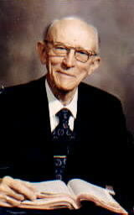
A C T S
3:1-26
Vance Havner (1901-1986) ~ “Never before has the church had so many degrees …
yet so little temperature.”

Slide 15
A C T S
3:1-26

Slide 16
A C T S
3:1-26
Prince ~ archēgos – Author (NIV)
Heb. 12:2a ~ looking unto Jesus, the author and finisher of our faith …

Slide 17
A C T S
3:1-26

Slide 18
A C T S
3:1-26
Remorse: I feel bad but it’s my weakness
Regret: I feel bad because I got caught
Resolve: I feel bad and I'll try harder
Repent: I change my mind, irrespective of how I feel

Slide 19
A C T S
3:1-26

