Slide 1
A C T S
of the apostles
2:22-47

Slide 2
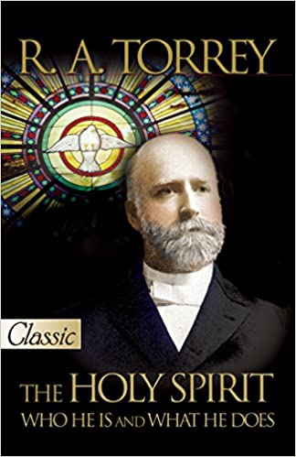
A C T S
2:22-47
OK …
The Holy Spirit has arrived.

Slide 3
A C T S
2:22-47

Slide 4
A C T S
2:22-47
Well-intentioned husband
“Maybe it needs a new spark plug”
Vacuum cleaner

Slide 5
A C T S
2:22-47

Slide 6
A C T S
2:22-47
38 miracles recorded in the 4 Gospels
Josephus (AD 37- c. 100), Antiquities, 18:3:63,
64 ~ “Now, there was about this time Jesus, a
Wise man, if it be lawful to call him a man,
for he was a doer of wonderful works — a
teacher of such men as receive the truth with
pleasure.
He drew over to him both many of the Jews, and
many of the Gentiles. He was the Christ; and when Pilate, at the suggestion of the principal men amongst us,
This Photo by Unknown Author is licensed under CC BY-SA

Slide 7
A C T S
2:22-47
38 miracles recorded in the 4 Gospels
Josephus (AD 37- c. 100), Antiquities, 18:3:63,
64 ~ had condemned him to the cross, those
that loved him at the first did not forsake
him, for he appeared to them alive again the
third day, as the divine prophets had foretold
these and ten thousand other wonderful things
concerning him; and the tribe of Christians, so
named from him, are not extinct at this day.”
This Photo by Unknown Author is licensed under CC BY-SA

Slide 8
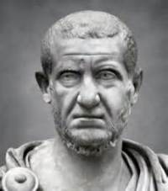
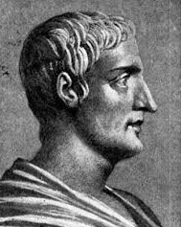
A C T S
2:22-47
38 miracles recorded in the 4 Gospels
Roman historians record the total eclipse and earthquake at the time of the crucifixion (during a full moon)
Phlegon of Tralles
Talmud: Jesus was guilty of “sorcery”
Thallus
This Photo by Unknown Author is licensed under CC BY-SA

Slide 9
A C T S
2:22-47

Slide 10
A C T S
2:22-47
foreknowledge ~ prognōsis

Slide 11
A C T S
2:22-47

Slide 12
A C T S
2:22-47
pains ~ ōdin – birth pangs
Only used here and in passages describing the birth pangs of the end times (Matt. 24:8, Mark 13:8; 1 Thess. 5:3)

Slide 13
A C T S
2:22-47

Slide 14
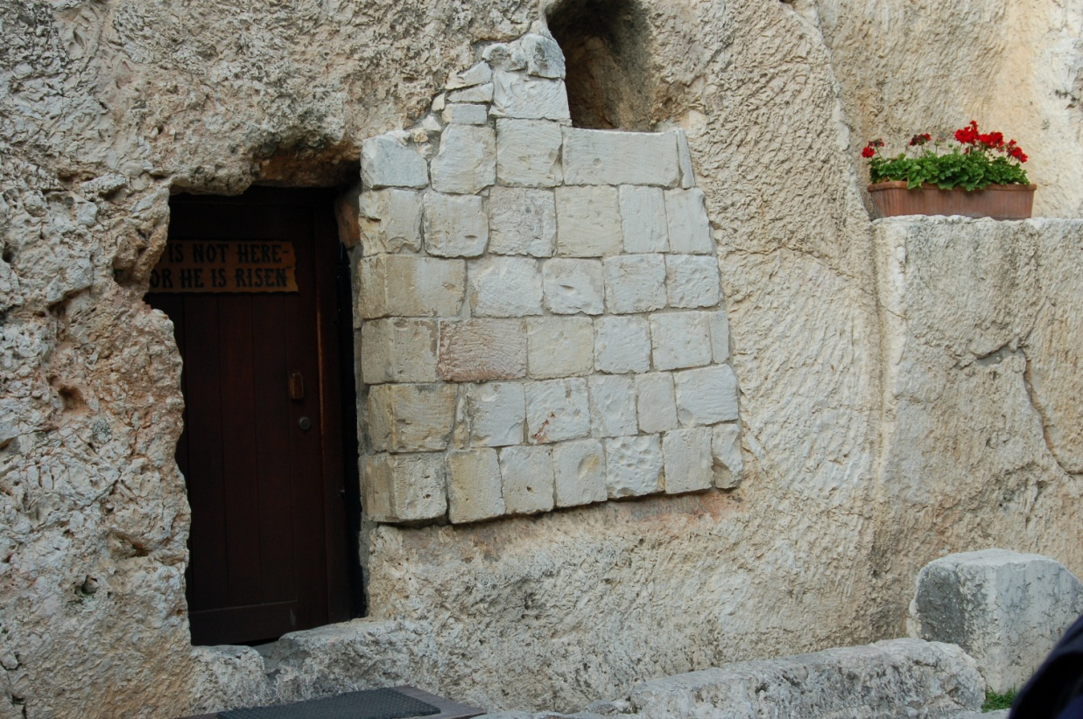
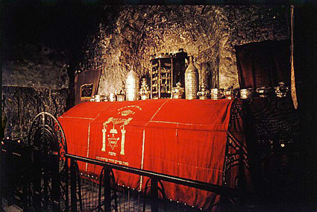
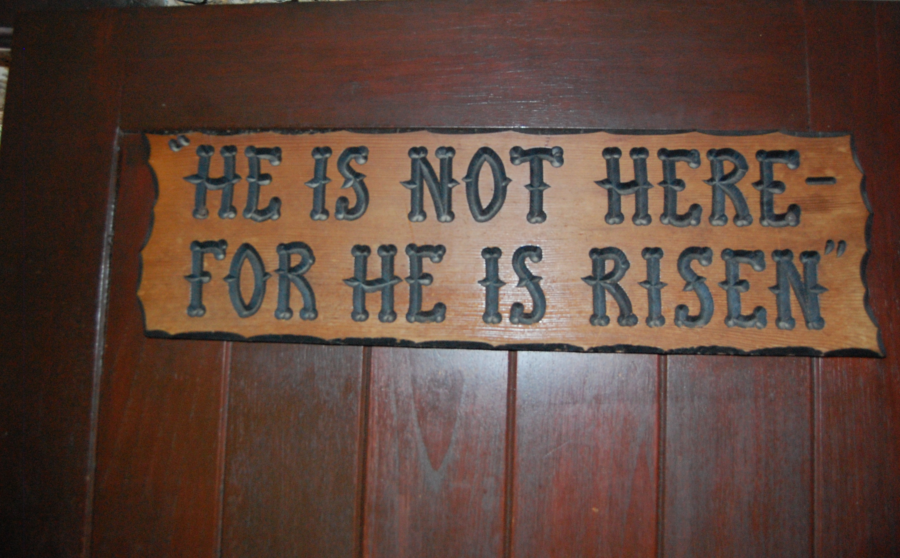
A C T S
2:22-47

Slide 15
A C T S
2:22-47

Slide 16
A C T S
2:22-47
cut ~ katanussō – to pierce thoroughly, i.e. (figuratively) to agitate violently
softening or
hardening
rebellion
contrition or

Slide 17
A C T S
2:22-47

Slide 18
A C T S
2:22-47
repent ~ metanoia – a change of mind
“1st word of the Gospel”
Matt. 3:2 ~ “Repent, for the kingdom of heaven is at hand!” (John the Baptist)
Matt. 4:17 ~ “Repent, for the kingdom of heaven is at hand.” (Jesus)
Acts. 2:38 ~ “Repent …” (Peter)
J. Edwin Orr (1912-1987)

Slide 19
A C T S
2:22-47
for ~ either with a view towards or because of
“I reached for a couple of extra cookies.” (with a view towards)
“He jumped for joy.” (because of)

Slide 20
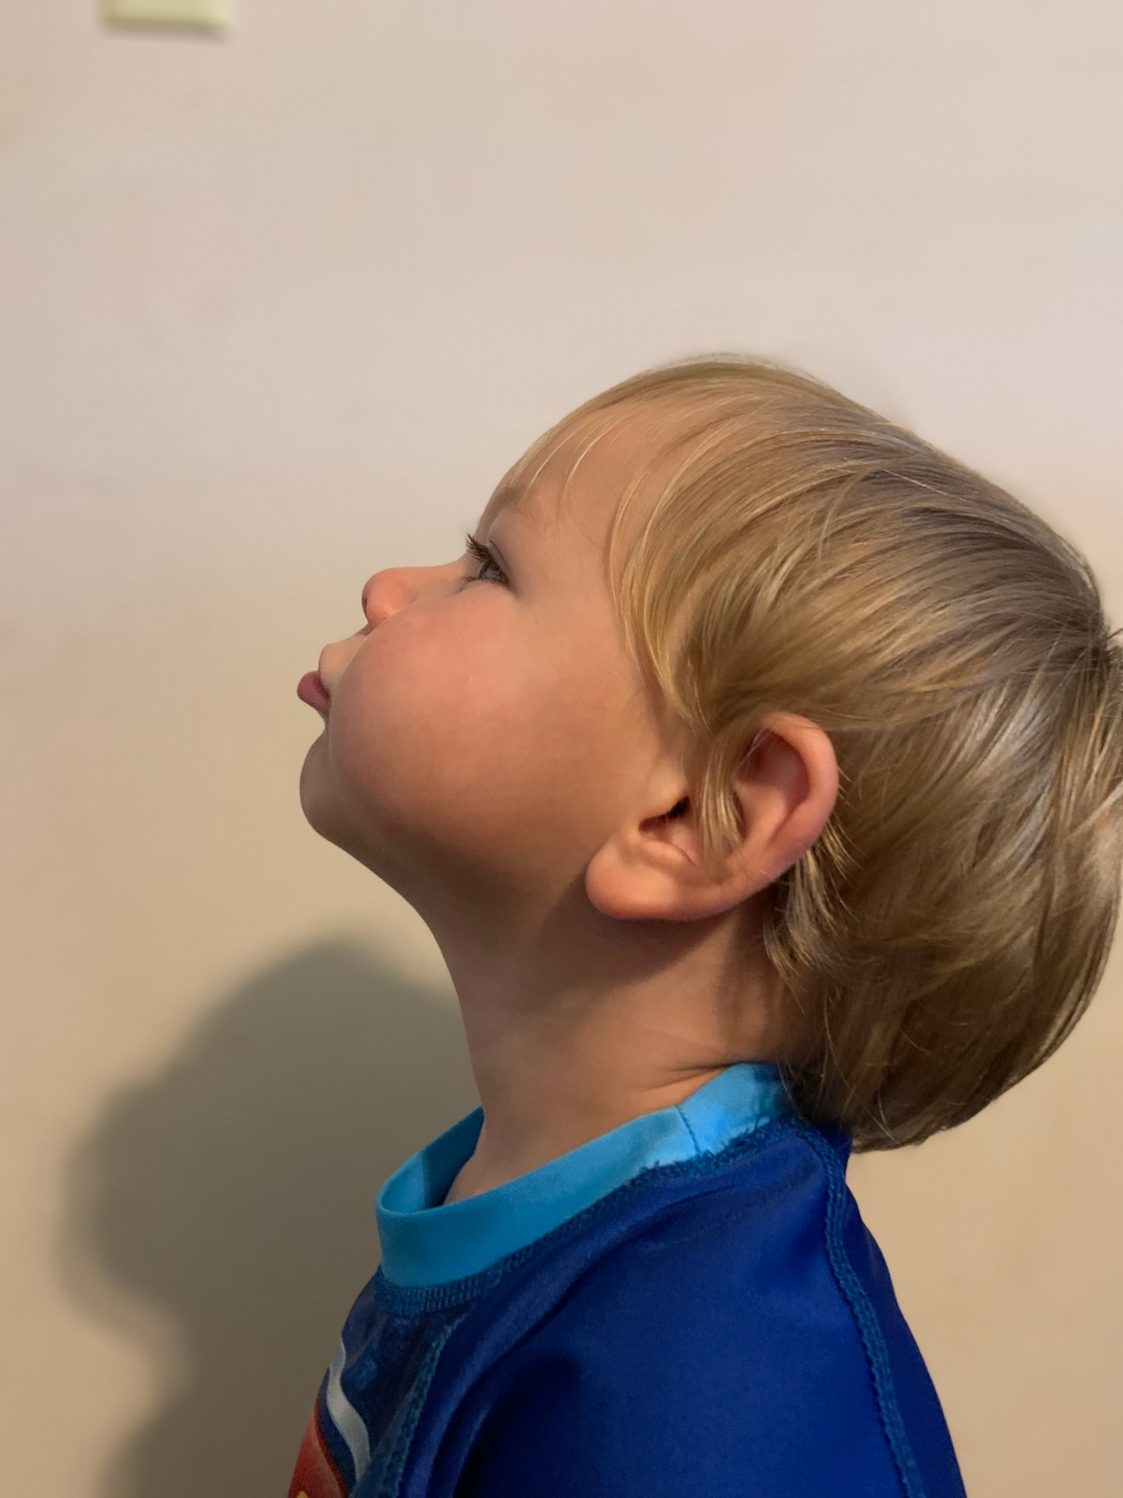
A C T S
2:22-47
Have you seen this varmint?
Street name
“Harley”
Presumed dangerous …
If seen, hold out your hands and get ready for a hard, overhead spike
OCPD - 752020
dob 051320
OCPD – 752020
dob 051320

Slide 21
A C T S
2:22-47
Wanted
Wanted with a “view towards” serving the volleyball out of bounds
or …
Wanted “because of” serving
the volleyball out of bounds
For
Serving the volleyball
out of bounds
Harley
WANTED VERY MUCH ALIVE
aka ~ Spike, Beach Digger, Deep Set, the Penetrator
Last known gang: the Wolfpack

Slide 22
A C T S
2:22-47

Slide 23
A C T S
2:22-47
perverse ~ skolios – to have a warped or twisted leg
KJV ~ untoward

Slide 24
A C T S
2:22-47

Slide 25
A C T S
2:22-47
3-fold rule of thumb for sound doctrine:
1. Taught by Jesus
2. Practiced in the book of Acts
3. Expounded on in the Epistles

Slide 26
A C T S
2:22-47
fellowship ~ koinonia
Communion, participation and fellowship
breaking of bread
Lord’s Supper or communal meals

Slide 27
A C T S
2:22-47

Slide 28
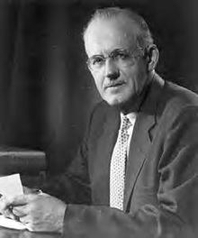
A C T S
2:22-47
A. W. Tozer (1897-1963) ~ “It seems to
me a significant, if not a positively ominous, thing that the words “program” and “programming” occur so frequently in the language of the church these days.”

Slide 29
A C T S
2:22-47
I do all
my shopping at Trader Joe’s cuz I believe my body is a “temple,”
Man
•

Slide 30
A C T S
2:22-47

Slide 31
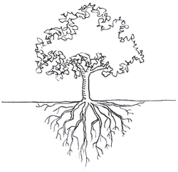
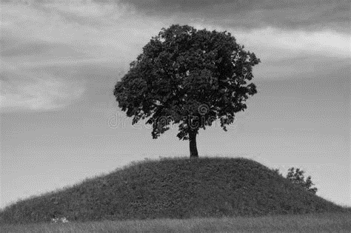
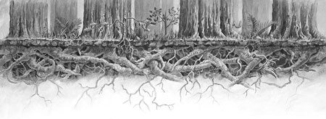
A C T S
2:22-47
•

Slide 32
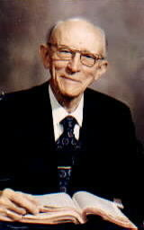
A C T S
2:22-47
Vance Havner (1901-1986) ~ “We will move this world not by criticism of it, not by conformity to it – but by combustion within it of lives ignited by the Spirit of God.”

Slide 33
A C T S
2:22-47

