Slide 1
A C T S
of the apostles
2:1-21

Slide 2
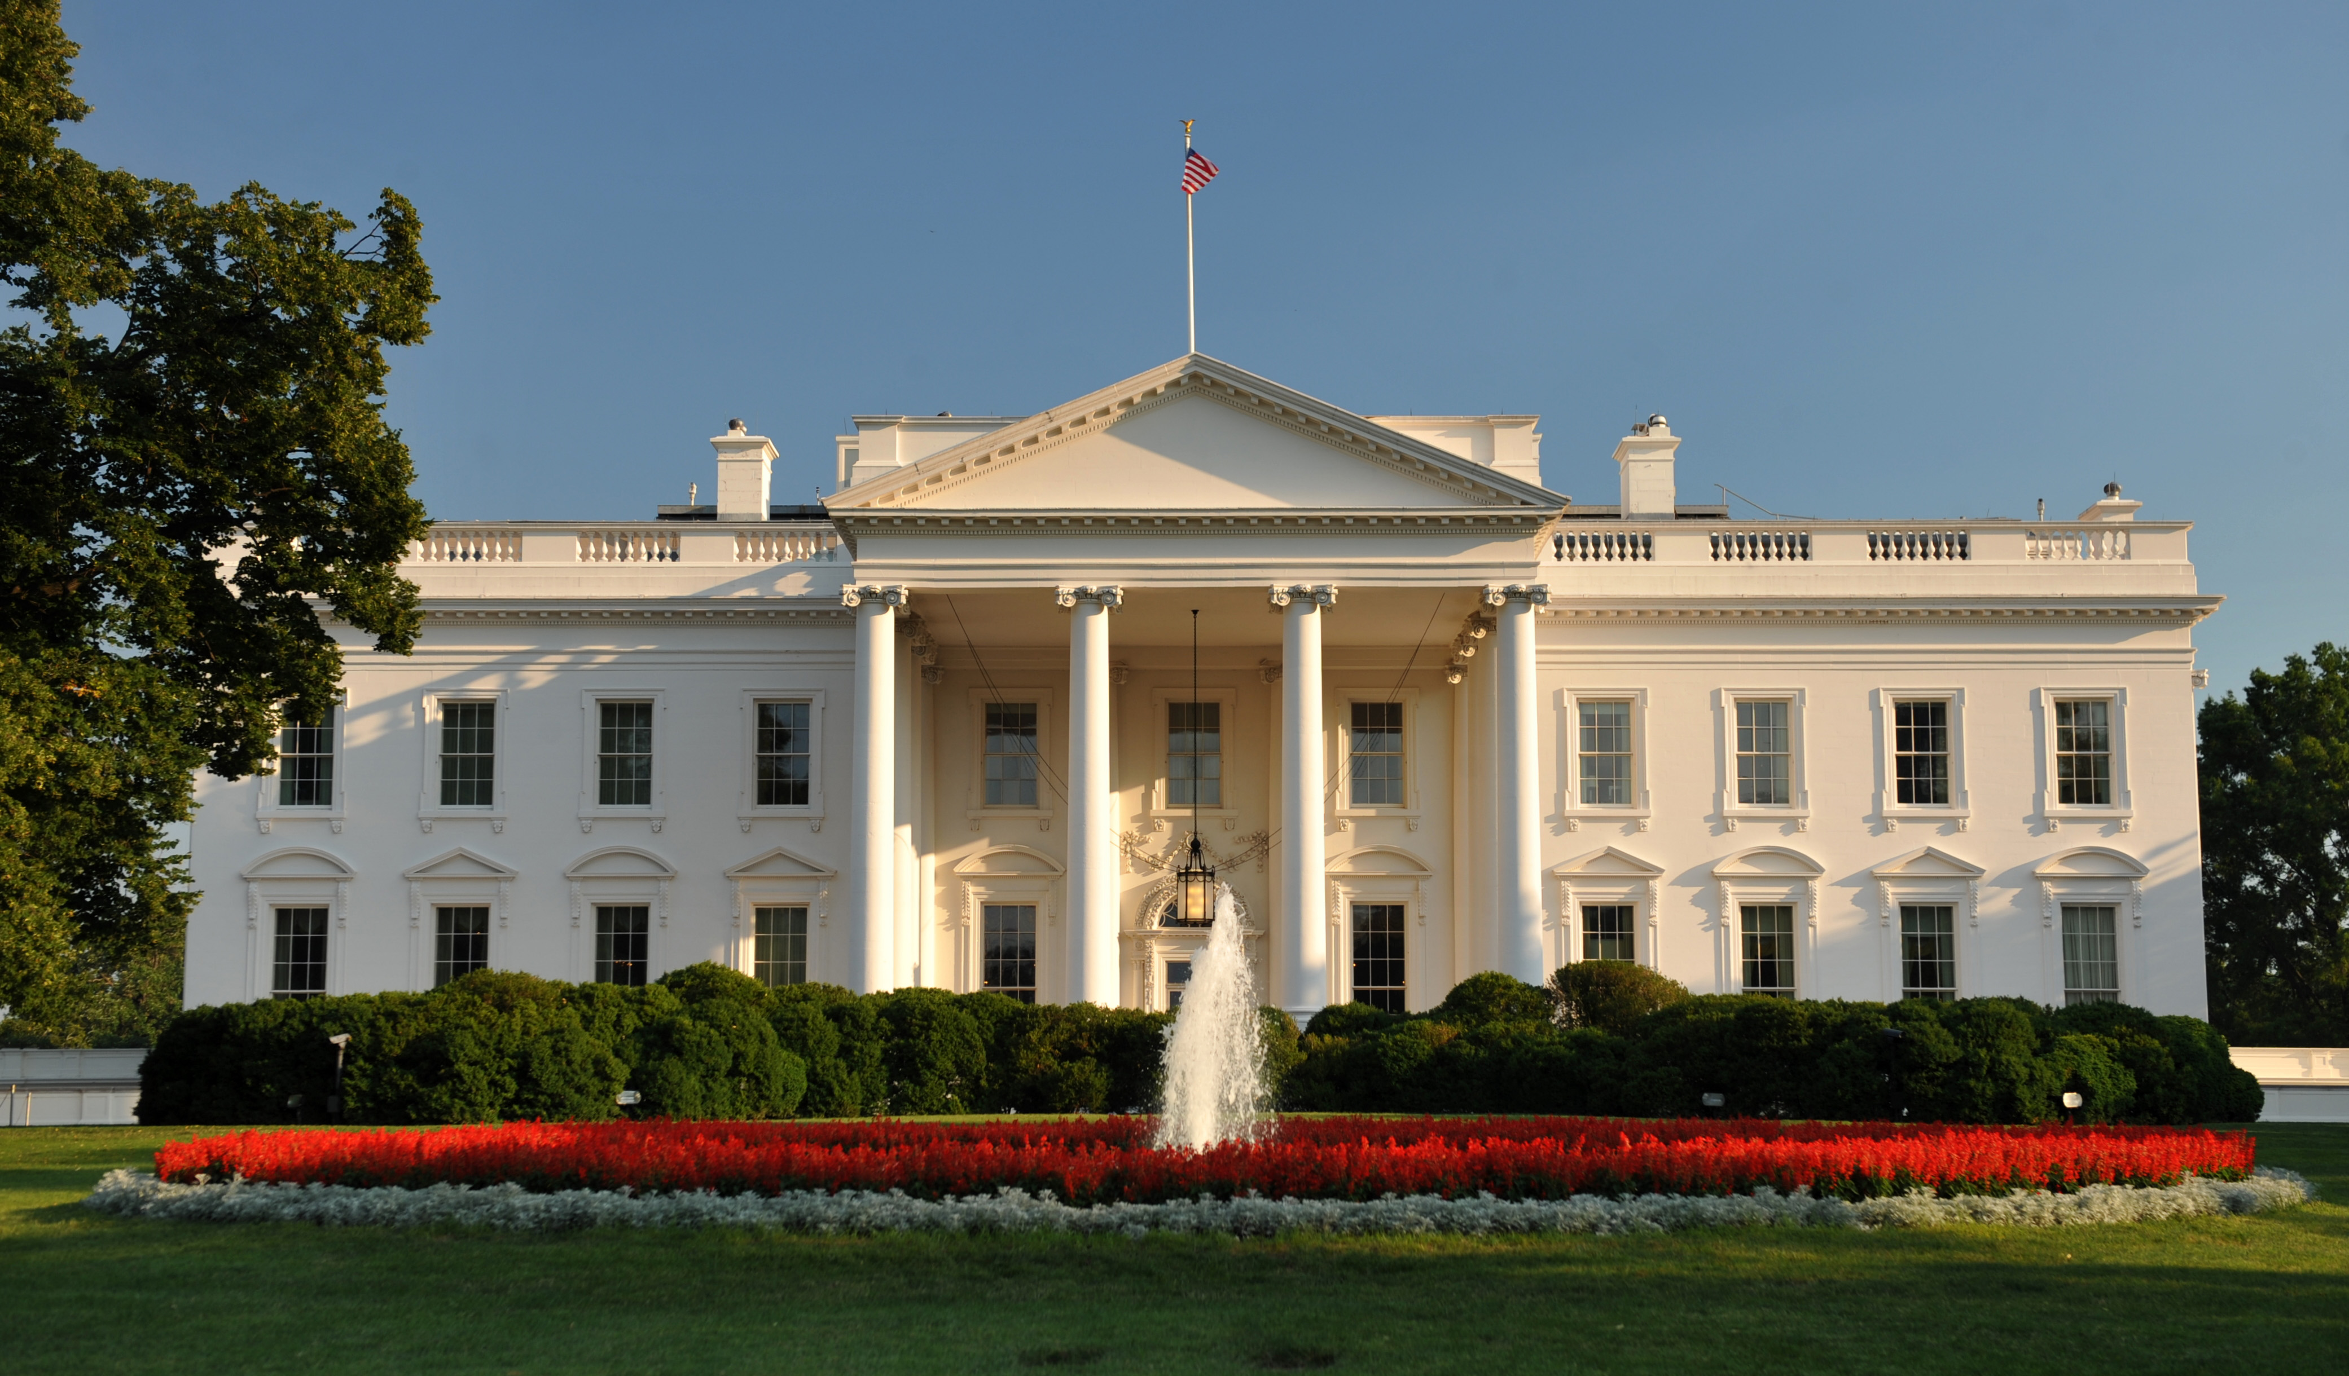
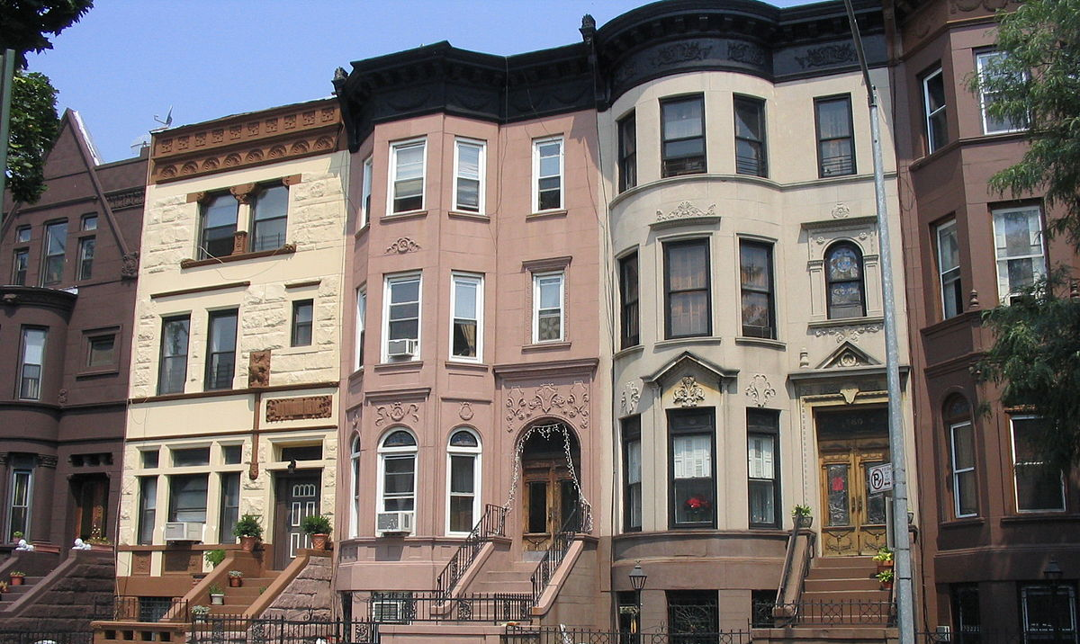
A C T S
2:1-21
I know, but then
I’ll have to stand in line to
get my ticket at the airport,
and try to get a seat on the plane, and I hate to sit in the middle ... it’s just too
much trouble.
Mama, listen to me!
I’m the President! I’ll send my helicopter for you! You won’t have to lift a finger. The Secret Service will handle everything.
Certainly, babushka,
I know you would but then
when we land, I’ll have to schlep my luggage through the airport, and try to get a cab ... at my age, it’s really too much
trouble.
I’d like to,
but it’s so much trouble. I mean, I have to get a cab from the airport, and I hate waiting on Ocean Blvd.
Mom! I’m the President
of the United States! I’ll send Air Force One for you – it’s my private jet!
Yes, that’s very nice, but,
you know, I still need a hotel room, and the rooms are so expensive, and I really don’t like hotels ...
Mama! I’m the President!
You won’t need a cab – I’ll send a limo for you!
Ma! I’m the President! You’ll stay at the White House in the Lincoln Bedroom!`
Well … all right. I guess I’ll come.
POTUS
Sylvia

Slide 3
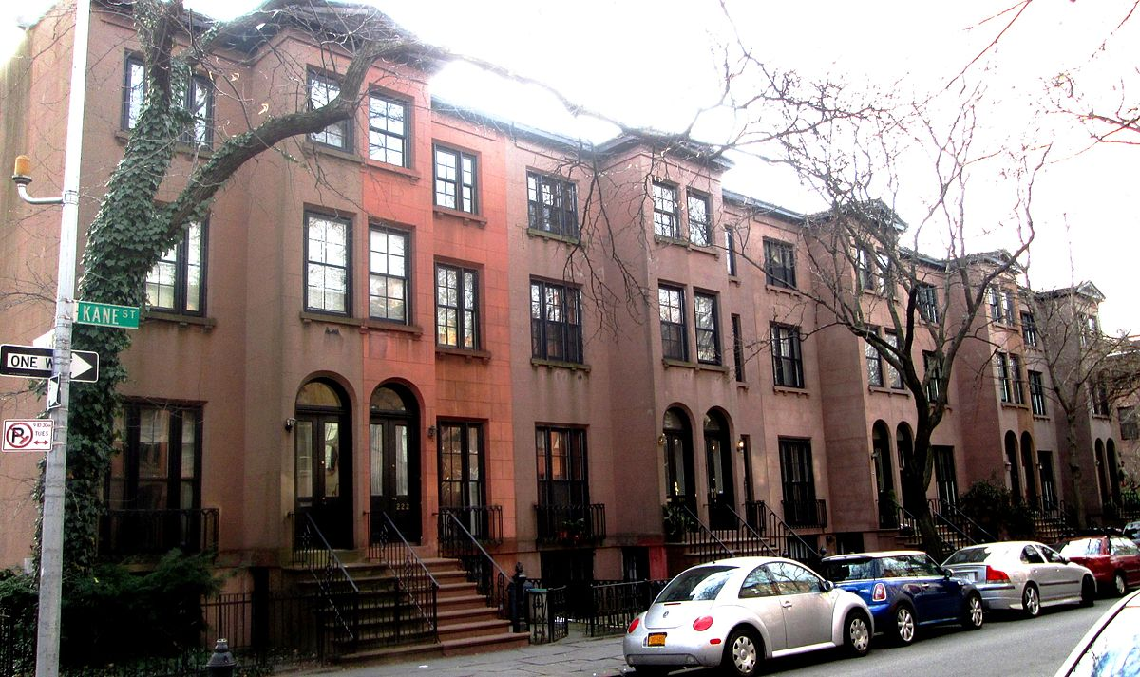
A C T S
2:1-21
Really? That’s wonderful. Which son is it? Marvin, the DOCTOR?
No …
Hello, Sylvia … so what’s new?
I’m visiting my son for Thanksgiving
It’s the other one
Esther
Sylvia

Slide 4
A C T S
2:1-21

Slide 5
A C T S
2:1-21
Day of Pentecost ~ Feast of Weeks, Firstfruits, Erev Shavuot
The 50th day following the 1st Sabbath following Passover
Always on a Sunday

Slide 6
A C T S
2:1-21

Slide 7
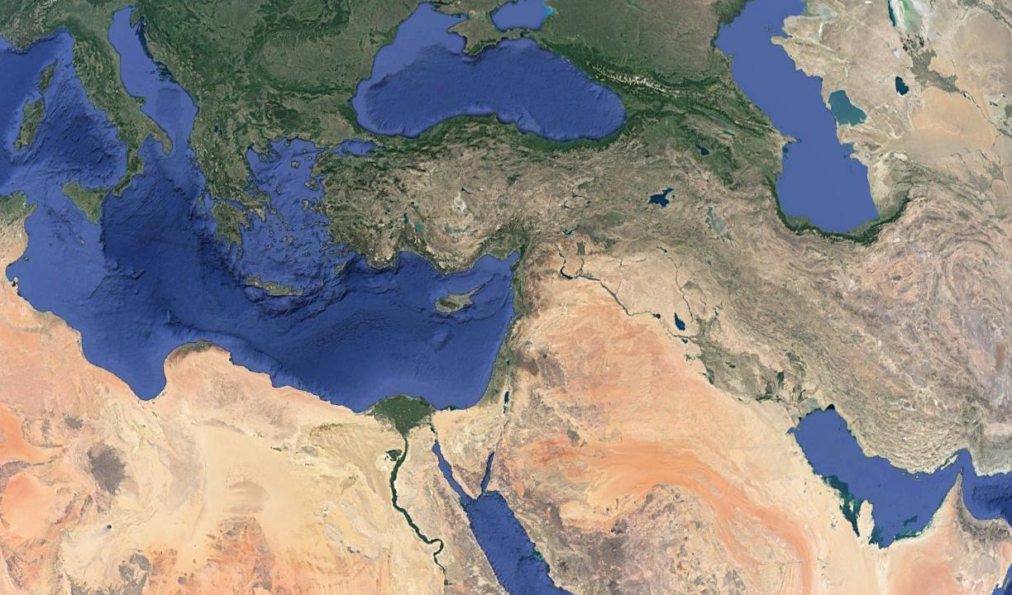
A C T S
2:1-21
Rome
Phrygia
Pontus
Pamphylia
Cappadocia
Asia
Mesopotamia
Parthia
Crete
Media
Judea
Elam
Libya
Egypt
Arabia

Slide 8
A C T S
2:1-21

Slide 9
A C T S
2:1-21
tongues (v. 4, 11) ~ glōssa (glossary)
language (v. 6, 8) ~ dialetos (dialect)

Slide 10
A C T S
2:1-21

Slide 11
A C T S
2:1-21
third hour ~ NIV, nine o'clock in the morning

Slide 12
A C T S
2:1-21

Slide 13
A C T S
2:1-21
1 Cor. 14:2a ~ For he who speaks in a tongue does not speak to men but to God,

Slide 14
A C T S
2:1-21

Slide 15
A C T S
2:1-21
Things that did not occur on the day of Pentecost
Things that occurred on the day of Pentecost
Sound of a mighty, rushing wind
Cloven tongues of fire
Speaking in other tongues
Sons and daughters prophesying
Young men seeing visions
Old men dreaming dreams

Slide 16
A C T S
2:1-21

Slide 17
A C T S
2:1-21
John 14:16-18 ~ ¹⁶ And I will pray the Father, and He will give you another Helper, that He may abide with you forever— ¹⁷ the Spirit of truth, whom the world cannot receive, because it neither sees Him nor knows Him; but you know Him, for He dwells with you and will be in you. ¹⁸ I will not leave you orphans; I will come to you.
with ~ para – alongside
in ~ en

Slide 18
A C T S
2:1-21
Acts 1:8 ~ But you shall receive power when the Holy Spirit has come upon you;
upon ~ epi – to superimpose

Slide 19
A C T S
2:1-21

Slide 20
A C T S
2:1-21
What does it mean to “receive the Holy Spirit”?
1. To get something; to come into possession of, i.e. “Did you receie your stimulus check yet?”
2. To go through or experience, i.e. “The player received minor injuries”
3. To express willingness to have in one’s home or environs, i.e. “The community gladly received the refugees”

Slide 21
A C T S
2:1-21
John 20:22 ~ And when He had said this, He breathed on them, and said to them, “Receive the Holy Spirit.”
1. To get something; to come into possession of

Slide 22
A C T S
2:1-21
Acts 1:8 ~ But you shall receive power when the Holy Spirit has come upon you; and you shall be witnesses to Me in Jerusalem, and in all Judea and Samaria, and to the end of the earth.
2. To go through or to experience

Slide 23
A C T S
2:1-21
Acts 2:38 ~ Then Peter said to them, “Repent, and let every one of you be baptized in the name of Jesus Christ for the remission of sins; and you shall receive the gift of the Holy Spirit.”
1. To get something; to come into possession of

Slide 24
A C T S
2:1-21
Acts 8:14-17 ~ ¹⁴ Now when the apostles who were at Jerusalem heard that Samaria had received the word of God, they sent Peter and John to them, ¹⁵ who, when they had come down, prayed for them that they might receive the Holy Spirit. ¹⁶ For as yet He had fallen upon none of them. They had only been baptized in the name of the Lord Jesus. ¹⁷ Then they laid hands on them, and they received the Holy Spirit.
2. To go through or to experience

Slide 25
A C T S
2:1-21
Acts 18:24-26 ~ ²⁴ Now a certain Jew named Apollos, born at Alexandria, an eloquent man and mighty in the Scriptures, came to Ephesus. ²⁵ This man had been instructed in the way of the Lord; and being fervent in spirit, he spoke and taught accurately the things of the Lord, though he knew only the baptism of John. ²⁶ So he began to speak boldly in the synagogue. When Aquila and Priscilla heard him, they took him aside and explained to him the way of God more accurately.

Slide 26
A C T S
2:1-21
Acts 19:1-6 ~ ¹ And it happened, while Apollos was at Corinth, that Paul, having passed through the upper regions, came to Ephesus. And finding some disciples ² he said to them, “Did you receive the Holy Spirit when you believed?”
So they said to him, “We have not so much as heard whether there is a Holy Spirit.”
³ And he said to them, “Into what then were you baptized?”
So they said, “Into John’s baptism.”

Slide 27
A C T S
2:1-21
Acts 19:1-6 ~ ⁴ Then Paul said, “John indeed baptized with a baptism of repentance, saying to the people that they should believe on Him who would come after him, that is, on Christ Jesus.”
⁵ When they heard this, they were baptized in the name of the Lord Jesus. ⁶ And when Paul had laid hands on them, the Holy Spirit came upon them, and they spoke with tongues and prophesied.
2. To go through or to experience

Slide 28
A C T S
2:1-21
R. A. Torrey (1856-1928) ~ “I recall the exact spot
where I was kneeling in prayer in my study … It
was a very quiet moment, one of the most quiet
moments I ever knew … Then God simply said to
me, not in any audible voice, but in my heart,
‘It’s yours. Now go and preach.’ He had already
said it to me in His Word in 1 John 5:14, 15; but
I did not then know my Bible as I know it now, and God had pity on my ignorance and said it directly to my soul … from that day to this …

Slide 29
A C T S
2:1-21
R. A. Torrey (1856-1928) ~ Sometime after this
experience (I do not recall just how long after),
while sitting in my room one day … suddenly …
I found myself shouting (I was not brought up to
shout and I am not of a shouting temperament,
but I shouted like the loudest shouting Methodist),
‘Glory to God, glory to God, glory to God,’ and I
could not stop … But that was not when I was baptized with the Holy Spirit. I was baptized with the Holy Spirit when I took Him by simple faith in the Word of God.”

Slide 30
A C T S
2:1-21
D. L. Moody (1837-1899) ~ “I was crying all the
time that God would fill me with his Spirit. Well,
one day, in the city of New York – oh what a day! –
I cannot describe it, I seldom refer to it; it is almost
too sacred an experience to name. Paul had an
experience of which he never spoke for fourteen
years. I can only say that God revealed Himself to me, and I had such an experience of His love that I had to ask Him to stay His hand. I went preaching again. The sermons were not different; I did not present any new truths; and yet hundreds were converted,

Slide 31
A C T S
2:1-21
D. L. Moody (1837-1899) ~ I would not now be
placed back where I was before that blessed
experience if you should give me all the world –
it would be as the small dust of the balance.”

Slide 32
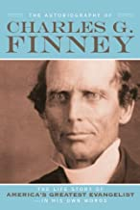
A C T S
2:1-21
Charles G. Finney (1792-1875) ~ “I received a
mighty baptism of the Holy Ghost without any
expectation of it, without ever having the thought
in my mind that these was any such thing for me,
without my recollection that I had ever heard the
thing mentioned by any person in the world, the
Holy Spirit descended upon me in a manner that
seemed to go through me body and soul. No words can express the wonderful love that was shed abroad in my heart. I wept aloud with joy and love.”

Slide 33
A C T S
2:1-21

Slide 34
A C T S
2:1-21
What does it mean to “receive the Holy Spirit”?
1. To get something; to come into possession of
2. To go through or experience
3. To express willingness to have in one’s home or environs

Slide 35
A C T S
2:1-21

Slide 36
A C T S
2:1-21
V. Raymond Edman (1900-1967) ~ Vice-president of the Billy Graham Evangelistic Association
Chuck Smith (1927-2013) ~
founder of the Calvary Chapel Movement

Slide 37
A C T S
2:1-21
Charismania
Cessessionism
Azuza Street
Revival (1906)
R. A. Torrey
Teaching on the Holy Spirit for the 1st 1900 years
D. L. Moody
Charles Finney
A. B. Simpson

Slide 38
A C T S
2:1-21

Slide 39
A C T S
2:1-21
1 Cor. 12:13 ~ For by one Spirit we were all baptized into one body— whether Jews or Greeks, whether slaves or free—and have all been made to drink into one Spirit.

Slide 40
A C T S
2:1-21

Slide 41
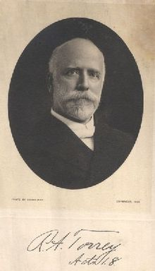
A C T S
2:1-21
R. A. Torrey (1856-1928) ~ “You can call it whatever you want to call it, but I’d rather have the right thing with the wrong name than the wrong thing with the right name any day.”

Slide 42
A C T S
2:1-21

