Slide 1
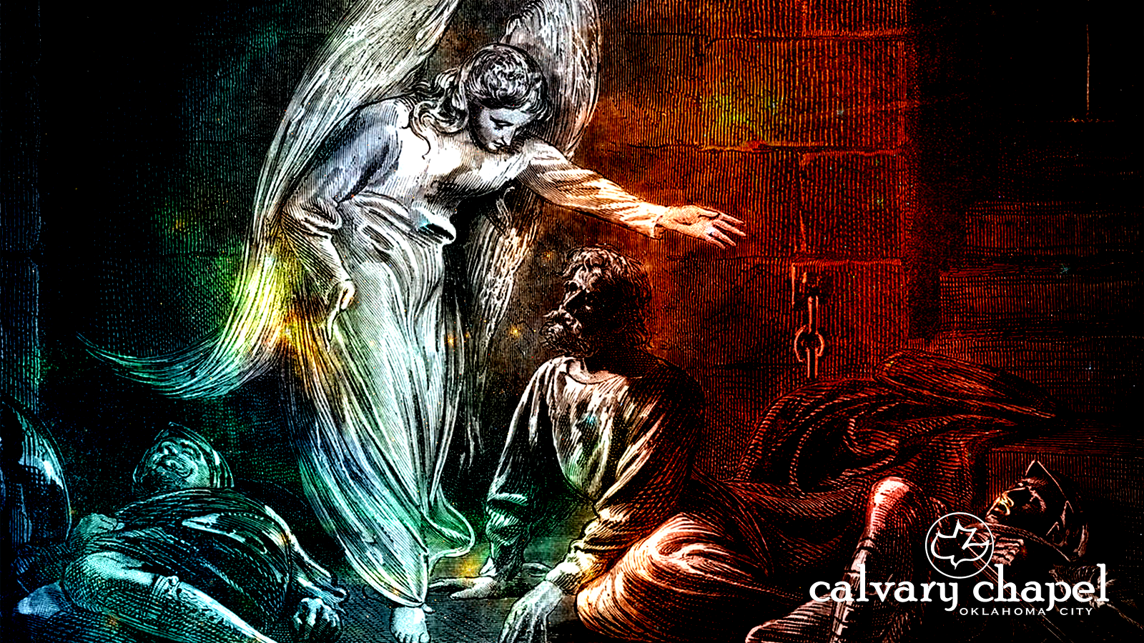
A C T S
of the apostles
1:1-26

Slide 2
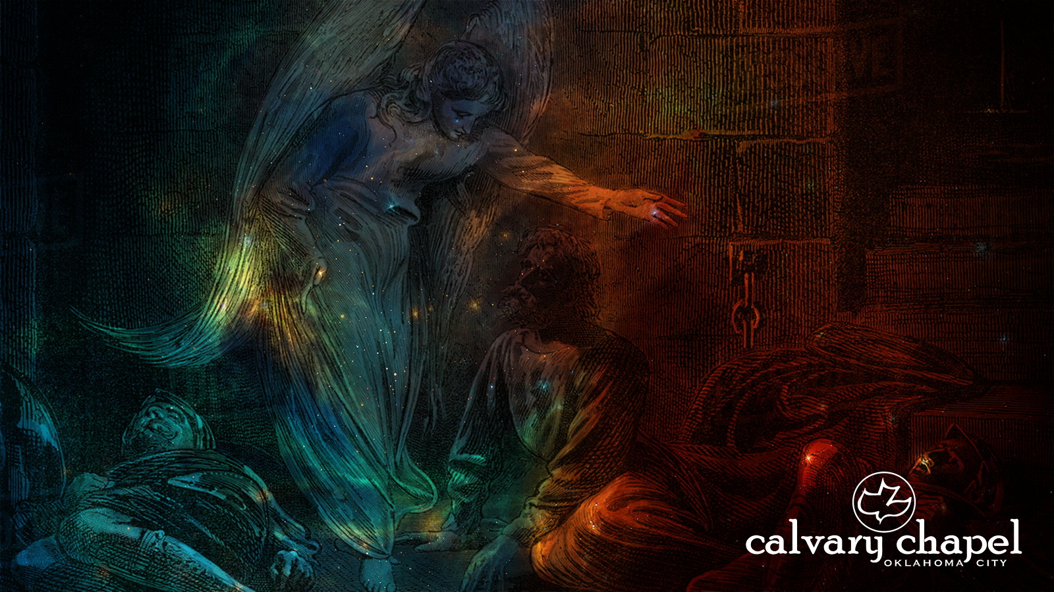
A C T S
1:1-26
2nd son ~ 1/3
1st son ~ 1/2
3rd son ~ 1/9
18  2 = 9
18  3 = 6
18  9 = 2

Slide 3
A C T S
1:1-26

Slide 4
A C T S
1:1-26
Better, The Acts of the Holy Spirit
Covers first 38-40 years of the Church
Ends ubruptly

Slide 5
A C T S
1:1-26

Slide 6
A C T S
1:1-26
former account ~ The Gospel of Luke
40 days between resurrection and ascension
Theophilus ~ theos (God) + philos (lover)
do, then teach

Slide 7
A C T S
1:1-26

Slide 8
A C T S
1:1-26
infallible proofs ~ criterion of certainty; incapable of failure or error

Slide 9
A C T S
1:1-26

Slide 10
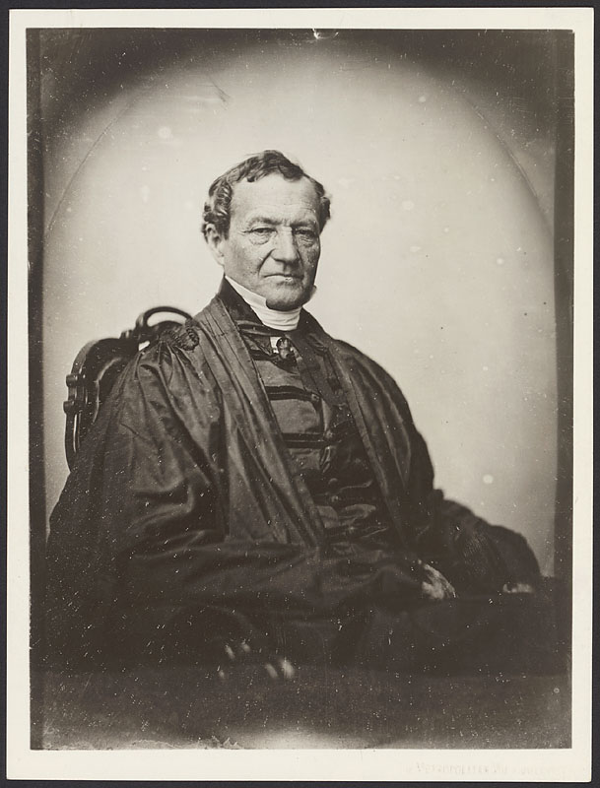
A C T S
1:1-26
Simon Greenleaf (1783-1853) ~ helped develop the Harvard Law School
“A Treatise on the Law of Evidence” (3 vol.)
“An Examination of the Four Evangelists by the Rules of Evidence Administered in the Courts of Justice”

Slide 11
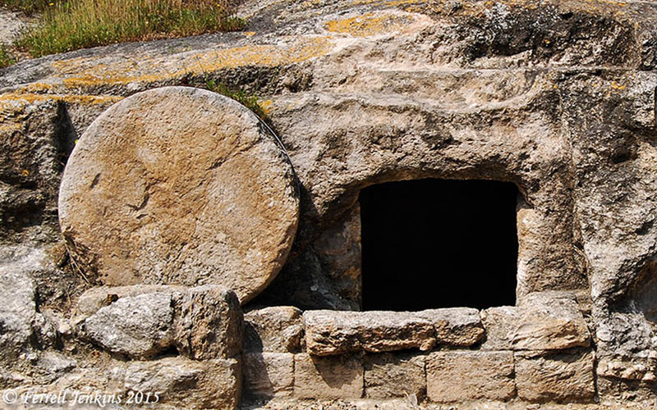
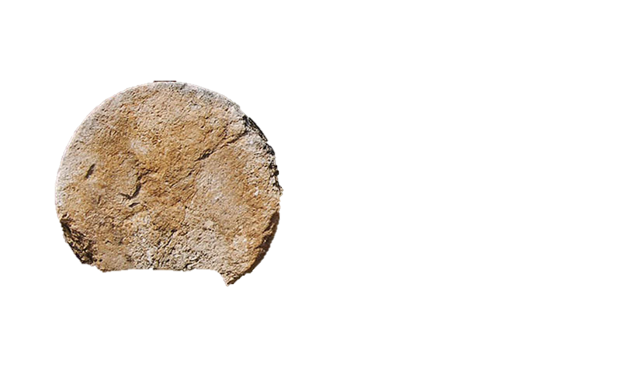
A C T S
1:1-26
Evidence for the Resurrection:
1. The Church
2. Sunday worship (1st practiced by Jewish believers)
3. Conclusion of sacrificial system (irrevocable for 1500 years)
4. New Testament testimony
5. The stone (between 2,000-4,000 lb.)
6. Post resurrection appearances
7. Empty tomb
8. The Apostles

Slide 12
A C T S
1:1-26

Slide 13
A C T S
1:1-26
But,
Not,
be witnesses
witness
martus ~ martyr
12 of the 13x in Acts ~ witness(es)

Slide 14
A C T S
1:1-26

Slide 15
A C T S
1:1-26
upon ~ epi – to superimpose
John 14:16-18 ~ ¹⁶ And I will pray the Father, and He will give you another Helper, that He may abide with you forever— ¹⁷ the Spirit of truth, whom the world cannot receive, because it neither sees Him nor knows Him; but you know Him, for He dwells with you and will be in you. ¹⁸ I will not leave you orphans; I will come to you.
with ~ para – alongside
in ~ en

Slide 16
A C T S
1:1-26

Slide 17
A C T S
1:1-26
Sabbath day’s ~ 2000 cubits ~ 1/2 mile
2,000 cubits

Slide 18
A C T S
1:1-26

Slide 19
A C T S
1:1-26
office ~ episkopē – to see upon or to oversee
KJV, bishoprick

Slide 20
A C T S
1:1-26

